Slide 1
Lead Generation
What Makes A Great Mobile Legal Website?

Slide 2
Global Smartphone Growth
Huge Mobile growth in 2014
Android: 1 billion 30 day active users → users check phones 100 billion times daily
‘More mobile devices & mobile device subscriptions than toothbrushes in the world’

Slide 3
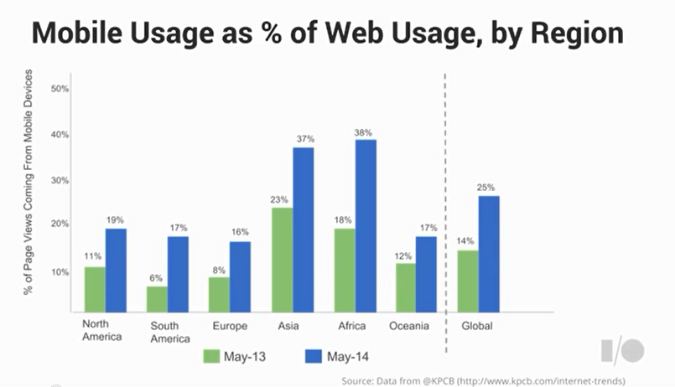
Mobile Usage

Slide 4
Marketing of Mobiles
Mobile users always presented as happy

Slide 5
Marketing of Mobiles
Studies show how they really feel…
Unfamiliar
Harder to Navigate
Sparse in Features
Cut Down
Smaller
Poor Design

Slide 6
1. Homepage & Navigation

Slide 7
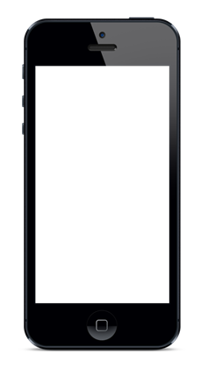
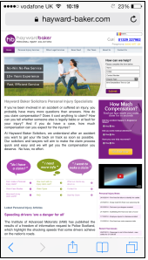
Keep Call To Actions Central
Notes:
Keep call to actions front and central
Don’t use wishy washy terms → powerful language to tell your customer what to do
Secondary call to actions can be reached further down the screen or through icons

Slide 8
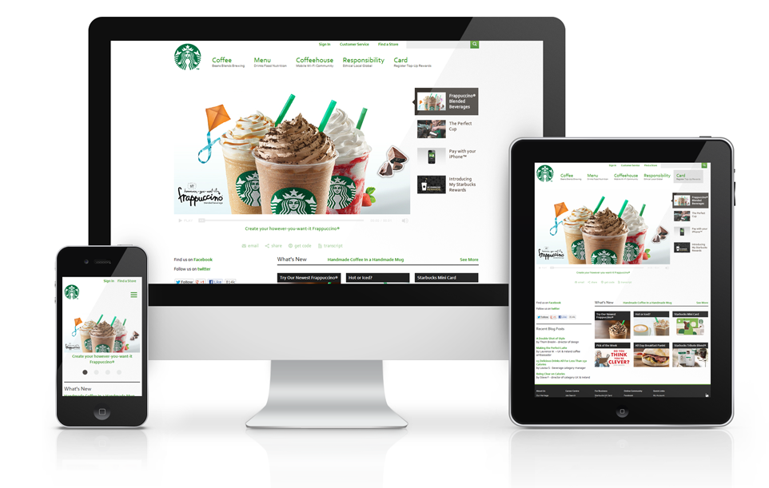
Always Go Responsive
m.starbucks.co.uk
www.starbucks.co.uk
Notes:
When building a website always go responsive over mobile as m. sit will cause time lag due to redirect

Slide 9
Keep Menus Short & Sweet
Notes:
Customers don’t like to scroll
Don’t hide menus behind icons
Less is more
Self explanatory
Clear call to actions

Slide 10
Homepage Navigation
Easy homepage navigation
Users will click top bar logo

Slide 11
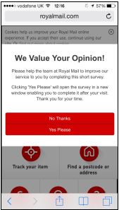
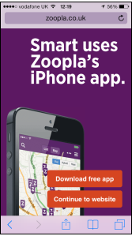
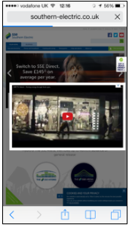
Let Users Explore
Notes:
Let users explore the site before you distract them with other things: surveys, downloading apps, videos
Sites need to work with people rather than against
Don’t require customer to sign up to an account or download you’re app

Slide 12
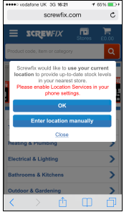
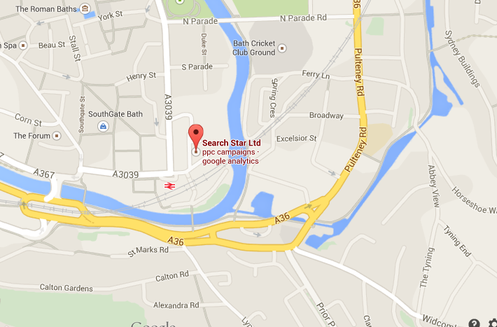
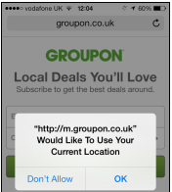
Be Clear Why You Need Location Info
Users care about security
Say why you need user GPS

Slide 13
2. Mobile Site Search

Slide 14
Make Site Search Visible
Notes:
Make site search easy & visible so customers can see immediately once their page has loaded.
Google believes search is important, search is good for users who have a sense of urgency
Don’t hide search behind an search icon, give it an actual field

Slide 15
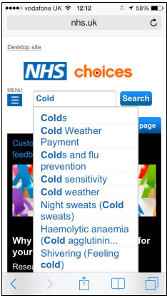
Ensure Results Are Relevant
Search needs to be smart
Autocomplete is a must
Ensure results are relevant
Correct any misspells

Slide 16
3. Optimising Form Entry

Slide 17
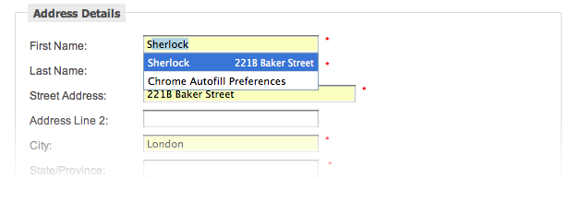
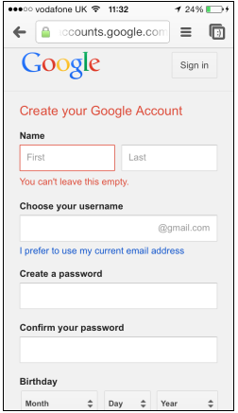
Autocomplete Forms
Users like to be recognised
Enable autocomplete forms

Slide 18
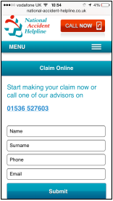
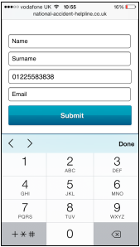
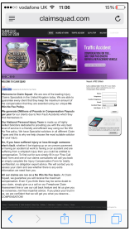
Design Efficient Forms
Notes:
Design efficient forms that are mobile appropriate
Forms may need to be adjusted for mobile purposes
Allow for streamlined information entry EG. Websites that have contextual keyboard (numberpad)

Slide 19
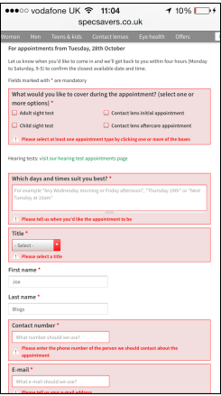
Real Time Validation Forms
Indication of required fields
Clear highlighting of error fields
Clear description of information required
Clear error messages
Notes:
Real time validation forms vital to tell customers when they have entered things wrong
In ideal world customers will only have to enter information once, if takes more then 1 time usually means form is too complex

Slide 20
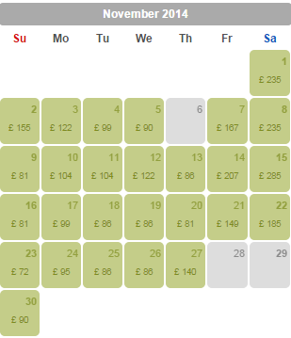
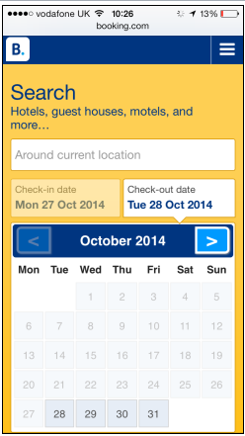
Provide Visual Calendars
Users need context when scheduling appointments

Slide 21
4. Design Considerations

Slide 22
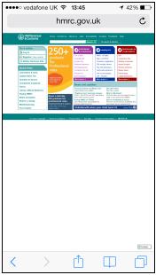
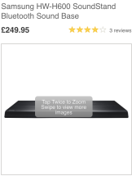
Don’t Make Users Zoom
Don’t make users pinch & zoom
Expandable images & text

Slide 23
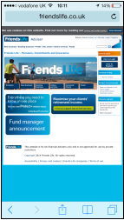
Optimise The Whole Site
Notes:
When going mobile make sure you optimise your whole website rather than just some of it
Make sure you keep the user in a single browser rather than taking them to a different browser for each menu option

Slide 24
Summary Of Mobile
Clear Call To Actions
Simple Menus & Navigation
Relevant & Visible Site Search
Design Efficient & Contextual Forms
Always Go Responsive
Enable Autocomplete
Explain Why You Need GPS
Optimise The Entire Website

