Slide 1

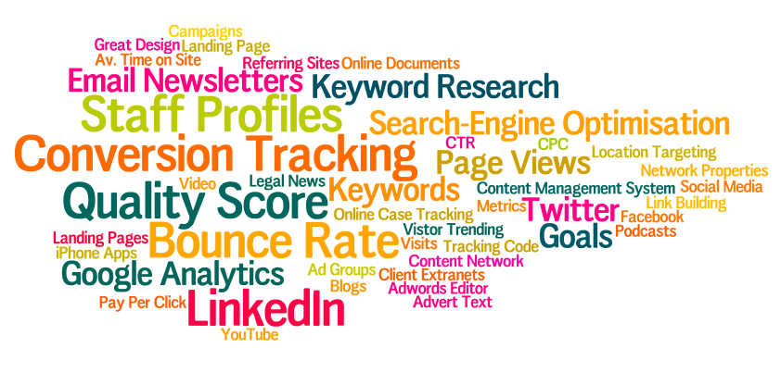
The Marketing Mix in a Digital World
Wifi = HolidayInnLeeds @conscioussol #consciousdmm

Slide 2
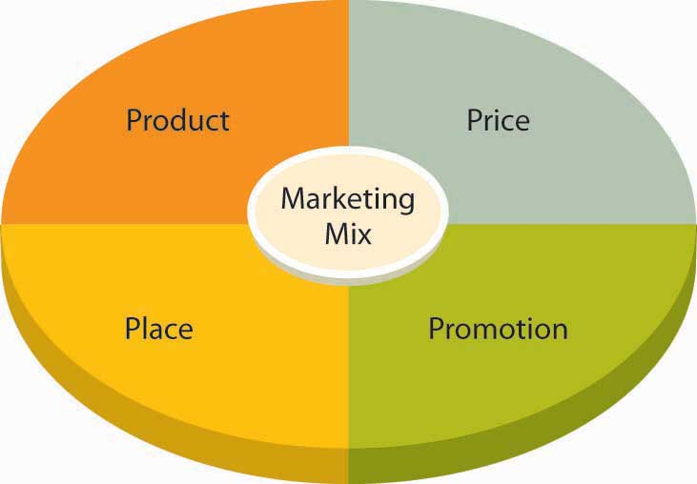
The Marketing Mix

Slide 3







Product
Do you have the right mix of work

Slide 4
Place
Where do buyers look for your service?
High street? Online? Events?

Slide 5

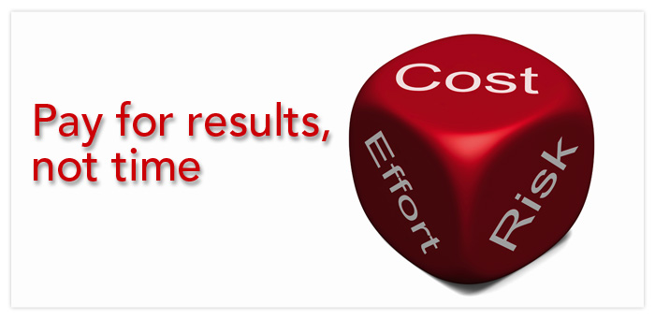
Price
Hourly rates
Fixed fees
Value pricing

Slide 6
Promotion
This is what most people think marketing is!
We’ll come back to this

Slide 7

Above & Below the “Line”
More “mass media”
More “one-to-one”
Notes:
The terms ‘Above The Line’ and ‘Below The Line’ came into existence way back in 1954 with the company Proctor and Gamble paying their advertising agencies a different rate and separately from the agencies who took on the other promotional activities.

Slide 8
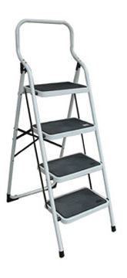
Content laddering
5 x Tweet = 100 char (yep, not 140)
2 x FB/G+/LI = 100 words
1 x Blog post = 3-500 words
1/6 = Email newsletter = 1,000 words

Slide 9
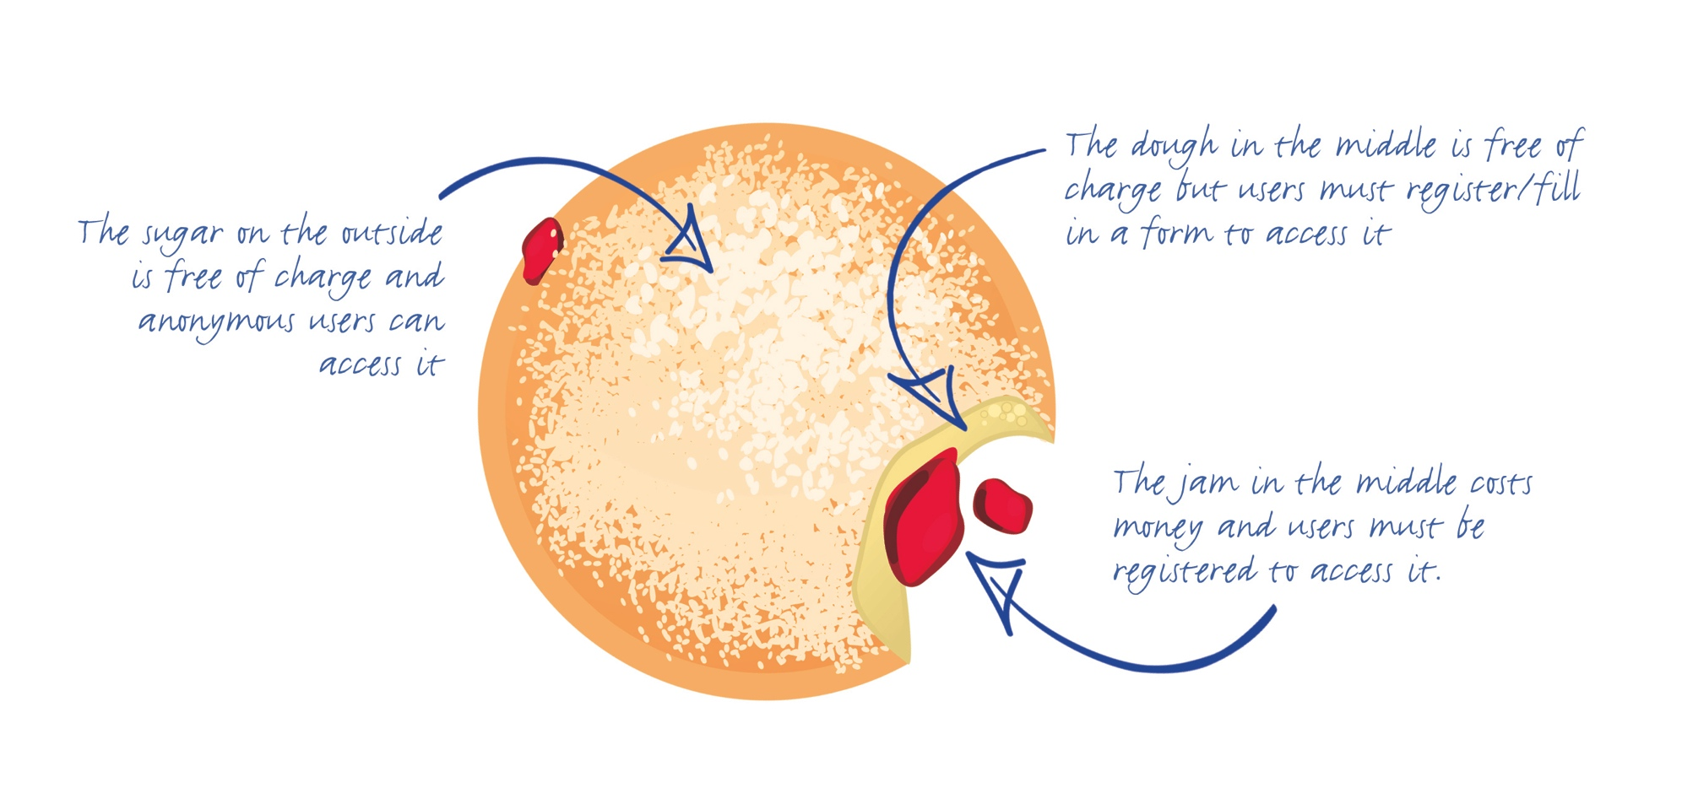
Jam doughnut model

Slide 10
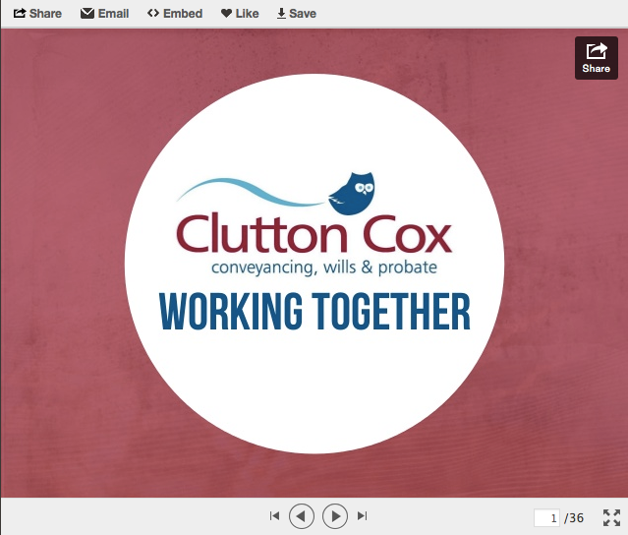
Great use of Slideshare

Slide 11
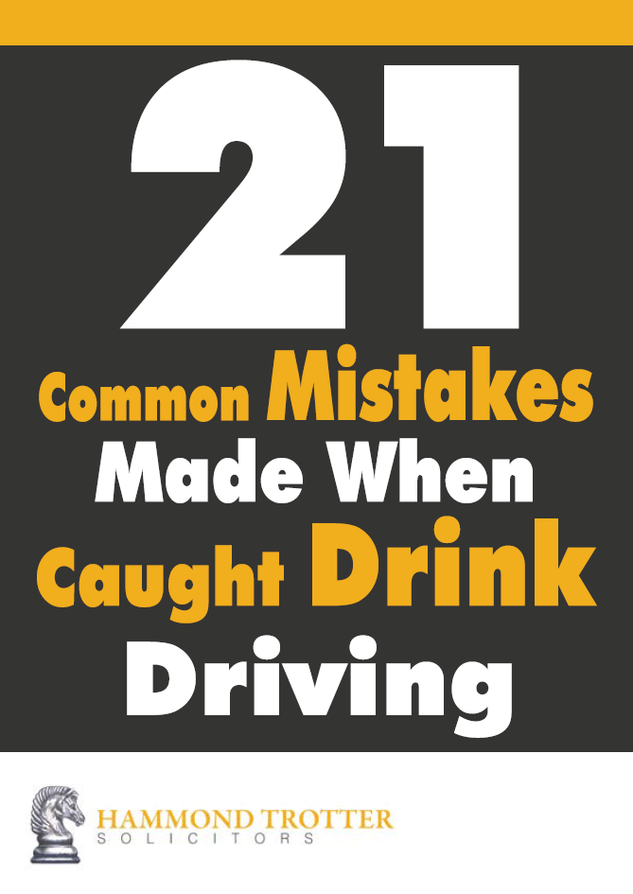
Tips booklets

Slide 12
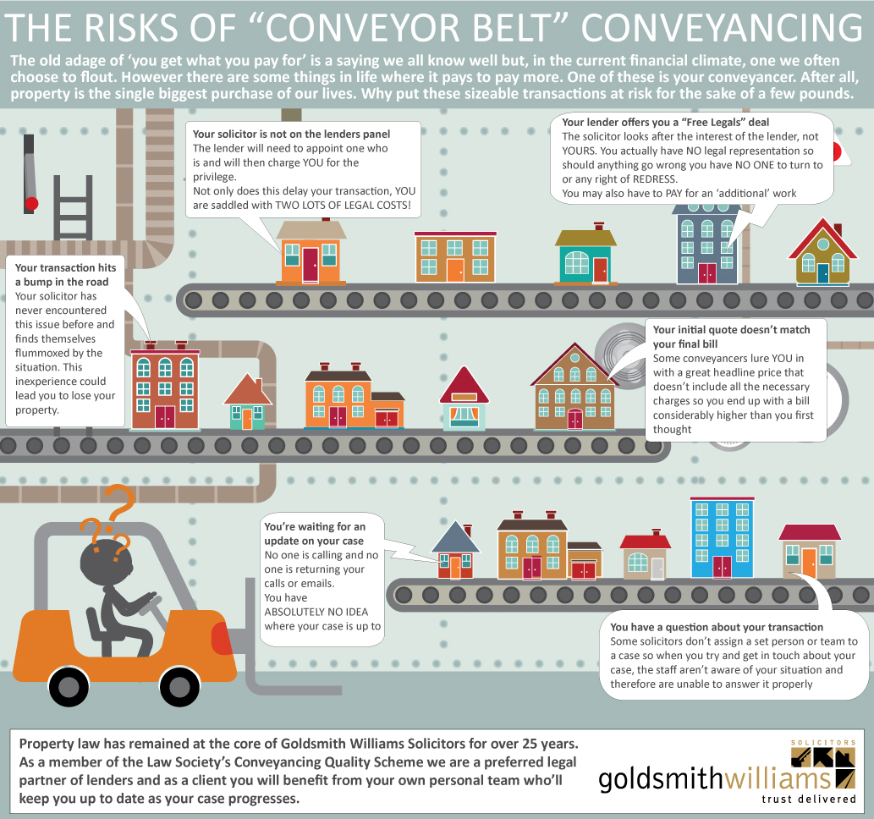
Infographics

Slide 13
Client testimonials

Slide 14


