Slide 1
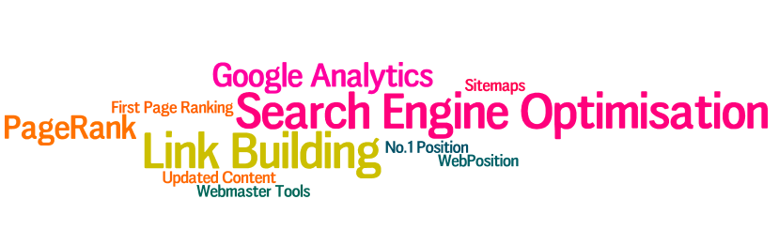

Slide 2
Google Local is dominating localised keywords
No more links in press releases!
“Social signals” from Facebook, LinkedIn, Twitter etc are becoming vital
Mobile search is becoming more important i.e. people searching via smartphones
As important as email marketing to existing clients
Keyword research to develop “targeted” keyword lists is even more important
(not provided)
Need to worry about “link” sites, not just your site

Slide 3


Penguin 2.0 & SEO in general
Well written sites
Sites with little advertising
Proven niche “authority” sites
Keyword stuffing
Poor link building practices (both in & out)
Lots of exact-match anchor texts (30% or more of a link profile)
Too many ads “above the fold”

Slide 4
3 Keys to SEO
Linkworthy - make it useful & compelling
  SEO is intertwined with web site design & content
  Tips booklets, news, content
  Bear in mind it’s the law we are talking about!
Keywords & Content - Site optimisation
  Theme optimization = keyword-focused content
  More content = higher PR
  Follow best practices, avoid worst
Link/Social Popularity - Off-site optimisation
  Social signals
  Maximise low volume, high PR inbound links (backlinks)
  Keyword filled anchor text (example: “planning solicitor” not “Kingsley Smith”

Slide 5
Page structure still important
Meta title
Page name
Body copy
H1 tag
H2 tag

Slide 6
Google Webmaster Tools

Slide 7
Google Webmaster Tools

Slide 8
Keeping Things in Perspective
Top Priorities
  Volume of communication contacts with existing clients (cross selling)
  Growth in prospects (mailing list)
  No. of new enquiries and their source (phone, letter, web)
Prospects
  No.of prospects coming to the site from a search engine
  How many then contact the firm?
  How many join the mailing list?
Marketing performance
  No.of people who respond to a specific communication

Slide 9
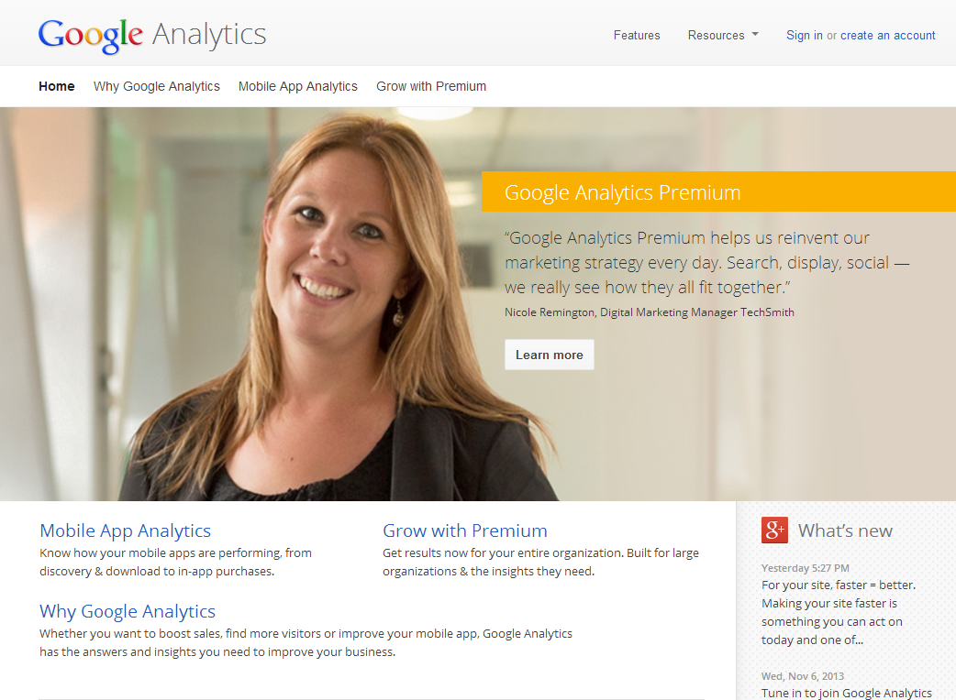
Create an account

Slide 10
Key Metrics – Google Analytics
Visits
Page Views
Pages/Visit
Bounce Rate
Av. Time on Site
% New Visits
Goals (enquiries!)
Phone calls

Slide 11
Real time tracking

Slide 12
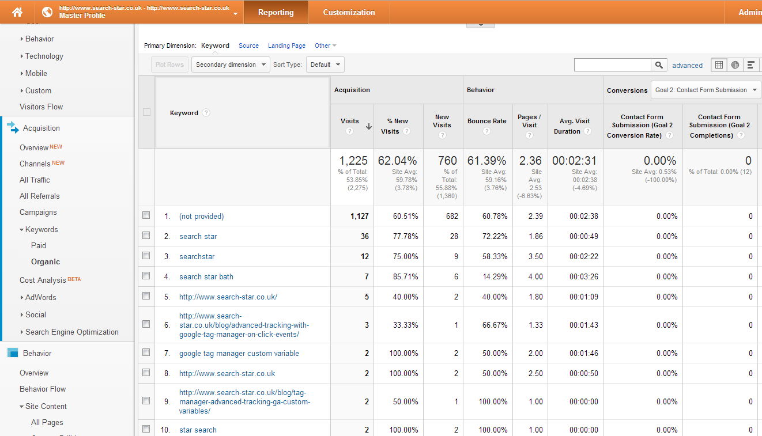
Traffic Sources – Keywords (not provided)

Slide 13
But what keywords?

Slide 14
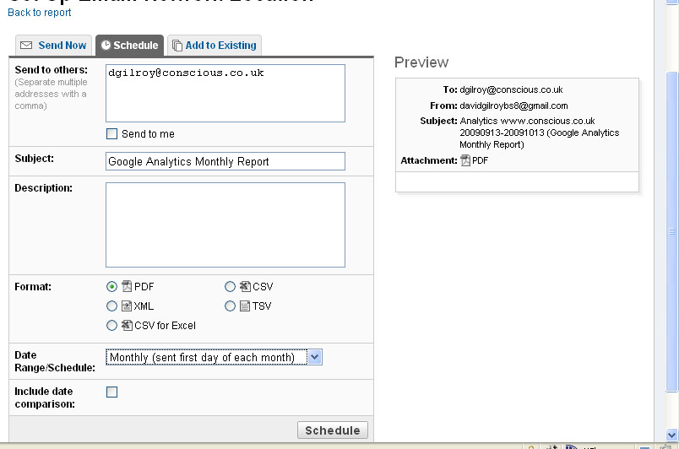
Set up automatic reports

Slide 15
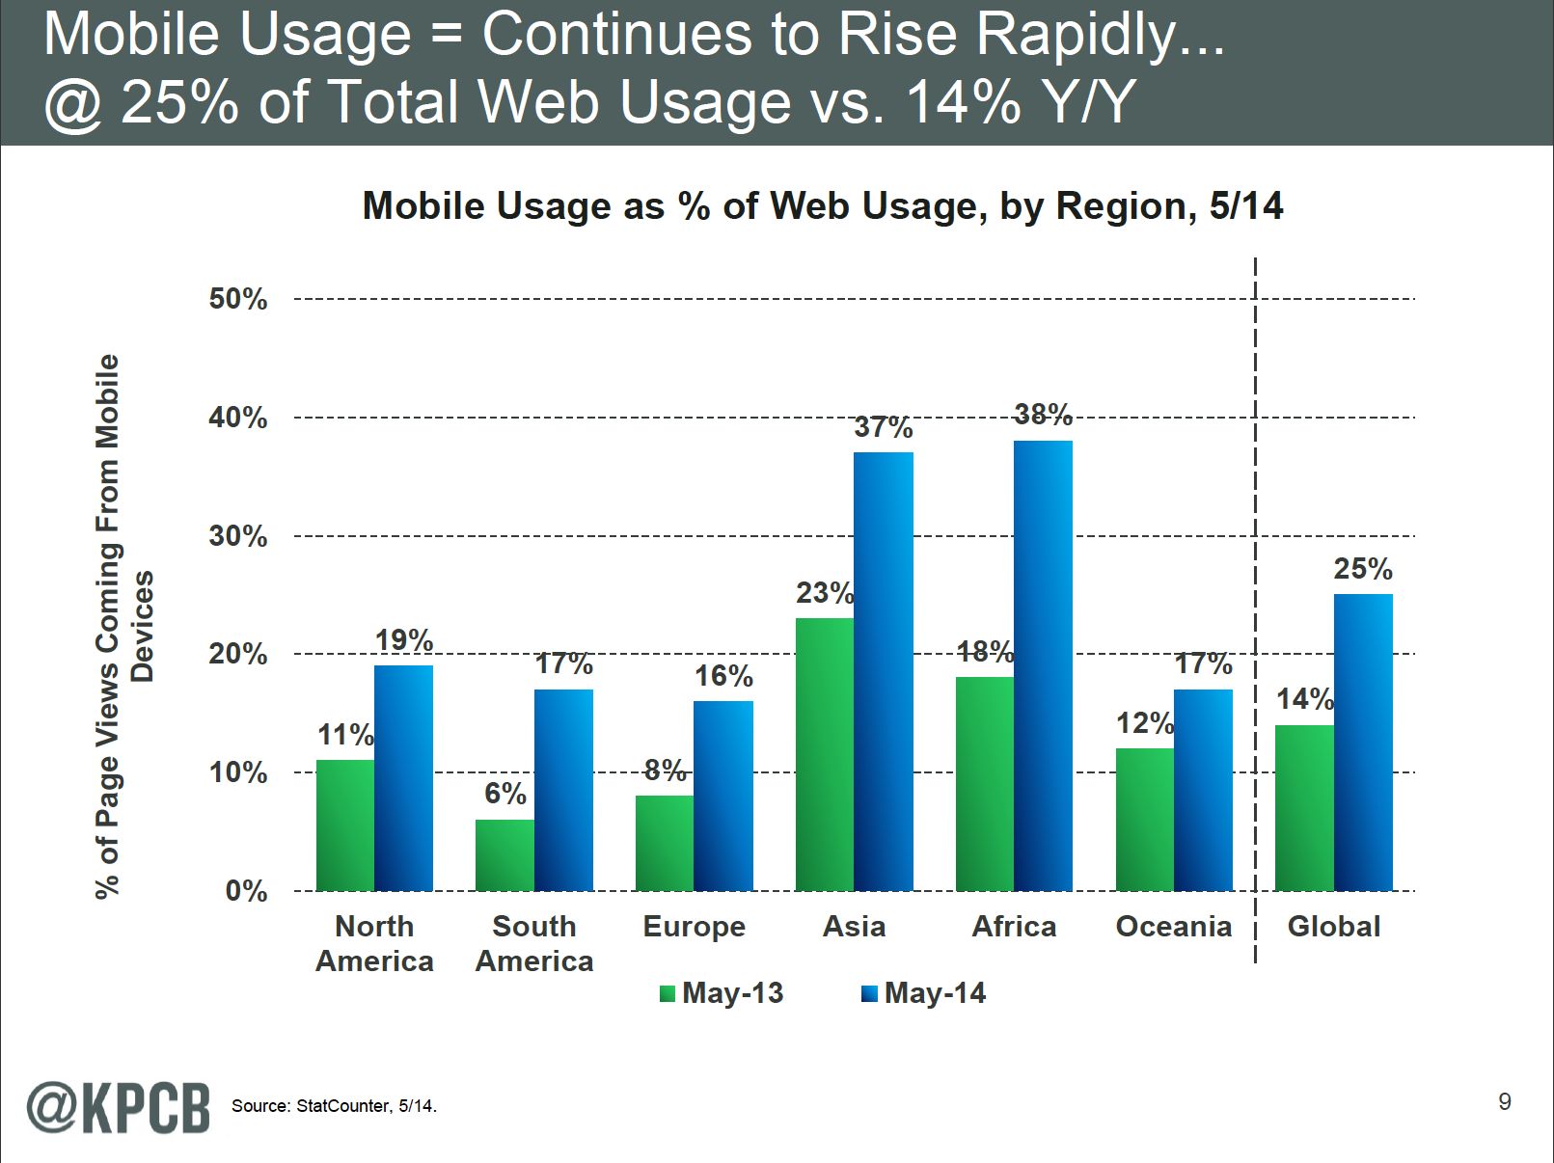
Growth in mobile usage

Slide 16
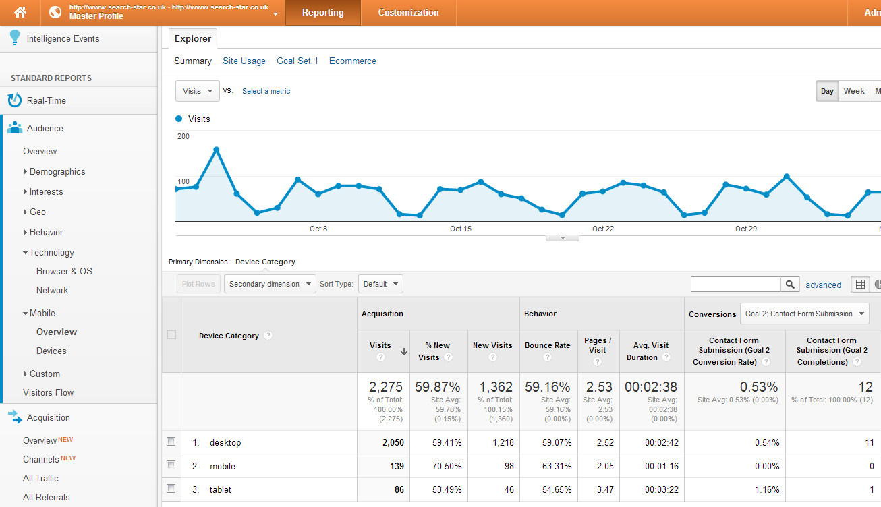
Mobile device access volume

Slide 17
Adwords Conversion Tracking Just Got Better
Track Leads that become clients not just leads
  Each ad click gets a unique alphanumeric Click ID
  Contact form submission passes Click ID into lead database
  Solicitors qualify leads into cases vs. junk
  Qualifying lead Click IDs are passed back to Adwords
  All cases can be tracked back to exact click source
 | Clicks | Cost | Cost Per Click | Leads | Cost Per Lead | Cases | Cost Per Case
Car Accident | 1000 | £5,000 | £5.00 | 50 | £100 | 15 | £333
Cerebral Palsy | 500 | £5,000 | £10.00 | 10 | £500 | 2 | £2,500
Head Injury | 500 | £4,000 | £8.00 | 10 | £400 | 3 | £1,333
Prof Neg | 1000 | £5,000 | £5.00 | 33 | £152 | 5 | £1,000
Slip & Trip | 2000 | £6,000 | £3.00 | 100 | £60 | 10 | £600
Total | 5000 | £25,000 | £5.00 | 203 | £123 | 35 | £714

Slide 18



Phone Call Tracking Integration
Google Analytics Call Tracking
Google Analytics integration allows you to see phone call conversions within your Google Analytics account.
  Tie the phone call conversion back to the exact visitor in real time
Google AdWords Call Tracking
Link Google Analytics & AdWords accounts to see phone call conversions within your AdWords account
  see how many phone calls your campaigns, ad groups and keywords have generated
  make more informed decisions about your PPC ad spend

Slide 19


