Slide 1
National Property Law Conference
Solicitors fight back

Slide 2
PR and marketing
for you and your firm
Graham Capper and David Gilroy

Slide 3
Should I and my firm care about PR?
Profile
Reputation
Competition
Clients – old and new

Slide 4
It’s not rocket science
Who do you want to engage with?
  who are your current clients?
  who will your new clients be?
  who influences the choices of your potential clients?
How can you reach them?
  their preferences, not yours
  (their) trade media, local media, golf club, village carnival
  social media

Slide 5
To save money, spend time
Advertising and sponsorship cost ££
PR costs much less but requires time
  understanding your audience and your medium
  building relationships
  planning ahead

Slide 6
Local and regional media – some tips
write journalese
outsmart the sub-editor
make it topical, give it an angle
think radio
paint a picture, provide a picture
confide only what you’re happy to see published
help the journalist to help you

Slide 7


Slide 8
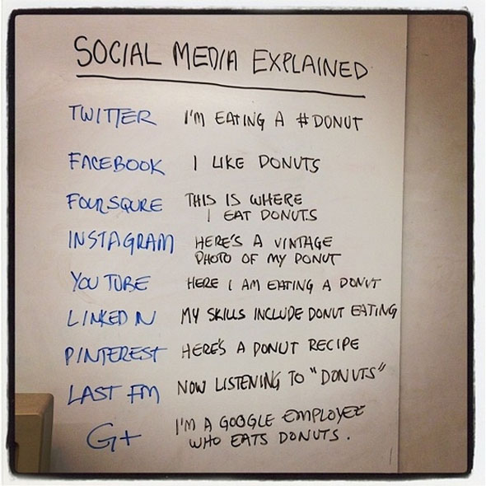
What is social media?

Slide 9
Social Media Engagement Model
Highly
Targeted
CONNECT
CONVERSE
Unengaged
Highly
Engaged
BROADCAST
SHARING
Un Targeted

Slide 10
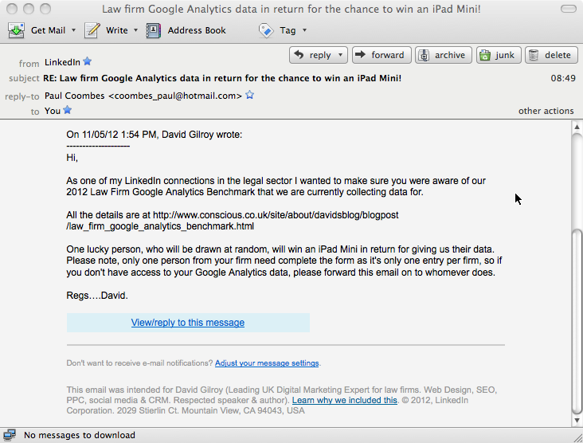
LinkedIn Events module

Slide 11
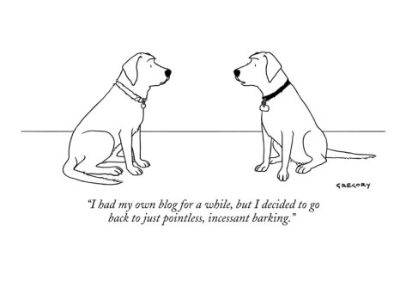
Blogs

Slide 12
Blog Examples

Slide 13
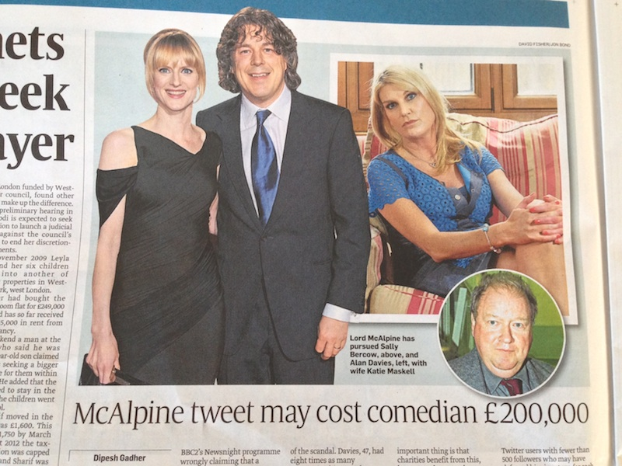
Is Twitter dangerous? It can be!

Slide 14
Retweet to build relationships

Slide 15
I am going to complain in different ways now!

Slide 16
Really? I did not want to know!
NEVER break Rule No.1 of social media

