Slide 1

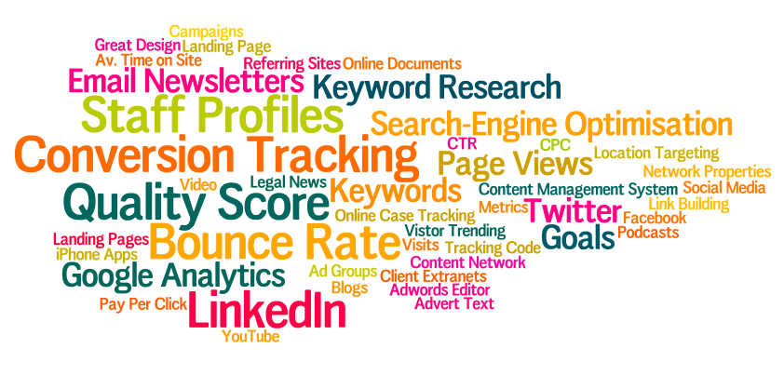
Introduction & Agenda
Wifi = HolidayInnLeeds @conscioussol #consciousdmm

Slide 2


House keeping
There are no fire drills scheduled
There are no rules – well “Chatham House”
Questions welcome through each session, don’t be shy
No need to put your hand up, it’s not school!
It’s a “workshop” not a series of “lectures”

Slide 3
Agenda – Marketing Stream
09:30 – 10:15 What do you want out of today?
10:15 – 11:00 Building Relationships in a Digital World
11:00 - 11:30 Break
11:30 – 13:00 Marketing Mix in a Digital World
Lead Gen & Marketing Efficiency
13:00 – 14:00 Lunch
14:00 – 14:30 Increasing profits through client feedback
14:30 – 3:15 Understanding How Your Website can be Improved
15:15 – 15:45 Break
15:45 – 16:15 Questions, Questions!
16:15 – 16:45 Plenary Session – What did each stream learn?

Slide 4
Agenda – Fee Earner Stream
09:30 – 10:15 What do you want out of today?
10:15 – 11:00 The Marketing Mix in a Digital World
11:00 - 11:30 Break
11:30 – 12:15 Increasing profits through client feedback
12:15 – 13:00 The Basics of Online Marketing
13:00 – 14:00 Lunch
14:00 – 14:30 Can Your Website Ever Be Good Enough?
14:30 – 3:15 What Is All This Social Media Malarkey?
15:15 – 15:45 Break
15:45 – 16:15 Internal Processes
16:15 – 16:45 Plenary Session – What did each stream learn?

Slide 5
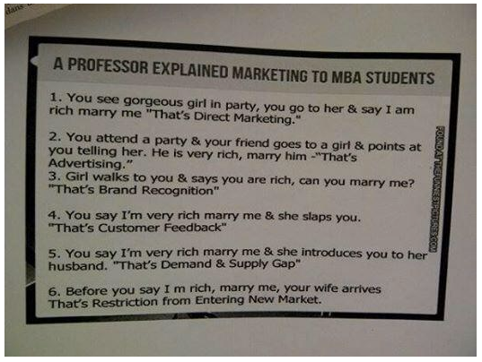

Slide 6
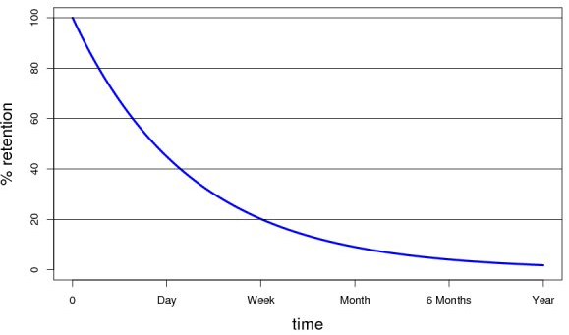
Ebbinghaus Effect
The forgetting curve is exponential. That means that in the first days the memory loss is biggest, later (as you can see in the forgetting curve at the right side) you still forget but the rate at which you forget is much, much slower.

Slide 7
