Slide 1
Building Your Niche
15th May 2014

Slide 2
Rudyard Kipling
I keep six honest serving-men
(They taught me all I knew);
Their names are What and Why and When
And How and Where and Who.

Slide 3
The Typical Lawyer
Time Poor
Transactional
Forever Prospecting
Generic Service
Small Invoices
Poor Profile

Slide 4
Common Conditions
Markets changing
Not delivering results
Pipeline insecurity
Networking / initiative malaise
Weak on pricing & value
Not getting the desired results
Feeling isolated
Fragile confidence

Slide 5
Why Develop a Niche?
Better clients
Higher earning potential – larger invoices
Invitations and introductions - Signposting
More “own” time
Satisfaction and confidence
Easier to be found
Focus on relationships
Investing in a pipeline for future revenue
Notes:
Photo Source: http://www.flickr.com/photos/pfala/3108965331/ from pale – Where is going the stock market ?????

Slide 7
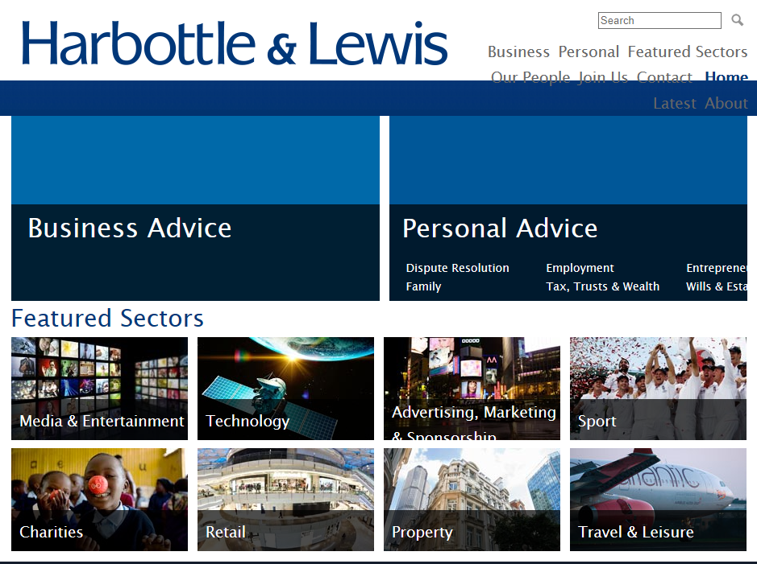

Slide 8
PRINCIPAL AREAS OF WORK Harbottle & Lewis provides advice to businesses on commercial, corporate, charity, employment, family, finance, intellectual property, litigation and property law. The services provided to individuals include asset freezing, employment, family, high-value residential property, mediation, personal injury, philanthropy, tax, trusts and probate. The firm offers specialist advice to clients in all areas of the communications and creative industries including advertising, broadcasting, digital media, fashion, film, interactive entertainment, live events, media finance, music, publishing, sponsorship, sport, television and theatre.

Slide 10
CLIENTS
Clients range from early stage companies to major corporations and include multinational brands and rights owners, early stage venture capital funds and investment companies, as well as entrepreneurs and leading individuals. Examples include:
Ben Sherman, Chelsea FC, Comic Relief, Conor Maynard, David and Victoria Beckham, Diageo, Emirates, England Cricket Team, Gok Wan, Hachette UK, IMO Car Wash, Jamie Cullum, Kate Moss, MAMA Group, Neal Street Productions, Penguin, PGA European Tour, Prescience Film Finance, PROfounders Capital, Raymond Gubbay Limited, Take 2 Interactive, The Royal Household, Universal Music Group, Universal Pictures, Virgin Group, Wolford London and Zattikka

Slide 12
EC3 Legal
EC3\Legal was launched in July 2012 aiming to bring a fresh attitude and commercial approach to legal services for brokers, Lloyd’s agencies, MGA’s and other insurance businesses. Our clients use us to provide much wider support than just legal advices.

Slide 14
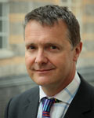
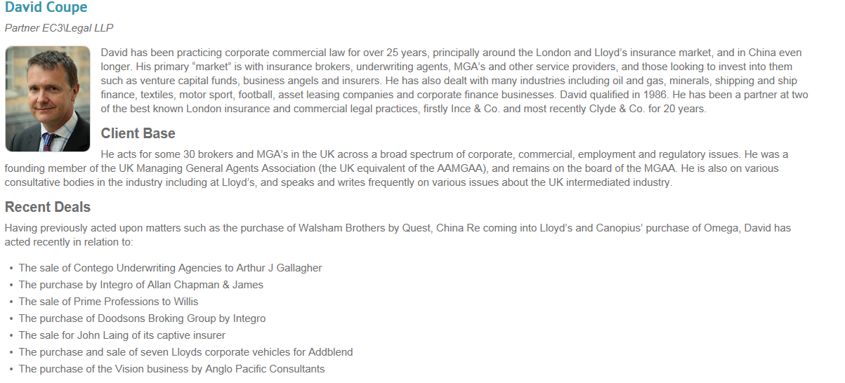

Slide 15
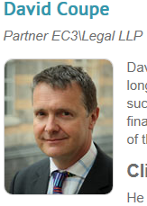
David has been practicing corporate commercial law for over 25 years, principally around the London and Lloyd’s insurance market, and in China even longer. His primary “market” is with insurance brokers, underwriting agents, MGA’s and other service providers, and those looking to invest into them such as venture capital funds, business angels and insurers. He has also dealt with many industries including oil and gas, minerals, shipping and ship finance, textiles, motor sport, football, asset leasing companies and corporate finance businesses. David qualified in 1986. He has been a partner at two of the best known London insurance and commercial legal practices, firstly Ince & Co. and most recently Clyde & Co. for 20 years.

Slide 16
Client Base
He acts for some 30 brokers and MGA’s in the UK across a broad spectrum of corporate, commercial, employment and regulatory issues. He was a founding member of the UK Managing General Agents Association (the UK equivalent of the AAMGAA), and remains on the board of the MGAA. He is also on various consultative bodies in the industry including at Lloyd’s, and speaks and writes frequently on various issues about the UK intermediated industry.

Slide 17
Recent Deals
Having previously acted upon matters such as the purchase of Walsham Brothers by Quest, China Re coming into Lloyd’s and Canopius’ purchase of Omega, David has acted recently in relation to:
The sale of Contego Underwriting Agencies to Arthur J Gallagher
The purchase by Integro of Allan Chapman & James
The sale of Prime Professions to Willis
The purchase of Doodsons Broking Group by Integro
The sale for John Laing of its captive insurer
The purchase and sale of seven Lloyds corporate vehicles for Addblend
The purchase of the Vision business by Anglo Pacific Consultants
David has extensive contacts within the corporate finance and banking sector in London specialising in the UK insurance market, and lectures to the major banks on insurance aspects as they affect banking practice. He can also provide contact details of specialised accountants and other relevant experts.
David is on the Regulatory and Compliance Committee of the MGAA and has regular contact with the UK Financial Services Authority (the UK regulator of brokers and insurance agents) in such capacity.
He is a well-known lawyer in the Lloyd’s broking and MGA market and has a good working relationship with the Corporation of Lloyd’s

Slide 18
A Niche Specialist – from Chambers
Geoffrey Shindler
Ranked in: North West Charities (Band 1) Private Client (Band 1) Specialisation: Trust and estate planning. Trusts, personal taxation specifically inheritance tax, capital gains, wills and probate.
Professional Memberships: Chairman Society of Trust and Estate Practitioners (STEP) 1994-98, now World President; Trust Law Committee; International Academy of Estate and Trust Law; Society of Legal Scholars.
Career: Qualified in 1969. Articled March Pearson. Halliwell Landau Partner from 1986 to 2006. Honorary Associate of Centre for Law and Business, Manchester University. Director of various local companies.
Publications: Consulting Editor of ''Trusts and Estates Law & Tax Journal.' Editorial board Wills and Trusts Law Reports. Regular conference speaker and writer.
Personal: Born 1942. Attended Bury Grammar School and Cambridge University (MA LLM Cantab). Leisure interests include Marylebone Cricket Club, Vice Chairman Lancashire CCC, Manchester United FC, Manchester Literary and Philosophical Society and Portico Library; Director Royal Exchange Theatre, Manchester; Chairman of the Development Committee, Chairman Manchester Camarata. Lives Prestwich, Manchester.

Slide 19
Finding Your Niche Jim Collins – Good to Great

Slide 20
Niche Essentials
Passion
Money
Best

Slide 21
Who are your Clients?
Organisation v Individual
Public Sector v Private Sector
Geographic Boundaries
Income Parameters
Industry Sectors
Where you have some existing expertise and clients to build upon

Slide 22
Obstacles to your reputation
Making a different intro every time
Describing what we do, versus ...(?)
Using generic, abstract language
Clients not recognisable to others
No follow-up system, no reservoir
No Showcase, to warm and develop the relationship
Doing own prospecting

Slide 23
The Prospect Pathway
Contact
Download Resources
Hear a talk
Phone someone
Subscribe to a blog
Google search
Networking
Read an article
Watch a webinar
Memberships

Slide 24
Showcase
Living at the heart of the client’s world: by providing them with something of value
Provides a means for referrers to position you in front of others
Prospects want to get a flavour of who you are, before they reveal themselves
Website is vital part of the Customer Journey
Social Media is fast becoming another stage on the journey

Slide 25
Example Showcase
Website with valuable resources
Articles in niche – media (online or offline)
Talks, seminars, given to the reservoir of others
Involvement social, charity, community events
PR (if you must)
Network events – niche specific

Slide 26
Social Media- an introduction, Amy Seppman, January 2010

Slide 27
Why use it for business…
Expand reach (The estimated number of individuals in a given audience)
Increase the profile of individuals within your business
Engage your audience
Provide a forum for interaction
It’s free!
Never use it for selling!
Social Media- an introduction, Amy Seppman, January 2010

Slide 28
Benefits of a regular bulletin (as long as it has value)
You stay in contact with people that would otherwise forget you... e.g. Networking contacts
Showcase what we do v. discussing it
Your own PR machine for any purpose
Build a reservoir to feed the pipeline

Slide 29
Guidelines for a regular bulletin
Avoid the word “newsletter” Use “briefing”, “bulleting” etc. Instead
MUST have value for the reader – not just about The growth of our team, new offices etc.
Should trigger for forwarding: if not, question the value!
Ask specific questions to evoke response
Notes:
29

Slide 30
Thank You
Contact Details
Mobile – 07836 596969
Email – simon@simonwhiteconsulting.co.uk
Twitter: - @legalbusiness

