Slide 1

On The Web:
Online Presence
It’s All About
Conversion
David Gilroy
Conscious Solutions
Melissa Davis
MD Communications

Slide 2
Win one of four free places at our “It’s All About Conversion” workshop in November
What’s the average bounce rate on a law firm’s website?
* 203 websites surveyed (2 – 100 partners)
Notes:
David

Slide 3




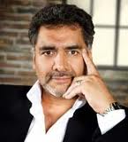

Who’s afraid of the big bad wolf?
£15m
£1m
£10m
£5m
Notes:
Melissa

Slide 4
Conversion defined
con·ver·sion (kn-vûrzhn, -shn)
noun
1. the act or process of converting; state of being converted.
2. change in character, form, or function.
3. spiritual change from sinfulness to righteousness.
Notes:
David

Slide 5
Notes:
David

Slide 6
Exit page analysis
 | Page Views | Exits
 | 10,437 | 4,096 | %
Home page | 913 | 364 | 41%
A news page | 259 | 244 | 94%
A contact page | 550 | 196 | 36%
A contact page | 418 | 176 | 42%
Notes:
David

Slide 7
Content/form experiments
Notes:
David

Slide 8
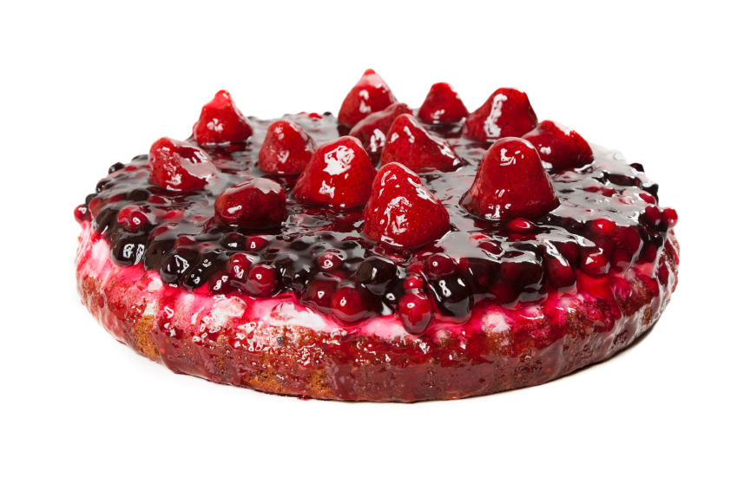
Website language patterns – talk “afters”
Courtesy of http://www.andybounds.com
Notes:
Melissa
- show them value
don't TRY and sell
show what they get AFTER they would with you
Andy Bounds

Slide 9



Explain the context

Slide 10
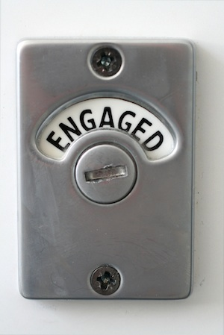
Please do not “we” all over your website
Notes:
Melissa

Slide 11
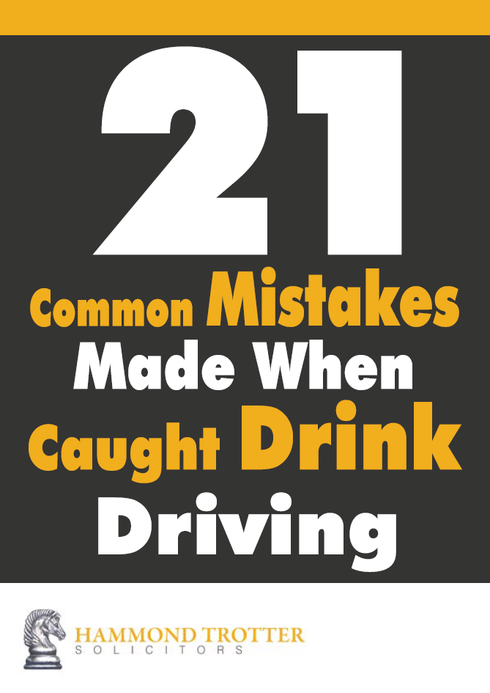
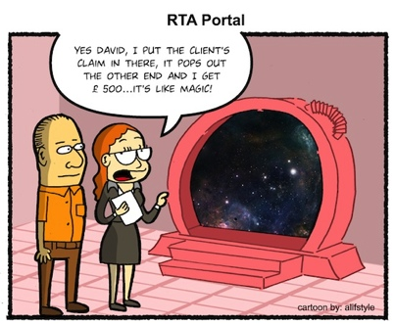
Comfort blankets. Do you have them?
Brochures or whitepaper
Get more “valuable” content
Notes:
Melissa

Slide 12
Social Media Engagement Model
Highly
Targeted
CONNECT
CONVERSE
Unengaged
Highly
Engaged
BROADCAST
SHARING
Un Targeted
Notes:
David

Slide 13
You don’t know me!!!
Notes:
David

Slide 14
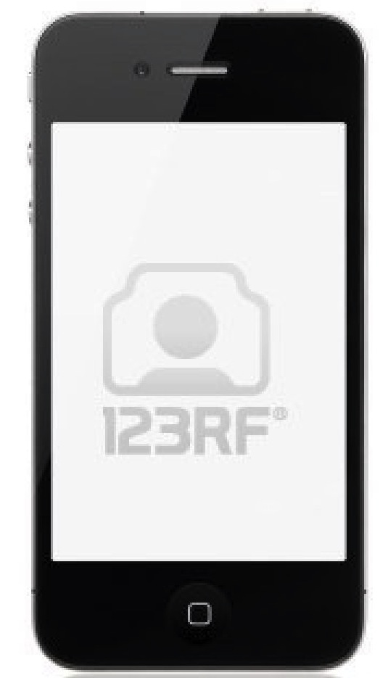
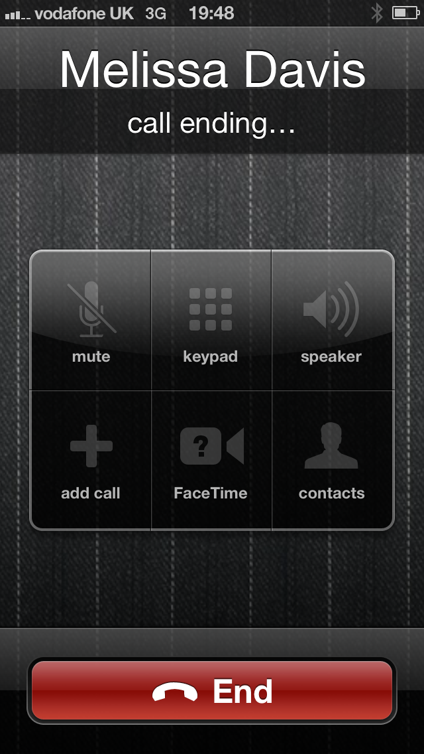
But I expect you to know who I am!
I really do
Notes:
David

Slide 15
10
Social media
rule
of
Notes:
Melissa

Slide 16
Really? I did not want to know!
NEVER break Rule No.1 of social media
Notes:
Melissa

Slide 17
Twitter clinics
Notes:
Melissa

Slide 18
I am going to complain in different ways now!
Notes:
Melissa

Slide 19
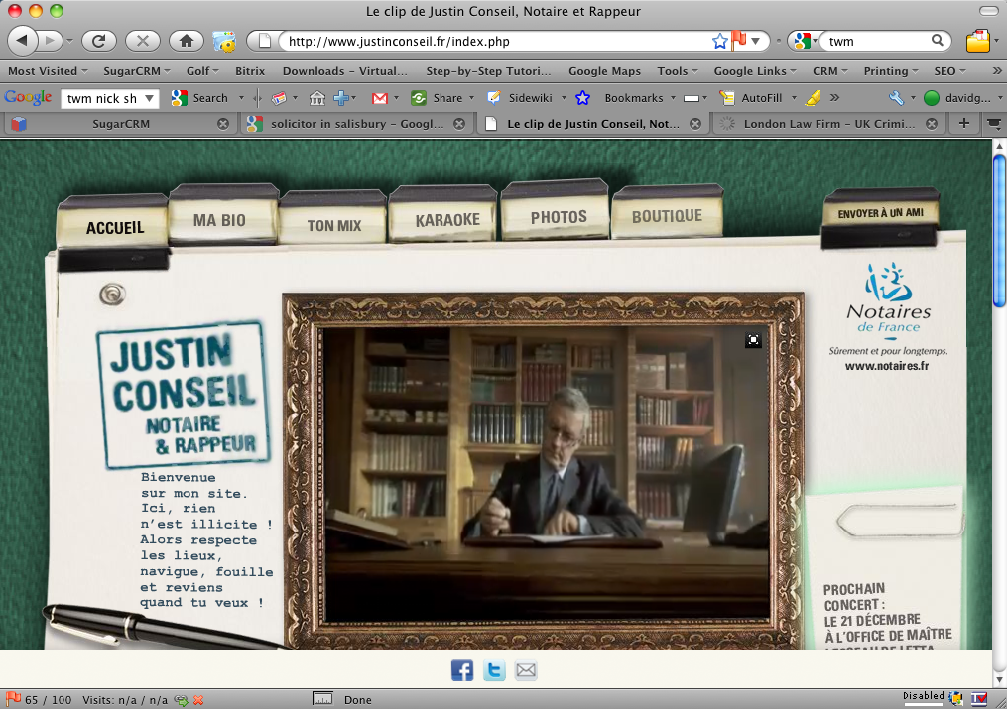
Does video drive website engagement?
Notes:
David

Slide 20
You bet!
Notes:
David

Slide 21
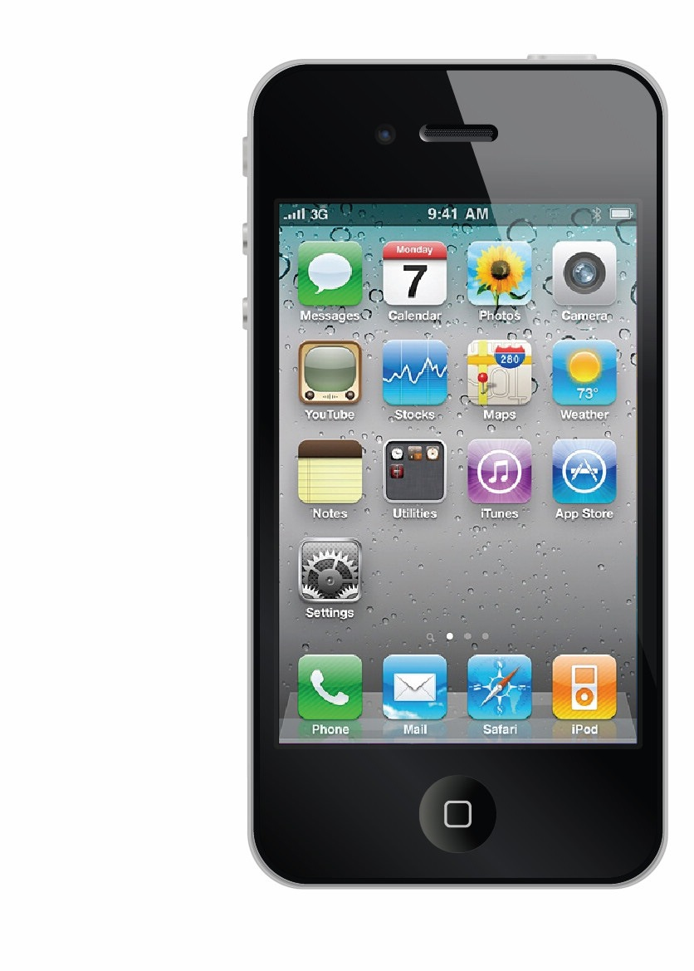
You HAVE to be mobile optimised
There are only three things that visitors use a law firm’s mobile website to do “today” :-
  Find you
  Phone you
  View you
Notes:
David

Slide 22

Any questions before the “answer”

Slide 23
The answer to the question
43.67%
Notes:
David

