Slide 1

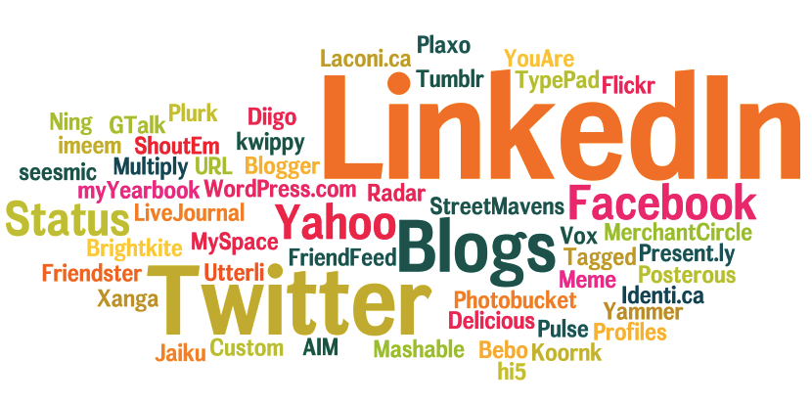
Social Media Marketing
Notes:
If there was one thing I could tell you today about Social Media what would it be ?
(Write this up on a white board)

Slide 2

Show of hands
Notes:
Who uses social media ?
Who has a LinkedIn or FaceBook Account ?
For LinkedIn keep your hands up if you have 100 connections. 200? , 300? Keep going until no one has their hand up or they are near 500

Slide 3
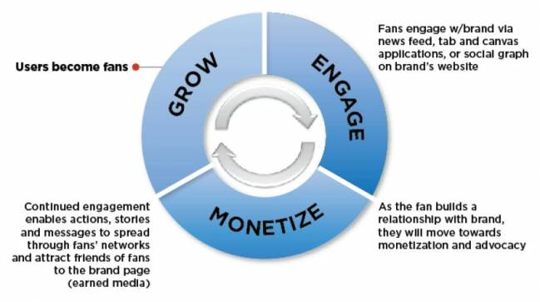
Three Stages of Social Media
Courtesy of http://www.traffika.com
Notes:
Where do you think you are on this scale ?
Most Law firms are “Crawling”

Slide 4
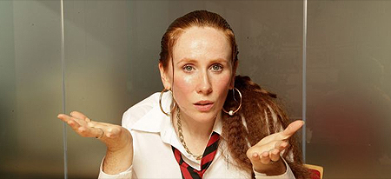
Am I bovvered? Lauren is!
£27,278
£20,896
£100,000
Notes:
£27,278 – What 6KBW made from the introduction of 1 tips booklet download
£20,896 – What David (My boss) quoted for on a project from an old employee through LinkedIn
£100,000 – What Higgs & Sons made from a single case as a result of connecting through LinkedIn

Slide 5
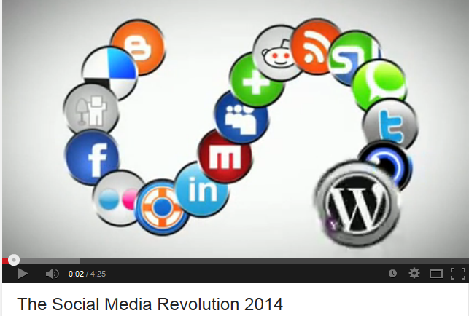
Just How Big is Social Media?
Notes:
Social Media Revolution (get the link up and show it) https://www.youtube.com/watch?v=0eUeL3n7fDs
Talk about the speed of change

Slide 6
Social Media Engagement Model
Highly
Targeted
CONNECT
CONVERSE
Unengaged
Highly
Engaged
BROADCAST
SHARING
Un Targeted
Notes:
Connect- Most law firms are here
Broadcast – Unengaged but may be too small or too big
Sharing – Engaged but not targeted
Converse – Engaged and targeted

Slide 7
How it all connects
Notes:
Its all about generating traffic to the website through social media

Slide 8




Social Media Marketing
It’s all about raising your profile
It takes time and commitment
Listen -> Talk -> Engage
It’s not about technology
Relax: it’s traditional legal marketing
Word of mouth reputation is the result
Social Media Care…whats that?
Notes:
1 – Listen – Talk – Engage – These are the core areas you need to concentrate on
2- Word of Mouth is the end result, this is the end goal you need to get to.

Slide 9
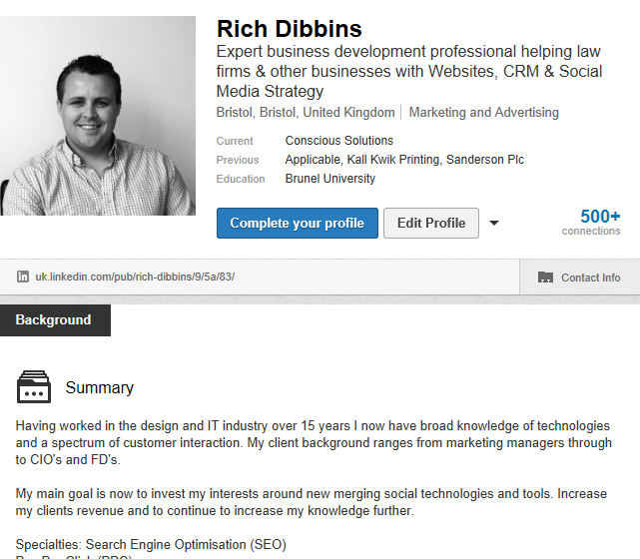
LinkedIn – The Basics
I want to know what YOU do, not just what your job title is!
Use a good photo
Don’t be ashamed of your past
A brief summary of who you are as an individual

Slide 10
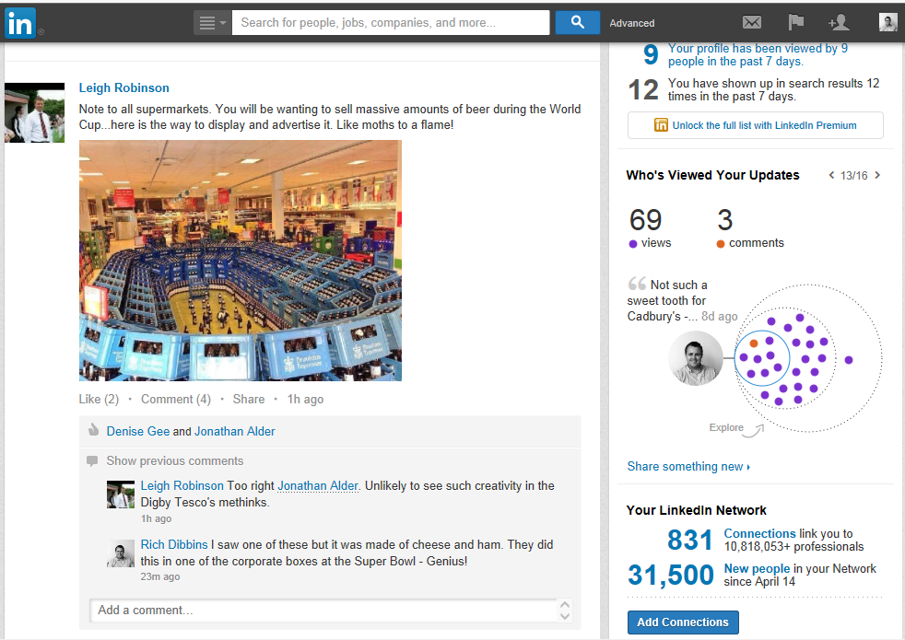
What does it all mean?
Notes:
Explain each of the icons:
Messages
Flag
Whos viewed your profile
How many connections
Status update, how you can share this with the public, or just your connections
Attach files into your update – use a PDF never a word doc. This is for security purposes
People are now using images to gain more attention on LinkedIn

Slide 11
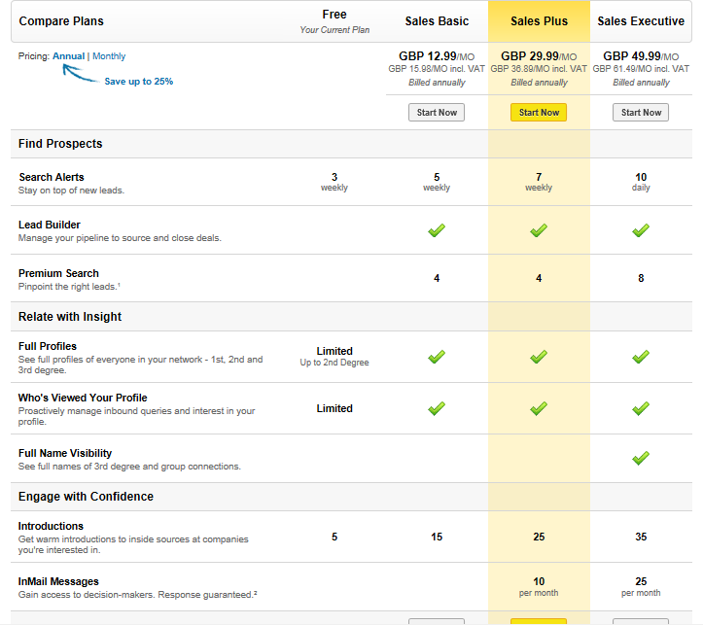
What's the difference ?
Notes:
The more you pay the more information you can see and use
If you are new to LinkedIn, use the free version until you are ready to explore the paid for versions
You can cancel at any time but it is non-refundable

Slide 12

What can you find ?
Notes:
The search feature is very powerful, even the free version
You can search people, companies, groups, universities and articles
Research a prospect or even a future employee. That’s how David found me!

Slide 13
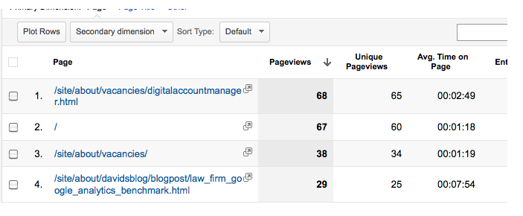
Measureable Results
Notes:
Google Analytics page result (This is of the Conscious Site)

Slide 14
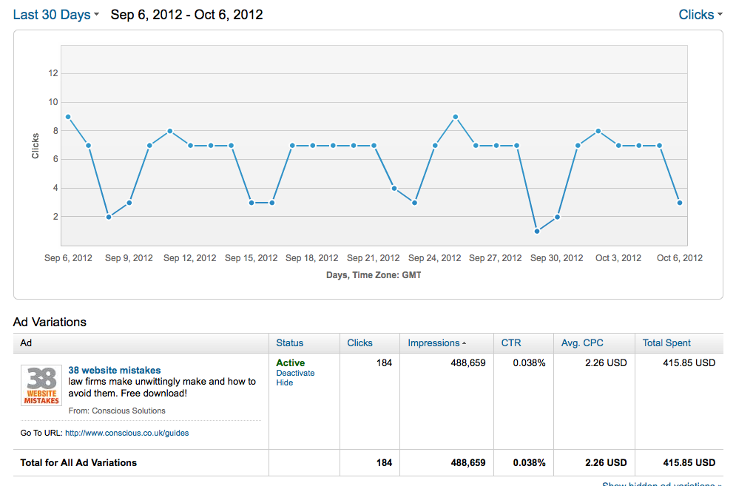
LinkedIn advertising
Company size, Industry, Geography
Notes:
Impressions = How many times it has appeared on LinkedIn
CTR = Click Through Rate
CPC = Cost per click
We recommend 1 month minimum if you are to run a campaign, this would be as much as your budget would allow. Example £10 per day for a typical medium sized firm.

Slide 15
LinkedIn looks Different
Endorse specific skills with one click
Notifications have changed in your toolbar
Company page updated allowing a new “banner”
Follow thought-leaders e.g. Richard Branson & apply to become one
Notes:
Go through the Endorsements, skils and profile page on your Linked In profile

Slide 16

LinkedIn Do’s and Don'ts
Notes:
Do’s
Contribute, give your opinion this sparks up further relationships
Listen to what is be said in groups, and the river of news
Engage with your connections
Use it regularly, get the app it helps. Make some time for LinkedIn even 5 minutes is better than nothing!
Don'ts
Ask for references' – give to receive, never ask
Abuse a group or join a group and not contribute
Leave your profile to turn into a “digital” graveyard
Ask someone to connect with you and use the “friend” button. Are they really a friend ? Understand the relationship first

Slide 17
LinkedIn Actions
Improve your Company profile
Get more Fee Earner profiles added
Build your connections
A “button” on your staff profile won’t do it!
P.S. Connect with me on LinkedIn
Do NOT ask for recommendations
Research prospects before you meet
Make some “LinkedIn” time each week
Join some Groups. Start one?
Notes:
Tell the story from last week of Snibor posting a message re. CRM software, me going to see them, then meeting a consultant in a coffee bar who is now the Biz Dev Dir for a large target client of ours.
Story of us getting 12 downloads of our social media booklet as the link showed up in a LinkedIn Group wrap-up email.

Slide 18
Twitter
What can you say in 140 characters?
Try and post a tweet once per day
Don’t post TOO often, you lose followers
Design a background
Sector specific Twitter accounts
Re-tweet to build relationships
Hootsuite – use to schedule Tweets
Notes:
I followed one law firm who tweeted 50 times in the first day!!! Not good
Example firms Trethowans - https://twitter.com/trethowansllp
Frettens https://twitter.com/frettens

Slide 19
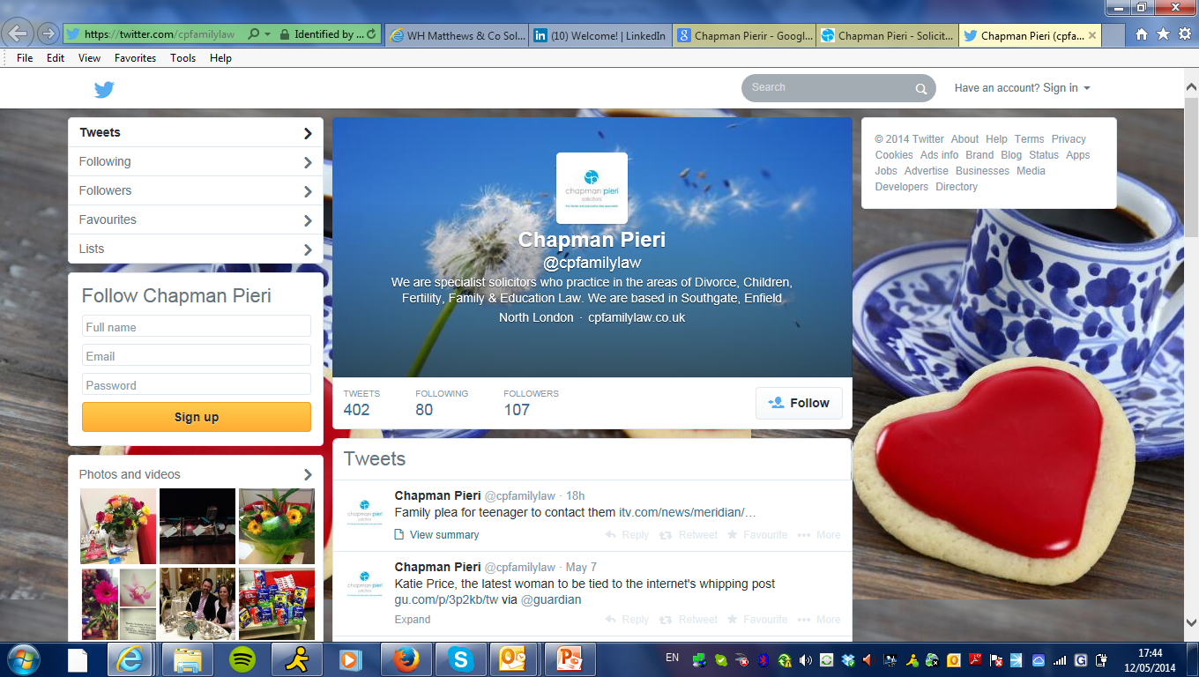
Use your Twitter background
Notes:
Example site

Slide 20
Mine’s bigger than yours!!
Name | Twitter Account | Followers
Stephen Fry | stephenfry | 6.8m
Silverman Sherliker | London_Law_Firm | 18.8k
Grant Thornton | GrantThorntonUK | 11.5k
Stephensons Solicitors LLP | SolicitorsLLP | 5,161
Walker Smith Way Solicitors | WalkerSmithWay | 3,856
Mogers | MogersLaw | 3,166
Osborne Clarke | OsborneClarke | 1,963
Conscious Solutions | ConsciousSol | 1,716
Wards Solicitors | wardssolicitors | 1,508
Clarke Wilmott | Three accounts | 1,203
Wedlake Bell | wedlakebell | 777
Last updated on 12 May 2014
Notes:
No ones is bigger than Stephen Fry

Slide 21

Give your Tweets Superpowers
Notes:
Give your Tweets some superpowers with Promoted Tweets
Target:
Keywords
Interests
Gender
Geography
Similarity to existing followers
Even by device
You are only charged for engagement, that could be following your promoted account, retweet, click or favourite the account.
Set a daily budget – know exactly how much you are spending, you can change it up or down as much as you want.
View performance in REAL time understanding your ROI

Slide 22
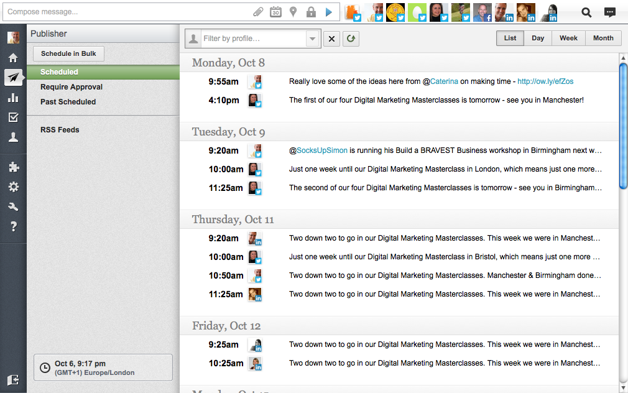
Hootsuite – save time!
Conscious can “connect” with 3,466 people on LinkedIn
Notes:
Explain how we use Hoot Suite by Dave to tweet / update our LinkedIn profile on behalf of the company

Slide 23
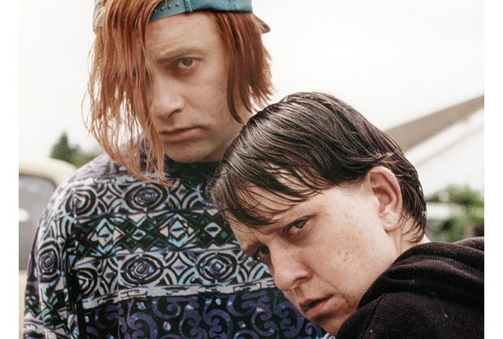
Facebook
Not just for kids!
Notes:
Not just for kids, Canter Levin Berg (get an example of their page up)
You can engage with the consumer on a deeper level than LinkedIn
Is Facebook for your business ? Typically its for Private Client / Legal Aid / Personal Injury firms
Not just for “the kids”
“Listen” first, what are others saying about you?
Who in your firm has a Facebook profile?
Engaging with the younger generation for recruitment

Slide 24
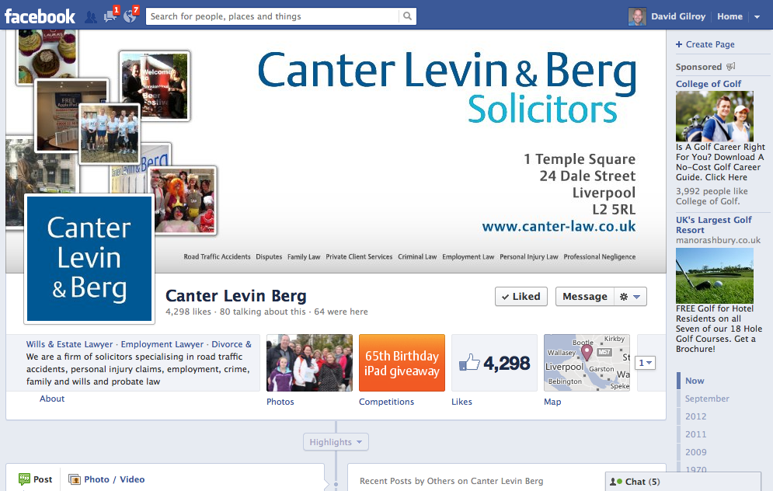
Get a decent Facebook page

Slide 25
Competitions
Notes:
Various competitions you could run

Slide 26
Facebook advertising
Sex
Age
Status
Geography
Events (Birthday, Moving house)
Education (Level, establishment)
Employment
Interests
Connections (via Fans)
Notes:
Ask this question:
A client ran a campaign with the following criteria:
Male / Female
Over 35
Within 25 miles
One or others status was engaged for at least 6 months
What was the advert for ?
Answer – Pre-nups

Slide 27

Google+
Started in 2011 – so still in its infancy stage
You must have a Google account
3.5m users in the UK
42% of users are 18-24 / Mostly a male audience
Integrates with everything Google
20% market share in 2013 for social media platforms – that’s Huge!
Important for any with a YouTube account
Features similar to Facebook
Notes:
The key to social media is to be careful,
Get a social Media Policy in place so everyone in the firm understands what is expected of them
Tools, there are some great tools out there that can help you monitor your social media output.
Some tools will allow you to monitor positive and negative keywords.
3. Have a process in place if something negative or positive happens. You need to be ready.
4. Timing is everything the sooner you respond to a negative or positive comment the better the response from the individual
5. Never argue online, you will lose. Instead acknowledge the issue, take the issue offline, re-post a positive outcome if there is one.

Slide 28

Social Media Care
Notes:
The key to social media is to be careful,
Get a social Media Policy in place so everyone in the firm understands what is expected of them
Tools, there are some great tools out there that can help you monitor your social media output.
Some tools will allow you to monitor positive and negative keywords.
3. Have a process in place if something negative or positive happens. You need to be ready.
4. Timing is everything the sooner you respond to a negative or positive comment the better the response from the individual
5. Never argue online, you will lose. Instead acknowledge the issue, take the issue offline, re-post a positive outcome if there is one.

Slide 29









What social media to use?
 | B2B | B2C
LinkedIn
Twitter
Facebook
Blogging
YouTube
Pinterest
Google+
Do a lot
Do some
Do a little

Slide 30

http://www.conscious.co.uk/presentations
Notes:
Overall Social Media is not a silver bullet, it is another medium to reach out to your audience and spread your brand
Not done correctly it can waste a lot of time, money and harm a reputation
But done well and you increase your revenue, brand awareness and stay ahead of the competition.

