Slide 1

New ideas How to sell to shoppers
What law firms can learn from retail
www.richmontewells.com

Slide 2

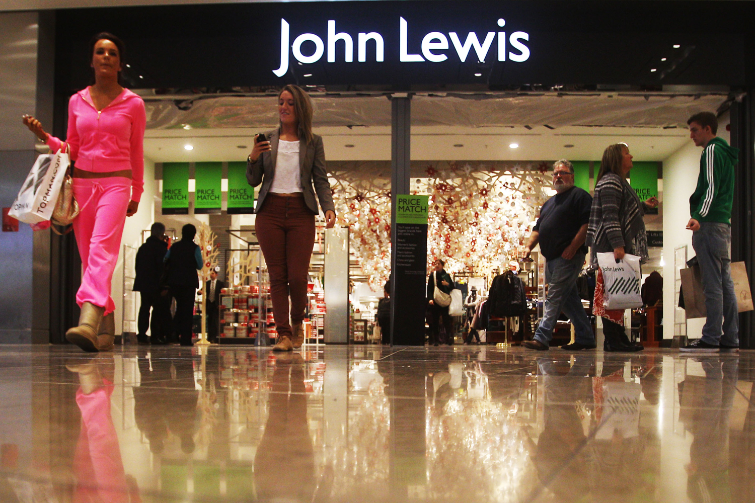


Slide 3
Who?

Slide 4


Slide 5


Slide 6
How?

Slide 7
Retail is Detail

Slide 8


Slide 9

How?

Slide 10
1. Be Creative

Slide 11
2. Be Convenient

Slide 12
3. Put Customer first

Slide 13
4. Be Consistent

Slide 14
5. Care about value

Slide 15
1. Be Creative

Slide 16


Slide 17
Excitement
Performance
Customer satisfaction
Kano Model Analysis
Threshold
Product Function

Slide 18
Excitement
Performance
Time
Customer satisfaction
Threshold
Product Function

Slide 19
2. Be Convenient

Slide 20
face to face

Slide 21

online

Slide 22


wherever

Slide 23
3. Put Customer first

Slide 24


Slide 25


Slide 26


Slide 27
4. Be Consistent

Slide 28
“We are what we repeatedly do. Excellence is then is not an art but a habit”
Aristotle

Slide 29
Get these wrong or miss some out and you have a problem
Excitement
Performance
Customer satisfaction
Threshold
Product Function

Slide 30
5. Care about value

Slide 31


Slide 32
What do your clients really really want?

Slide 34
What?

Slide 35
Focus

Slide 36
Who are your most profitable clients and what do they really really want?

Slide 37
Design

Slide 38


Slide 39
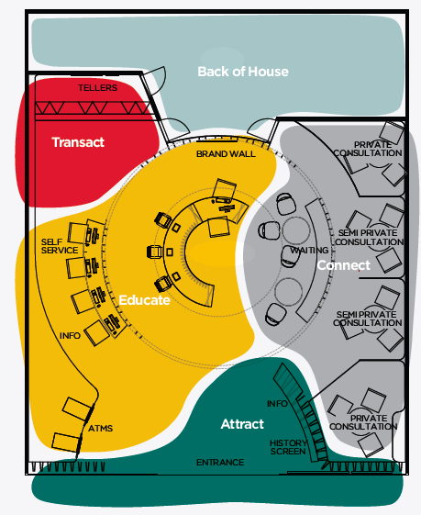



Slide 41
Transform

Slide 42


Slide 43


Slide 44
Price

Slide 46


Slide 47
Deliver

Slide 48


Slide 49
When?

Slide 50
T: 0117325 0253 Sally Calverley
M:07545395282
Managing Director
www.richmontewells.com

