Slide 1
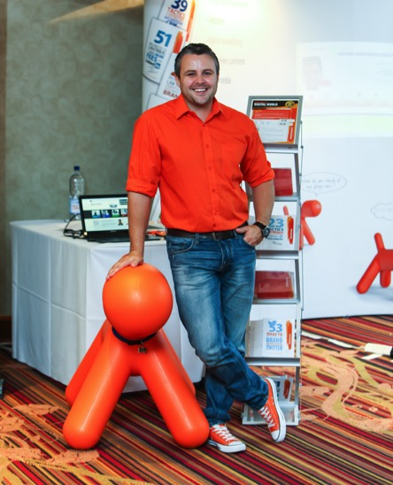
Rich Dibbins
Business Development /
Social Media Consultant
“Social Media Marketing for 2015

Slide 2
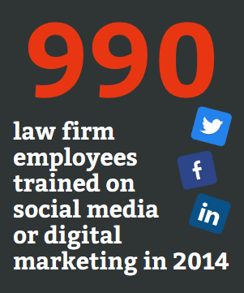
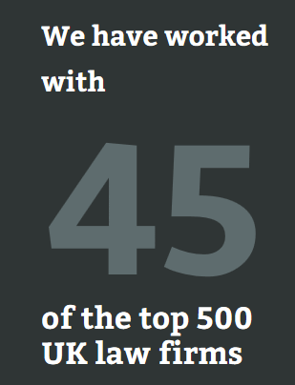
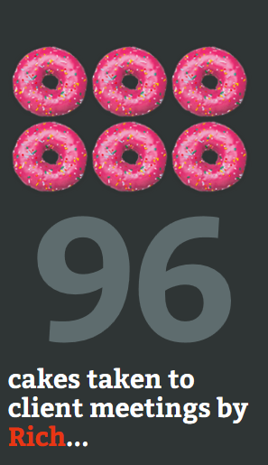
“We only work within the
legal sector”

Slide 3
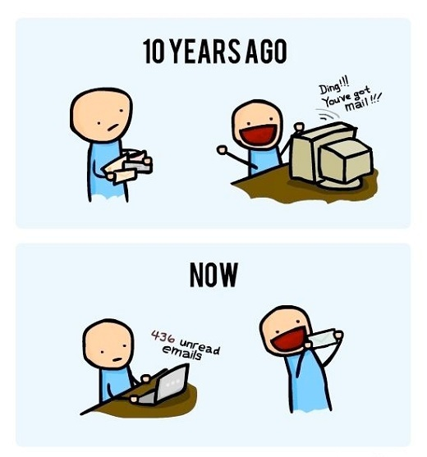
How do your potential clients find you ?

Slide 4
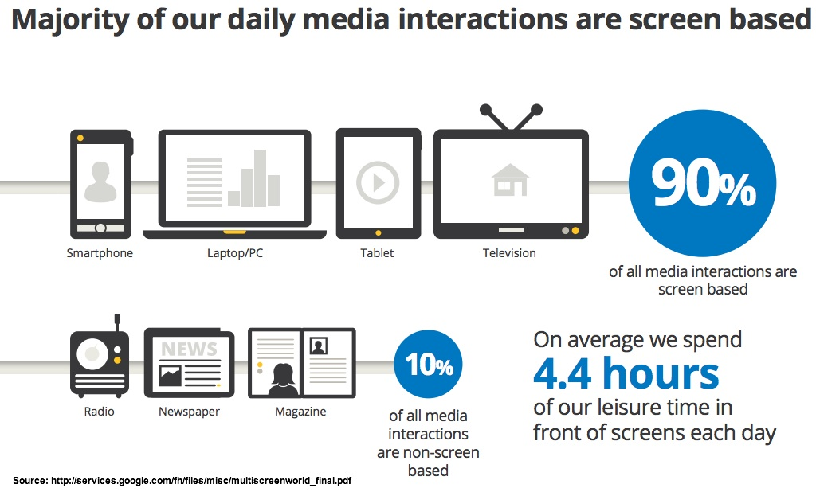

Slide 5
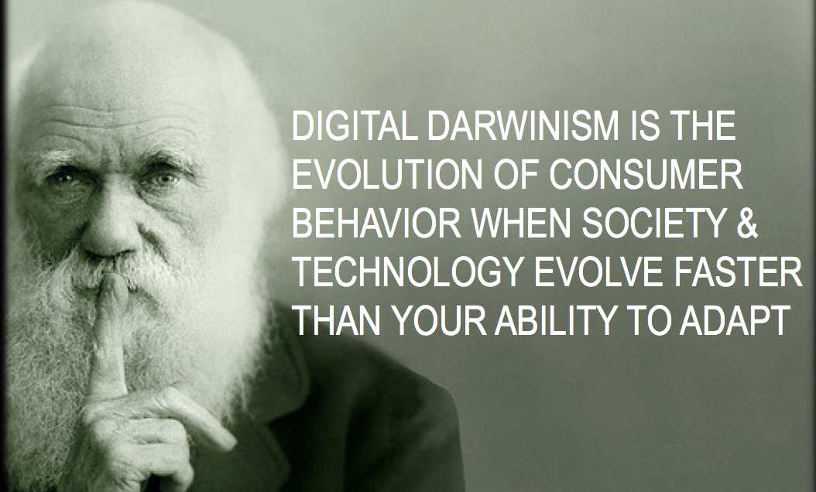

Slide 6

Why should YOU, bother with Social Media ?

Slide 7

How will it benefit YOU?
Helps establish and improve your client relationship
Improve your personal brand
Increases website traffic
Improves your credibility

Slide 8
What is Social Media ?
Social media is the social interaction among people in which they create, share or exchange information, ideas, and pictures/videos in virtual communities and networks.
Source – Wikipedia
of management at law firms consider Social Media to be very significant in raising the firms/individuals profile (source PM Forum 2014 report)
77%

Slide 9







What one should I be using ?
Platform | Private Client | Commercial Client
LinkedIn
Twitter
Facebook
Blogging
YouTube
Pinterest
Google+
Do a lot
Do some
Do a little

Slide 10







What one should I be using ?
Private Client
(Business to Consumer)
Commercial Client
(Business to Business)
Do a lot
Do some
Do a little

Slide 11





Social Media Marketing
It’s all about raising YOUR profile
It takes time and commitment
Listen -> Talk -> Engage
It’s not about the technology
Relax: it’s traditional legal marketing
Word of mouth reputation is the result

Slide 12

Which came first ?
Audience
or
Content

Slide 13

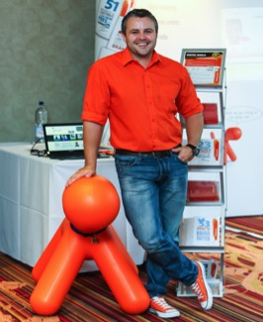
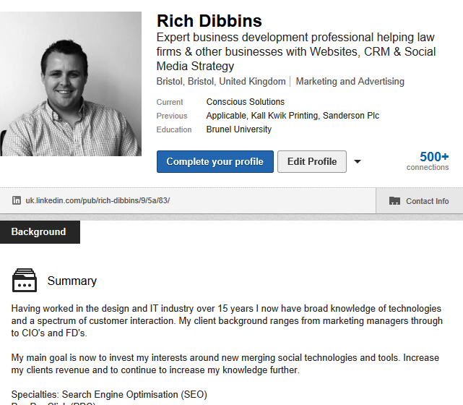
LinkedIn – The Basics
Use a good photo
I want to know what YOU do, not just what your job title is!
Don’t be ashamed of your past
A brief summary of who you are as an individual

Slide 14
LinkedIn – How to use it
Create mini blogs – this adds credibility
Share other peoples updates, this builds your network
Post non-work specific updates
Put a LinkedIn button on your website / email footer
Monitor and review your updates, what works ?
2-3 updates a week is more than enough

Slide 15


Twitter – The Basics
What can you say in 140 characters?
Try and post a tweet once per day
Don’t post TOO often, you lose followers
Sector specific Twitter accounts
Re-tweet to build relationships
Hootsuite – use to schedule Tweets

Slide 16

How do I use Twitter ?
Add # to your tweets, this gets picked up as a keyword.
Make your tweets informative, useful, or funny.
Post pics, these get more engagement over text tweets
Link your LinkedIn profile with Twitter – 2 4 1 (saves time)
Say “thank you” to people who follow or retweet you.
Don’t tweet anything boring!

Slide 17
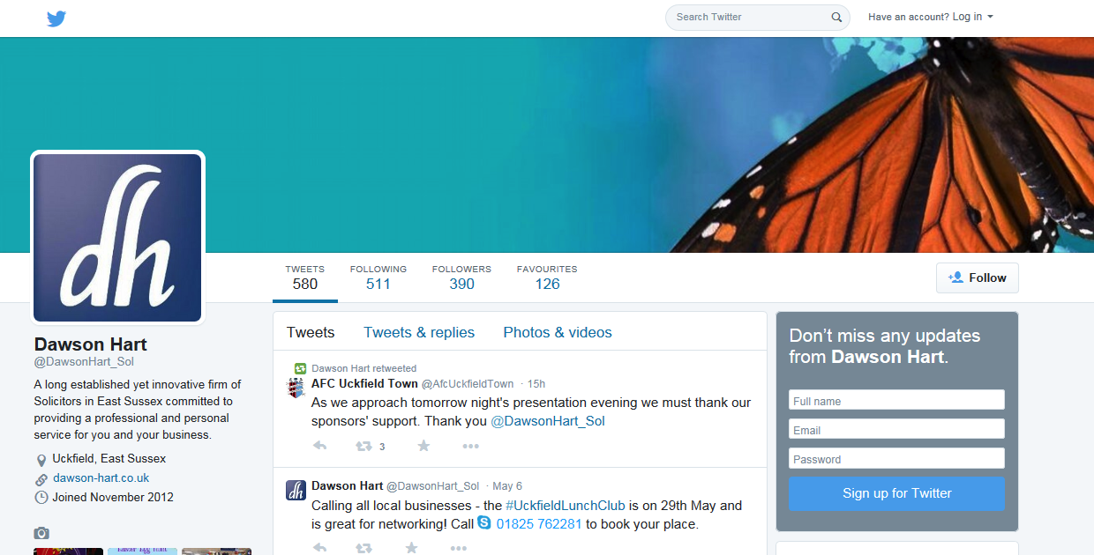

Slide 18

Facebook – The Basics
Over 1.4 billion users
Great for engaging with private clients
Greater range of search variables
Security is paramount
Advertising is cheaper than Google Ads

Slide 19
How do I use Facebook
Create a branded firm page
Don’t post legal jargon 24/7
Post topical and local content
Create competitions
Do you work with a charity?, engage them on your Facebook page.
Monitor what people say

Slide 20
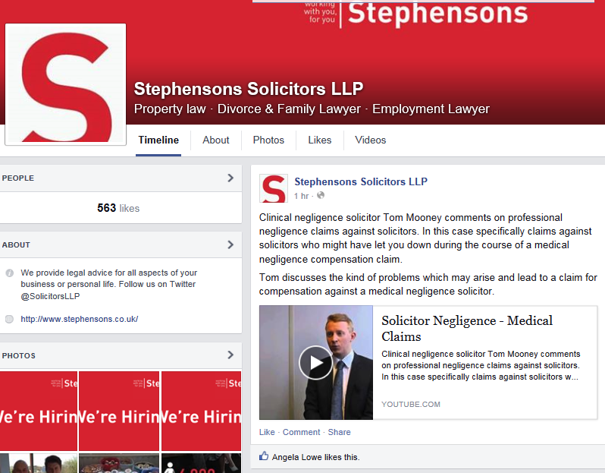

Slide 21

Blogs demonstrate knowledge, in turn demonstrates credibility
Don’t blog too often, once a week.
Create a blog rota
Allow the juniors to create content, senior partners can then pick and choose.
Its original content, Google loves this!
Share your blogs on social media sites

Slide 22




These tools will save you time!
Twitter based Search and reporting tool
Management & engagement platforms
for social media

Slide 23

Rules of Social Media
Really? I did not want to know!
NEVER break Rule No.1 of social media
Rule No.2 of social media. It’s a private conversation in public
10
The rule of

Slide 24
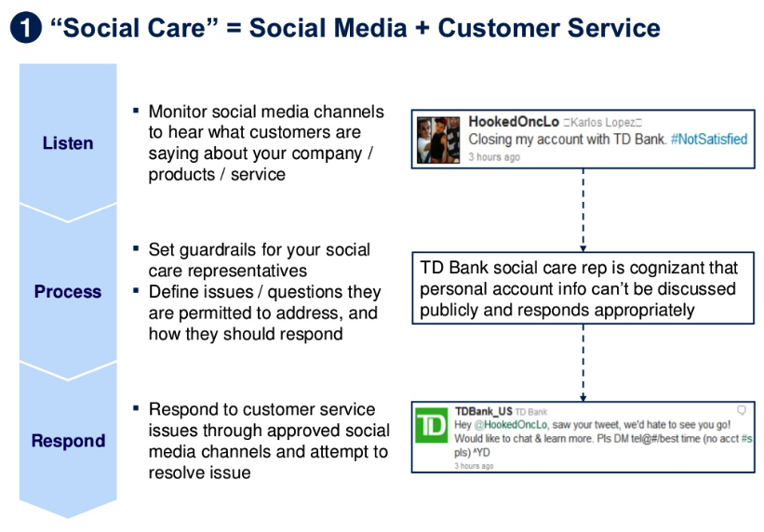
Social Care

Slide 25
Social Care In Action

Slide 26
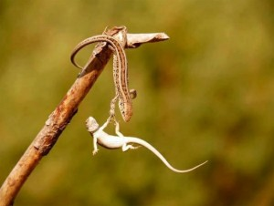
Help Others…They will help you.

Slide 27
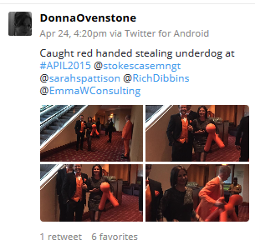
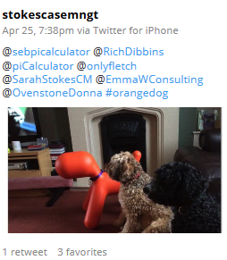
It could go Viral!
Potential reach of 4,986 followers (all 7 Twitter accounts combined)
48 Retweets
15 Favourites
12 photos
Cost to Conscious and the others…Zero ££

Slide 28

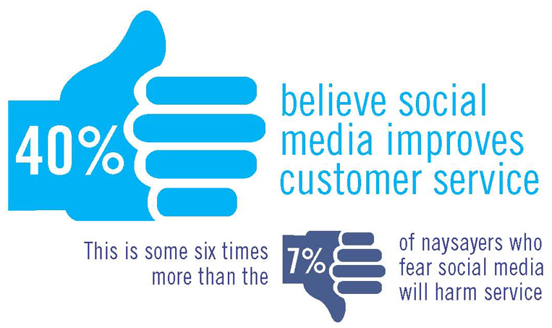
New for 2015

Slide 29
Social Media Shopping List
Buy in from the top
Social Media Policy
Social Media Strategy
Social Media “Champion” to drive the strategy
Hoot Suite – the basic version (FREE)

Slide 30

What our clients said,
“Fantastic Service” 5*
“Perceptive, Creative and Professional” “Innovative and Responsive”

Slide 31

Websites for 2015
Websites are like teenagers, you need to nurture, support and encourage them. If you abandon them,
they turn into this…..

Slide 32
What a GREAT website needs
Responsive design, to capture “on the go” visitors
Key relevant content, updated regularly.
Editing Suite to allow you to edit content
Google Analytics, allowing you to monitor performance
Local Search Engine Optimisation (SEO)
Social Media integration

Slide 33
Web Searches from 2014
Over 2,000,000 legal searches made on Google UK
600,000 searches from a mobile device
Google Ads increasing along with SEO
Social Media Ads increasing
Search requests getting longer e.g
“Cheap Conveyancing in Bristol”

Slide 34

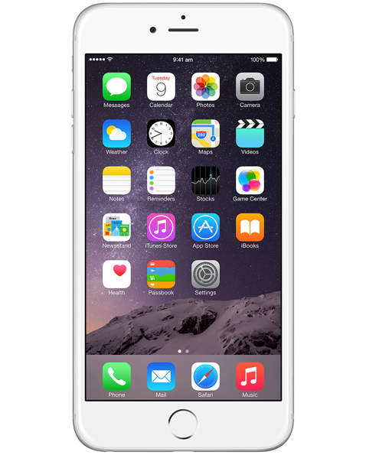
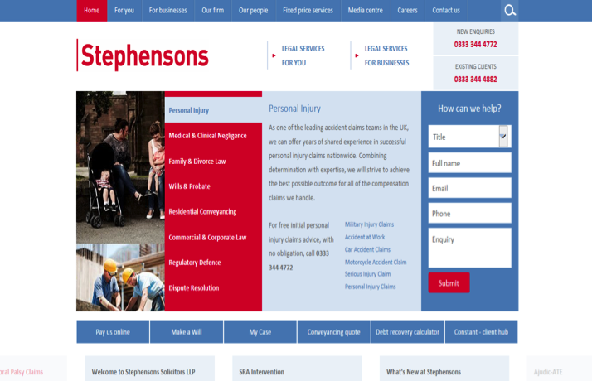
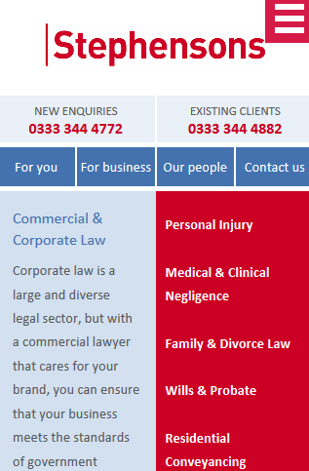
Responsive Design

Slide 35
Key Navigation & Call To Action
How easy is it to navigate around your site ?
As few clicks as possible
Don’t over complicate the process
Contact details / Squeeze pages

Slide 36
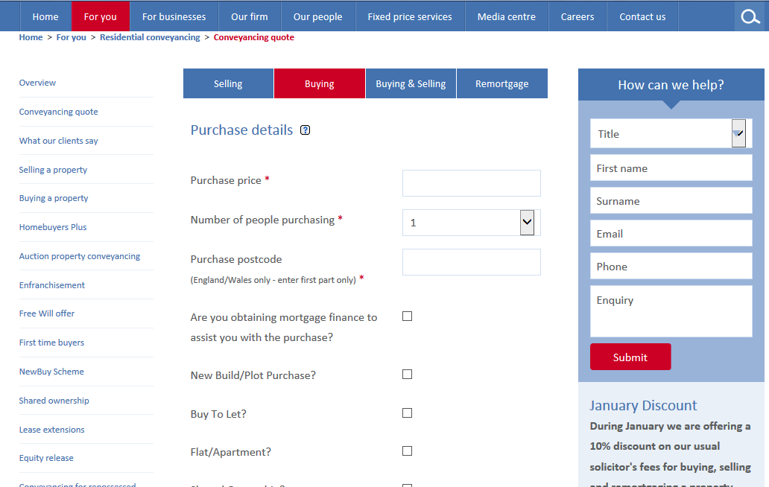
Online Tools

Slide 37
Relevant Content
Blogs
News items, legal and non legal
Updated profiles
Service pages
Minimum of 300 words per page

Slide 38
Content Management System
(CMS)
Do you still rely on 3rd parties to edit your site?
Freedom to edit your site, without the need to be a techy!
Encourages you to edit your site, regularly.
Is it supported ? Security ? Training ?
Create new pages and events ?

Slide 39

Google Analytics
GA allows you to monitor the performance of your site.
How many visitors ?
How many viewed from a mobile ?
Bounce rate…what is this ?
Referral traffic
New v repeat visitors

Slide 40
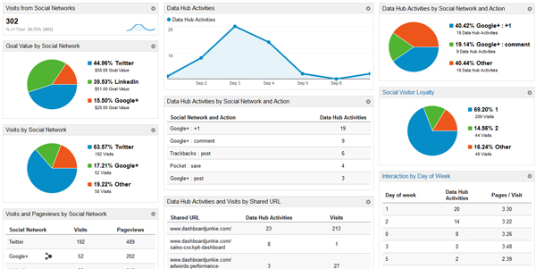
Google Analytics

Slide 41

Search Engine Optimisation
(SEO)
Chosen keywords
Services and location
Local or National competition ?
Do you have enough content ?
The core elements,
  Meta Description
  Meta Title
  HTML Headings

Slide 42
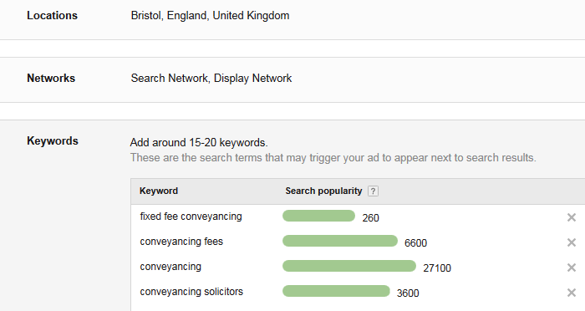
Keyword Research

Slide 43

Social Media Integration
Blogs with share buttons to social media
Staff profiles with LinkedIn / Twitter buttons
Home page with social media share icons

Slide 44

One line of code, One client per week!

Slide 45
5 Marketing Ideas You Can Do
In The Next 3 Months
Notes:
Intro Conscious Solutions – We are a digital marketing agency based in Bristol and work with sole practitioners through to multi partner firms up and down the UK.
Our core services are designing and hosting websites, helping you build your digital marketing strategy as well as intranets and CRMS systems for law firms.
It's not just about having a great looking website; it's about what you do with it once you've got it.
So just a quick competition before we start, We did a survey of Law Firms between 5 & 60 partners within the top 500 law firms in the UK in 2012.
Can I ask you to write down on a business card or a bit of paper with your name and firm and what you think the expected annual marketing budget spend is for a typical law firm - Between 5 & 60 partner firms.
Once I have all the entries in I will draw one out at random and that person will enjoy a free 1 day seminar (complete with CPD points) at our client conference in May this year at Coombe Abby.
I will give you the answer shortly.

Slide 46

Make a start on an email newsletter
Notes:
Email newsletters are still effective
- Got to be interesting, if its not yours will blend in with all the other of newsletters your clients or prospects recieve
Great subject lines, WIN, FREE etc,
- End with a funny, if you are different you will be remembered out of all the other newsletters the client receives.

Slide 47
Audiences
Notes:
Ideally you need to segment your audience.
We think the three categories above are a good start.
Larger firms might segment their customers into smaller groups based on the areas of law they practice.

Slide 48
Personalisation
Dear A,
Dear Bob,
Dear Client,
Dear Mr & Mrs Smith,
Dear ,
Dear A. Smith (Dec’d),
Dear Mr David & Ms Jane Gilroy & Collas
Notes:
Personalize your salutation.
Everyone knows it’s a computer that’s doing it but at least you’ve acknowledged that you know who the recipient is.
All of these are real examples that we’ve seen our clients do.
The big problem is the quality of your data in your practice management and/or CRM system.
We even have one client who’s PMS does not allow them to export email addresses without physical address data at the same time.
- We have recently seen a “Dear N/A” I wonder how that client or prospect perceived their newsletter

Slide 49
How to save money!
Law Updates - Andersons Solicitors Business Newsletter – July 2015
A year in the life: expansion, cake and zombies!
Last chance to boo!
Conscious Newsletter: FREE consultancy; WIN a book; SugarCRM; Social network intranets; Yellow Pages?
I’m just going to come out and say it!
Weekly News
Could You Survive Without a Job?
Ten Tips for Nurturing your Way to Increased Sales
Notes:
The importance of good subject lines in the email.
Get the words “free” or “win” into the subject line.
You need to be careful of words that spam filters are going to pick up on.
Test and Try and record the results. If you don’t record your results then what do you have to measure against for your ROI?

Slide 50
2. Start using video
Notes:
Make a video, A few things happen when you have video on your website; you increase the Search Engine Optimization (SEO) ranking of your website,
Google Analytics statistics increase (time on site, click-through, conversion rate), and your website looks a lot better.
But it is also about the quality of the video, we don’t expect you to spend a box office budget to make a short video. However don’t cut corners by using a cheap camera and microphone.
If it is made on a poor budget this will reflective badly on the firm
Here are a few examples
http://youtu.be/BfXhn3tf_vE
http://www.youtube.com/watch?v=QduSXP3UoJI
http://www.thomaslegalgroup.co.uk/
http://www.sarahedmundslegal.co.uk/

Slide 51
Notes:
This is Kerman & Co, they have a camera pointing at the Royal Courts of Justice.
This is something different, so they stand out from other law firms.

Slide 52
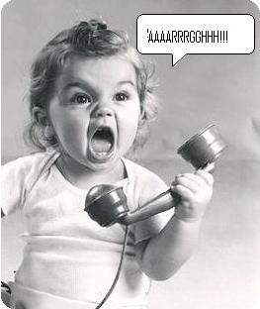
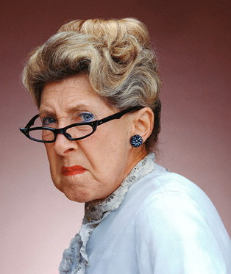
3. Improve your lead handling
Notes:
show them value
don't TRY and sell
show what they get AFTER they work with you, its about ensuring the client is satisfied with what you have done.

Slide 53
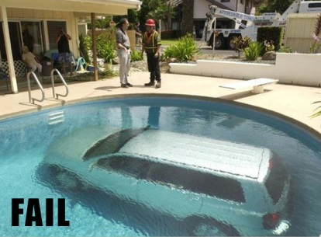
Wow! That’s a lot of money, we better make sure we get this right for you.
Notes:
Get it right!
To you £500 might not be very much for an instruction, but to the client it could be.
Ensure you get it right, don’t take their money or the size of the instruction for granted.

Slide 54

You don’t do this…. ……do you?
Notes:
Follow up on leads that come in.
We see many law firms spend time and effort on presenting a price to a prospect, then to find out this hasn’t been recorded in any form of CRM system.
Gather the information, store it and use it. Getting a client could take months, losing one could take minutes.

Slide 55
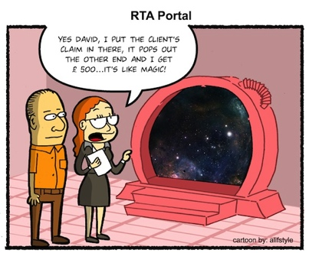

4. Improve your content marketing
Current news
Blogging
Google likes to see big sites get bigger slowly
Must be relevant to your intended audience
Notes:
Improve your legal content. People still like to read.
We have created various tips booklets for law firms. These are some of the most popular areas on their site.
If you make the content intriguing then people WILL read it.

Slide 56


9. Google Algorithm History Lesson
Oct-13 Penguin 2.1
Aug-13 Hummingbird
Jun-13 Payday Loan/Porn
May-13 Penguin 2.0
Originally Apr-12
Feb-11 Panda

Slide 57
SEO in early 2014
Let’s not “do an Irwin Mitchell?
Google Local is dominating localised keywords
No more links in press releases!
“Social signals” from Facebook, LinkedIn, Twitter etc are becoming vital
Mobile search is becoming more important i.e. people searching via smartphones
As important as email marketing to existing clients
Keyword research to develop “targeted” keyword lists is even more important
(not provided)
Need to worry about “link” sites, not just your site

Slide 58

Balanced SEO
Content
Social
media
Links

Slide 59
Page structure still important
Meta title
Page name
Body copy
H1 tag
H2 tag

Slide 60
Summary – What Could be Improved ?
Social Media – policy, output, who is on it in the firm ?
Website – Responsive, Google Analytics, SEO – What needs to be done
Canddi – Want to really know who is looking at you ?
Start creating real content, blogs & newsletters

Slide 61
What our clients said,
“Fantastic Service” 5*
“Perceptive, Creative and Professional” “Innovative and Responsive”

