Slide 1
Marketing + Efficiency + Money = Profit

Slide 2
Marketing + Efficiency + Money = Profit

Slide 3
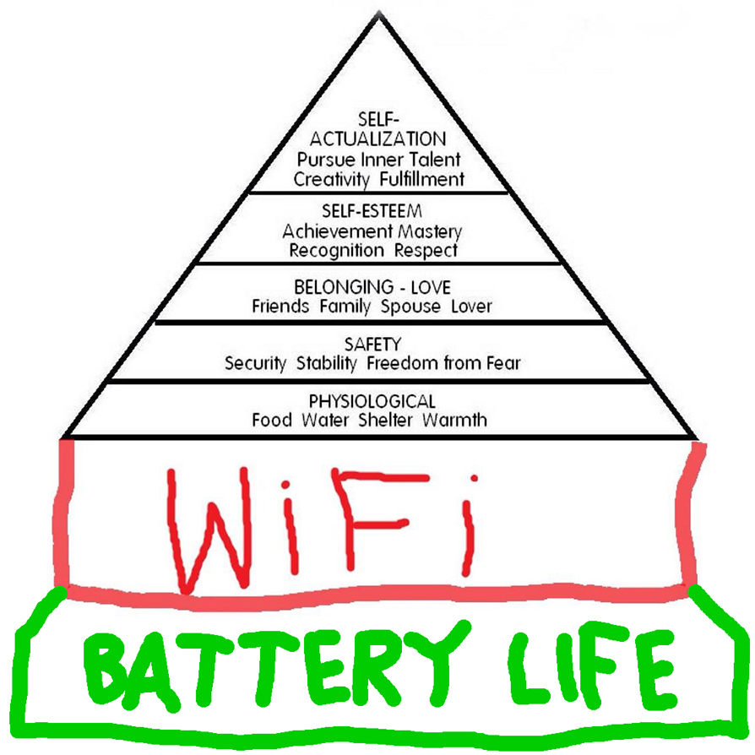

Slide 4







CRM

Slide 5
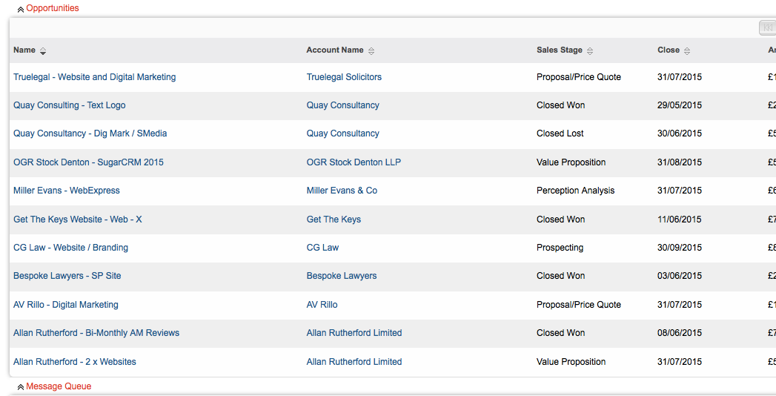

Slide 6
Do you have one?

Slide 7
Here’s what we do

Slide 8
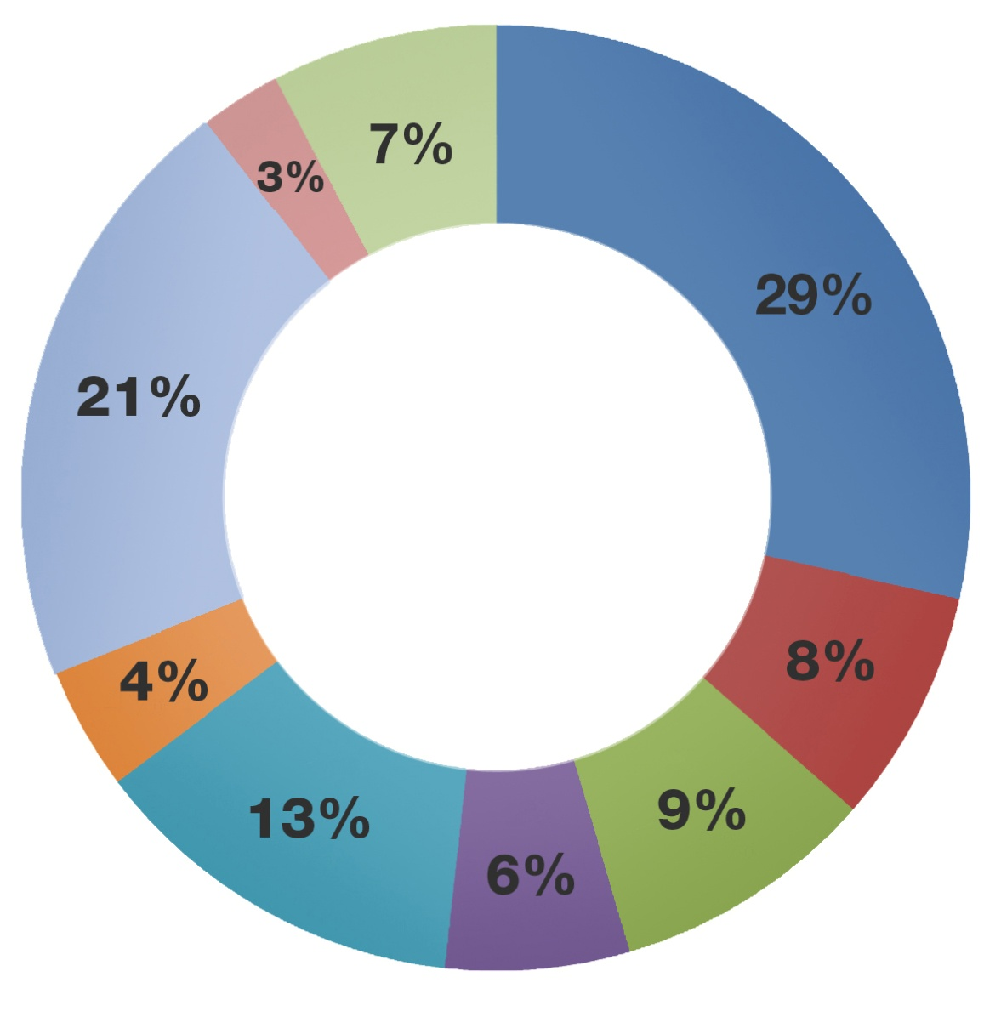
Client Surveys - Why did you instruct us?
Advertising
Recommendation
Cost
Location
Ease of Communication
Character of firm
People
Existing Client
Other
Source = LawNet
Notes:
50% of clients choose to instruct our firms because either they have used the firm before (29%) or because they have been recommended to them (21%).
This statistic illustrates the importance of getting your client service right.
In order to secure that repeat business or recommendation you need to invest in looking after your existing clients and providing them with a high quality experience.

Slide 9


Value of Mystery Shopping
 | Website Ease of Use (4) | Email Enquiry Direct to Fee Earner (18) | Contact through the Website (18)
30 partners | 4 | 0 | 13
16 partners | 4 | 15 | 0
18 partners | 4 | 12 | 14
10 partners | 4 | 11 | 13

Slide 10
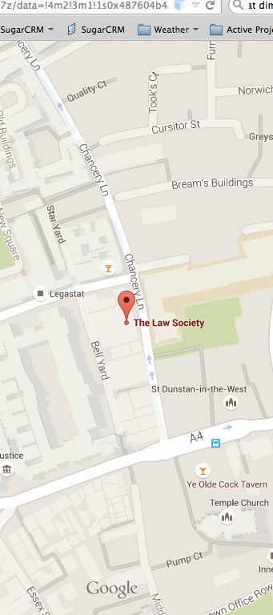


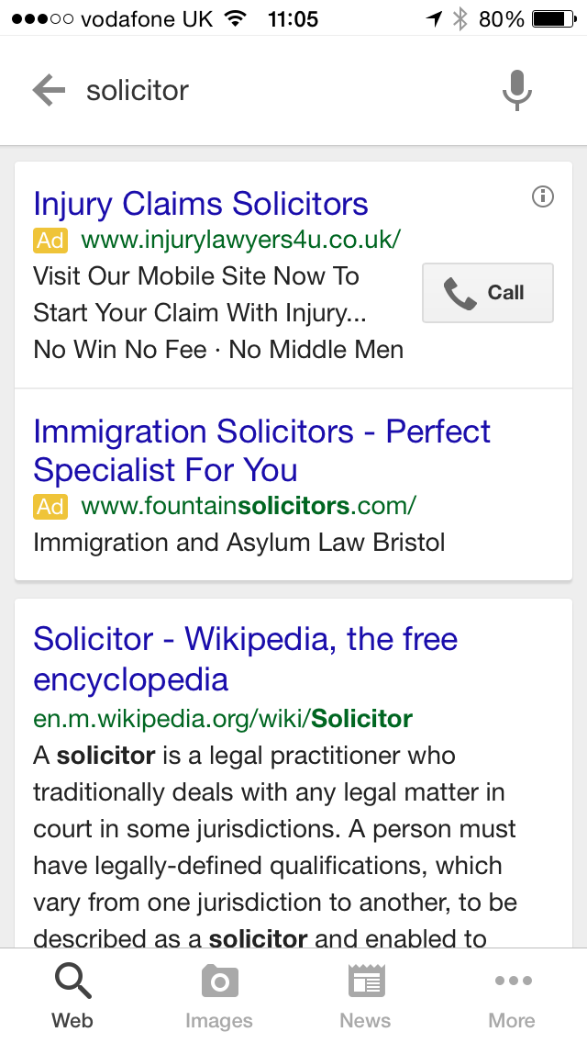
Local
Mobile
Video

Slide 11
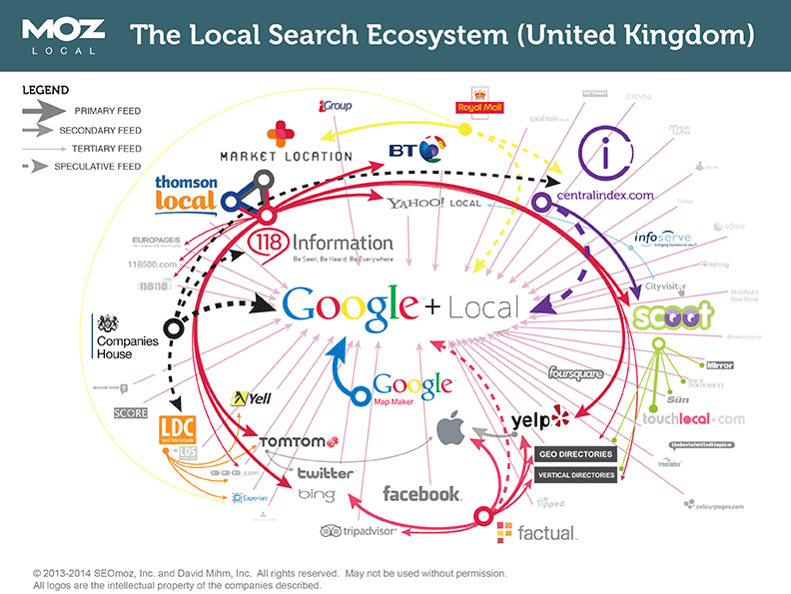

Slide 12
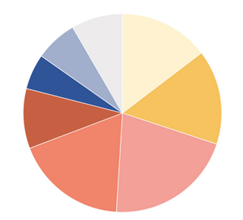
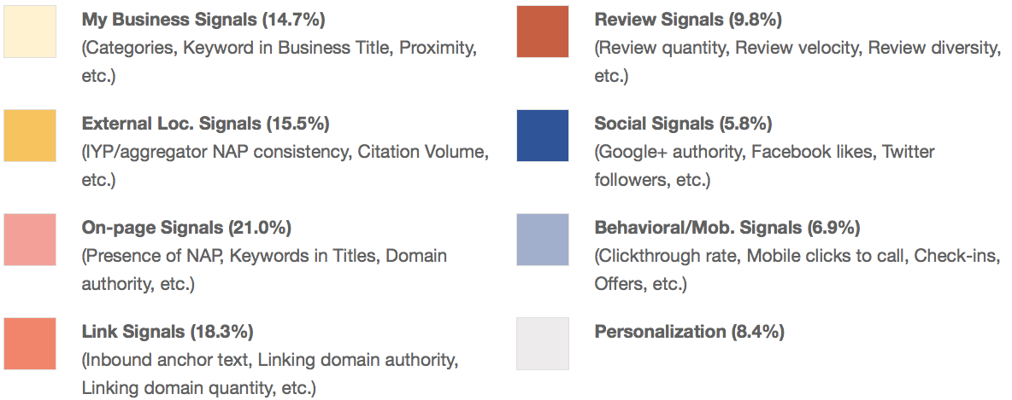
Moz - 2014 Local Search Ranking Factors
8.4%
14.7%
6.9%
5.8%
15.5%
9.8%
18.3%
21%

Slide 13
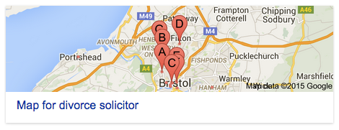
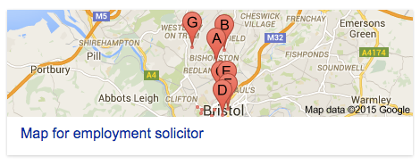
Different search radius per keyword

Slide 14
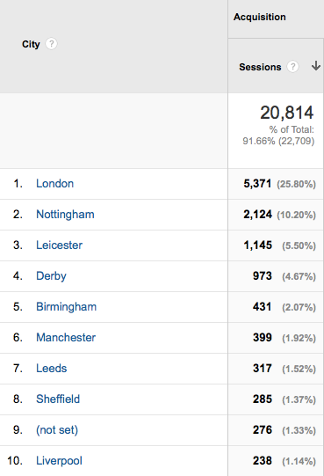
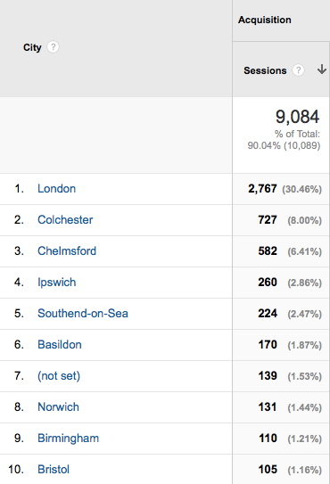

Slide 15
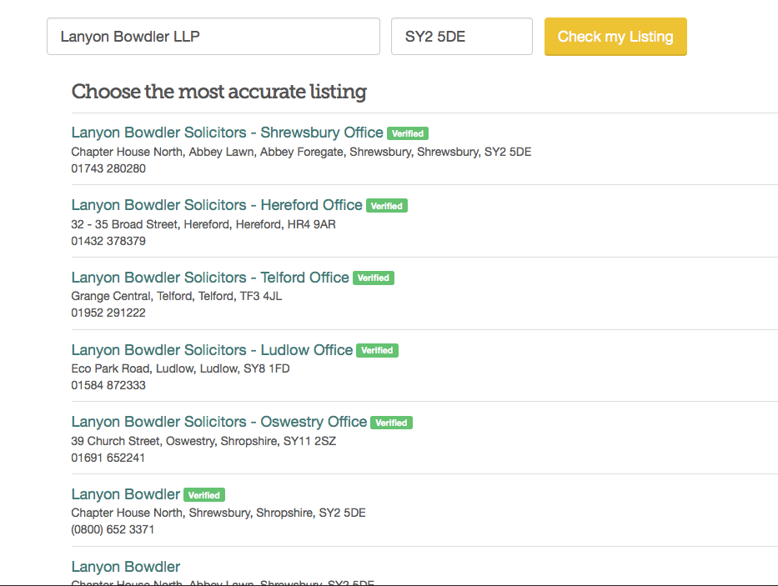


Slide 16
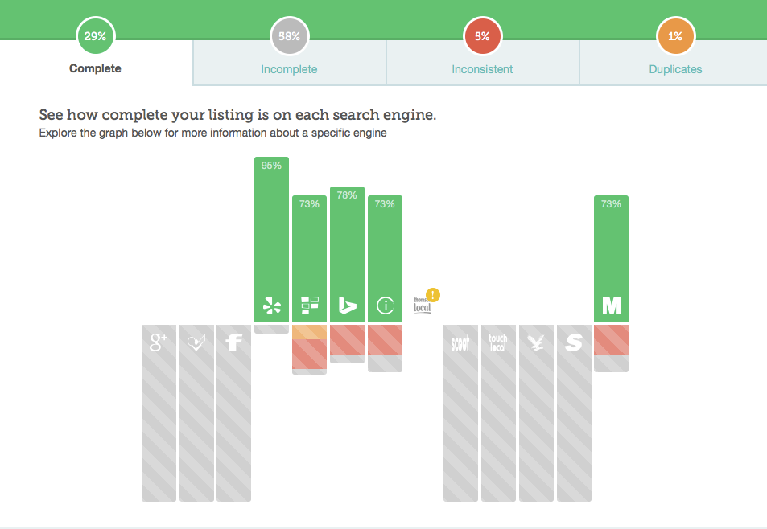





Slide 17
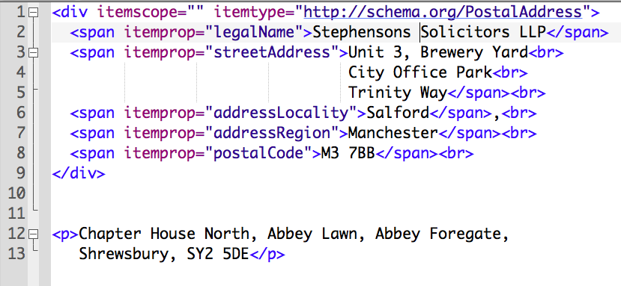
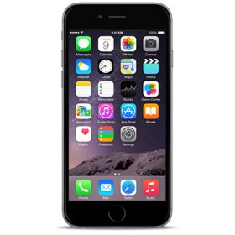
Schema data

Slide 18


Reviews & Social Care
Social medialand = 76%
Review sites (80) = 77%
Survey of 800 law firms (3-50 partners)
  81% had a Google My Business page
  5% had any reviews

Slide 19

Mobilegeddon + 62 days

Slide 20

14 sensors…yes FOURTEEN!
Accelerometer
GPS
Gyroscope
Wifi
Magnetometer
Bluetooth
Barometer
Microphone
Proximity
NFC:Near Field
Light sensor
Camera: Front
Touch screen
Camera: Back

Slide 21

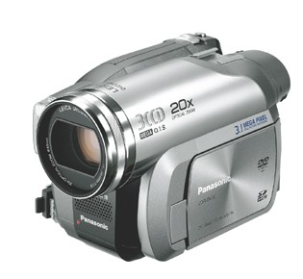
What is the likely impact on your website?

Slide 22
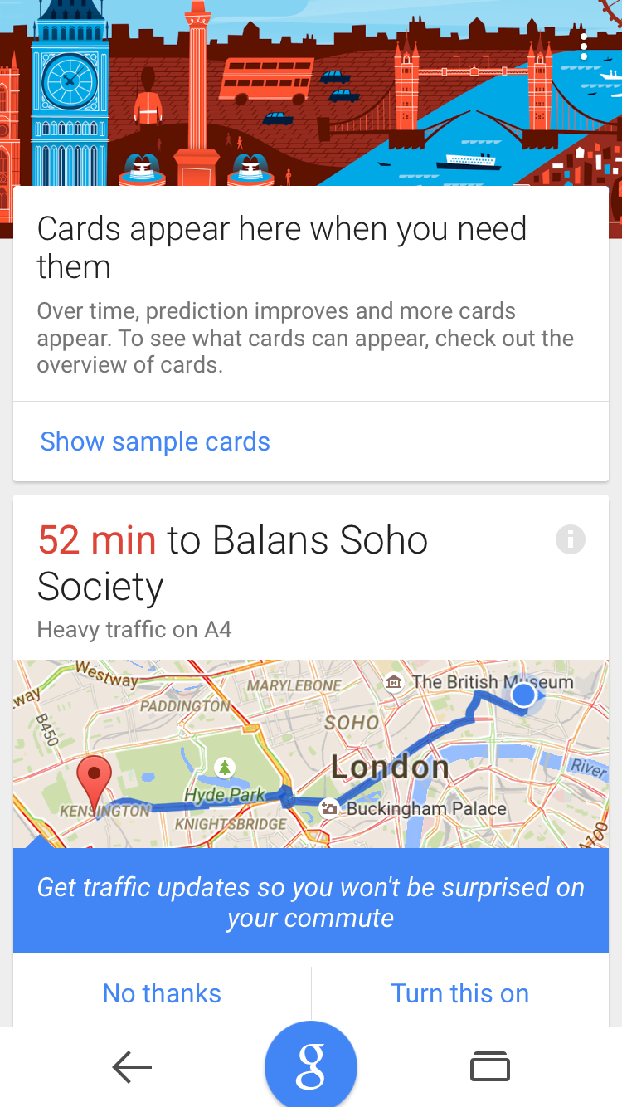
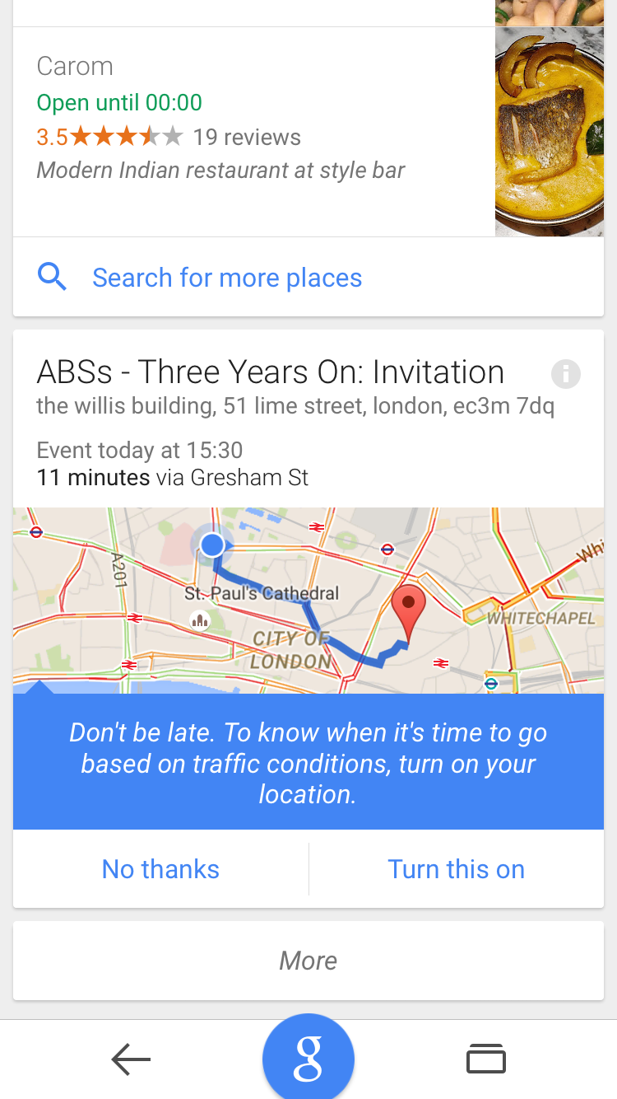
Google Now – anyone tried it/use it?

Slide 23
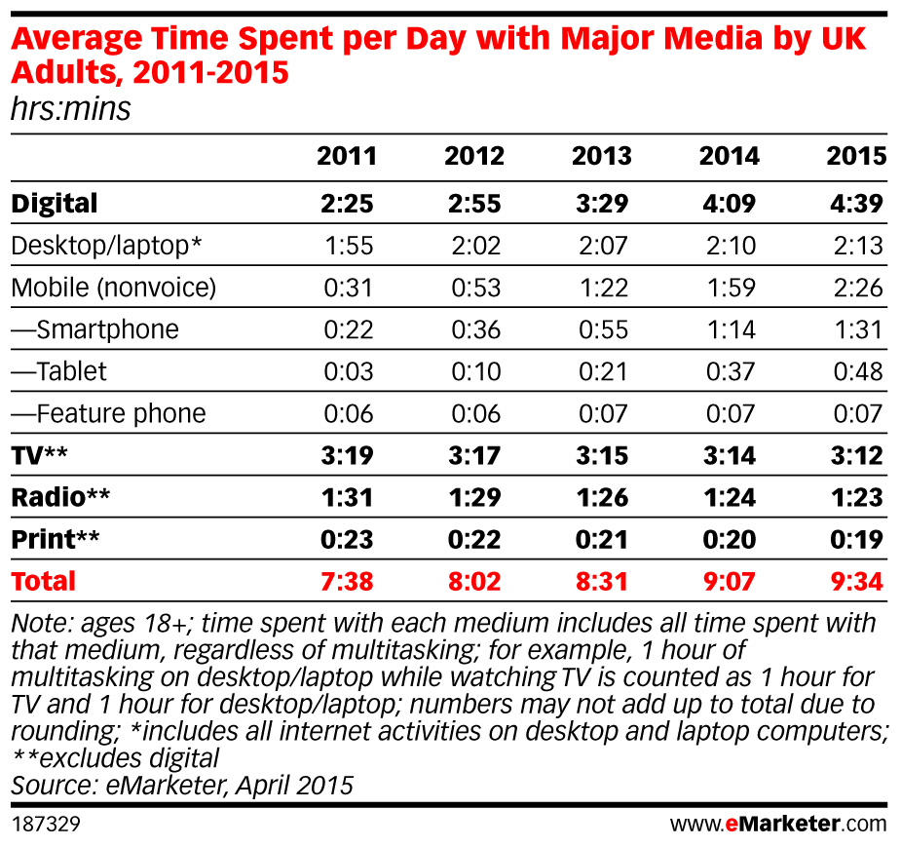
Wow…what a shift in usage amount & device!

Slide 24
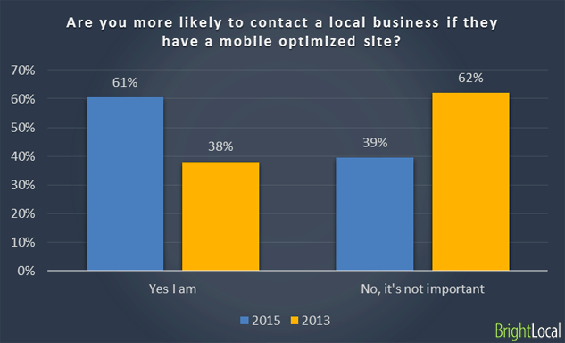
Will they contact you?

Slide 25
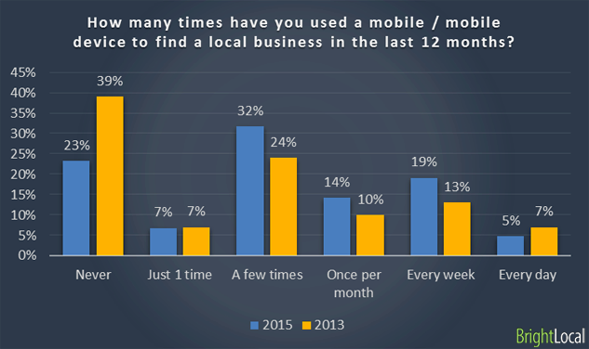
38% searched at least 1 time per month on mobile

Slide 26
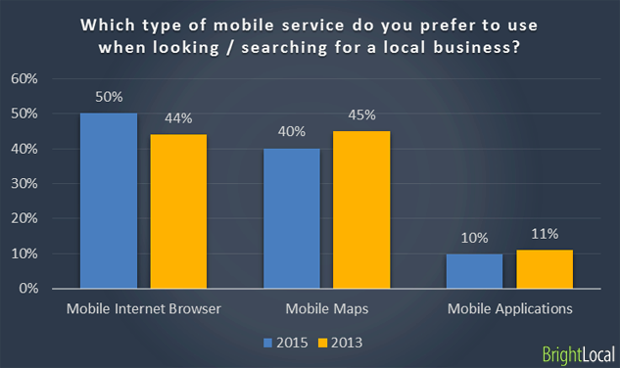
50% use a browser. 40% use maps

Slide 27
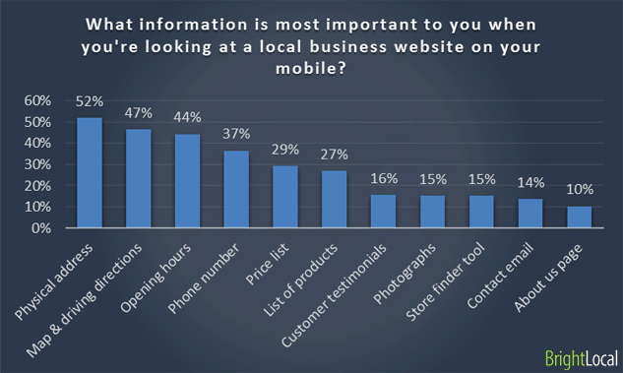
What information are they looking for?

Slide 28



Slide 29
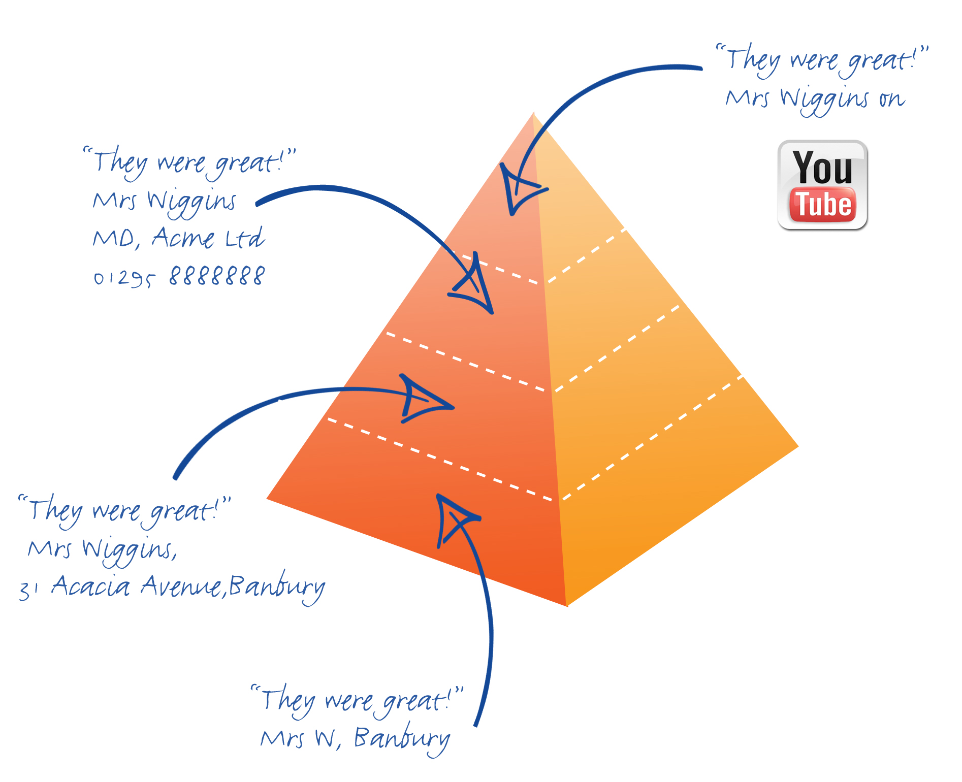
How video helps “The Hierarchy of Belief”

Slide 30
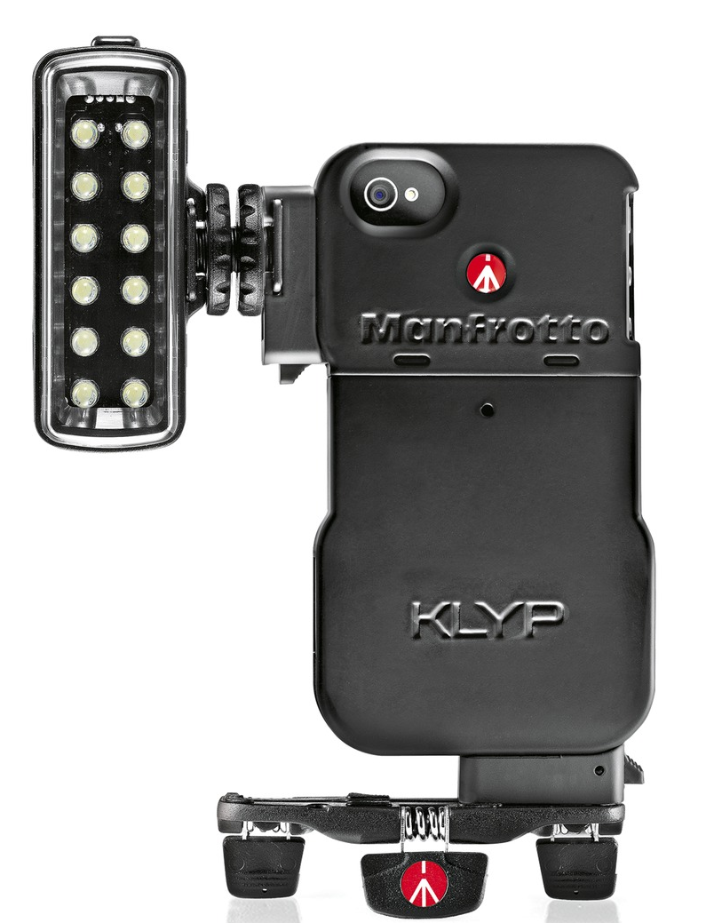

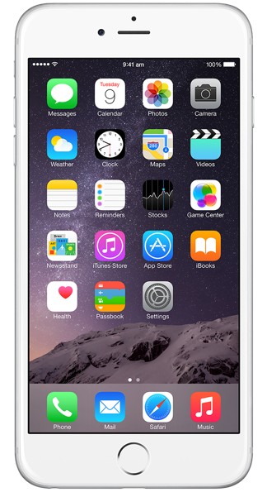
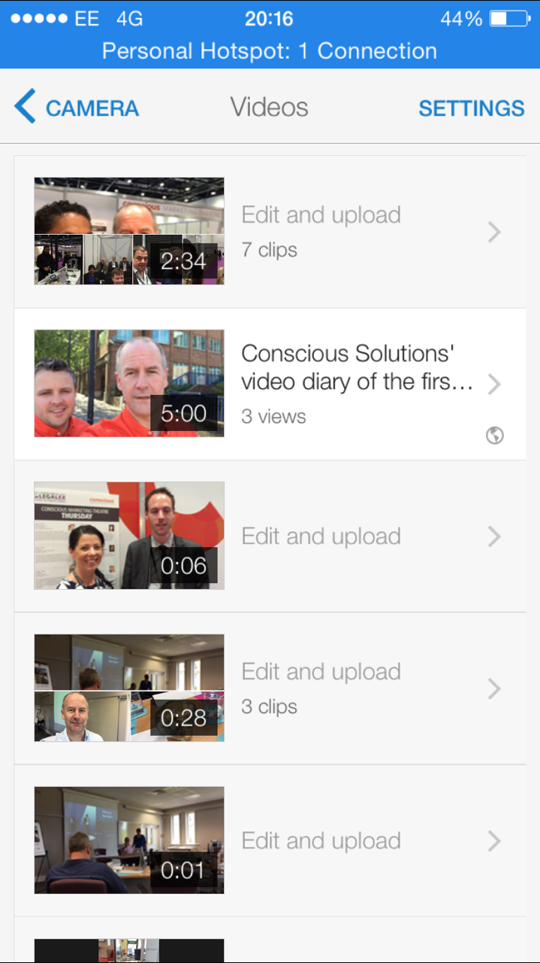
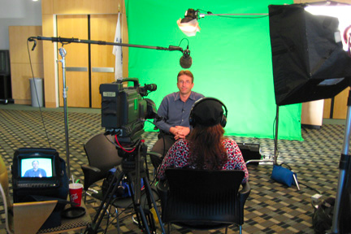
So how do we make a video David?

Slide 31
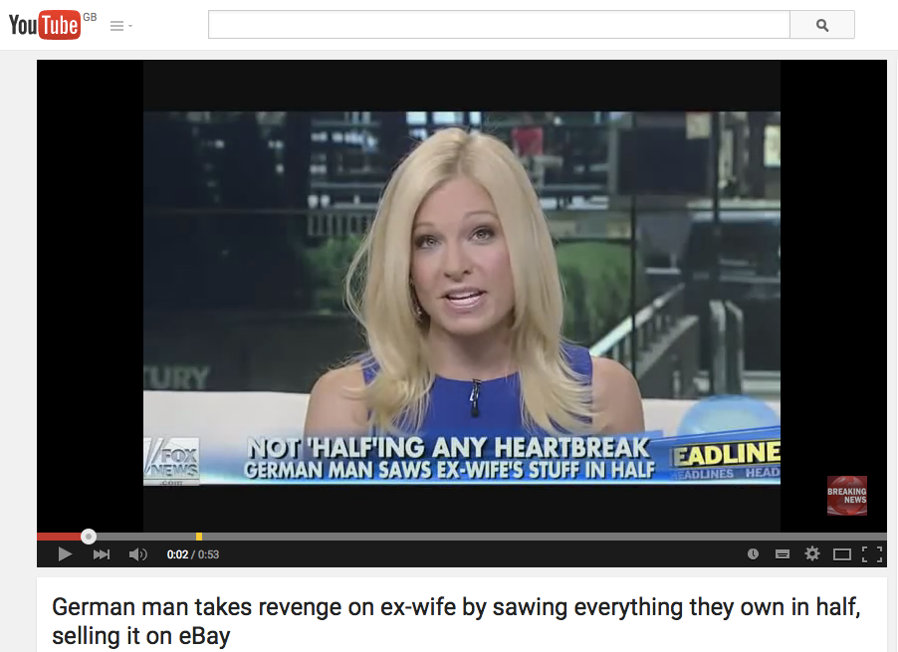
LegalFutures

Slide 32
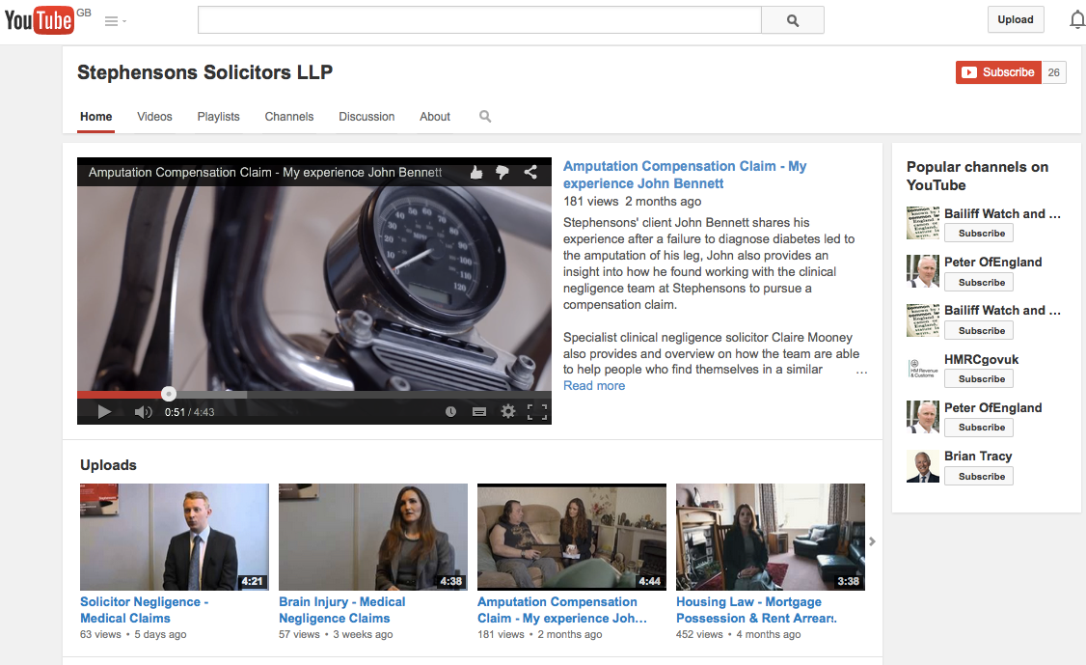
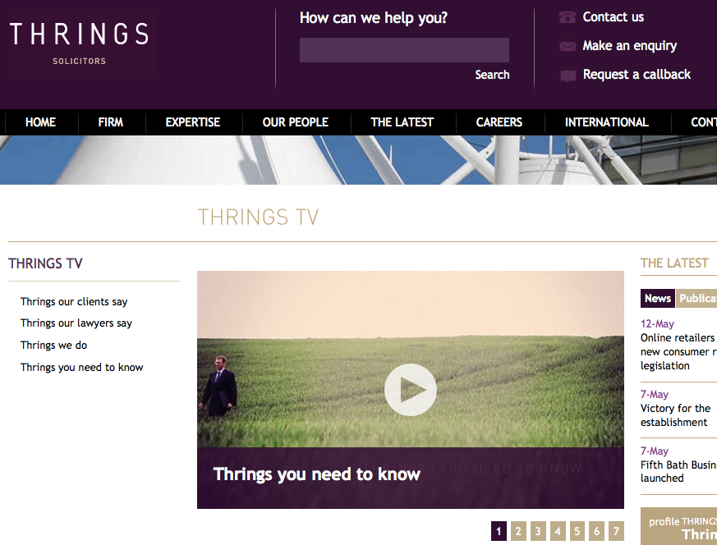
So, who’s doing it well?

