Slide 1
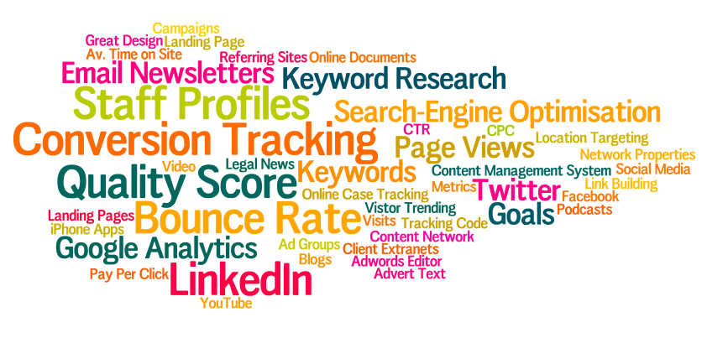
Lead Generation & Marketing Efficiency

Slide 2
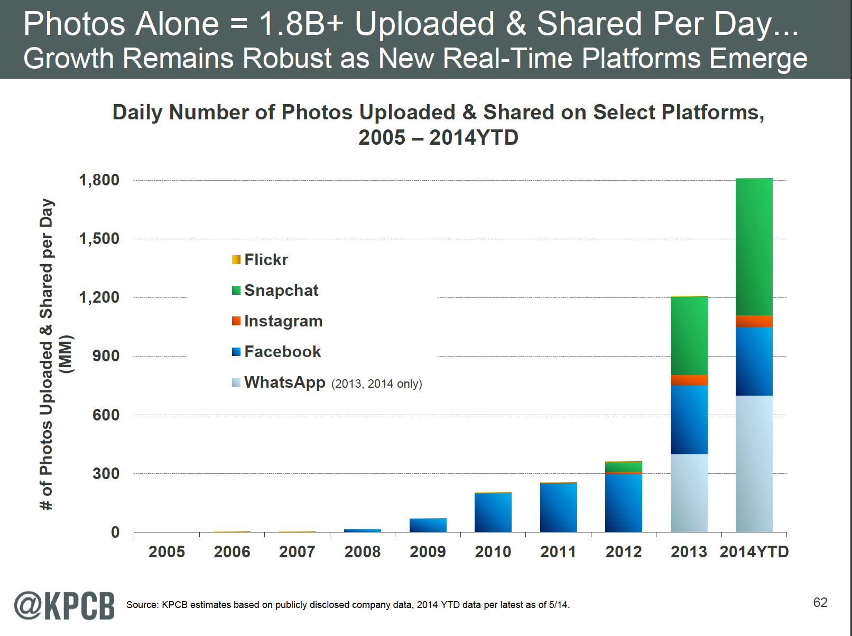

Slide 3
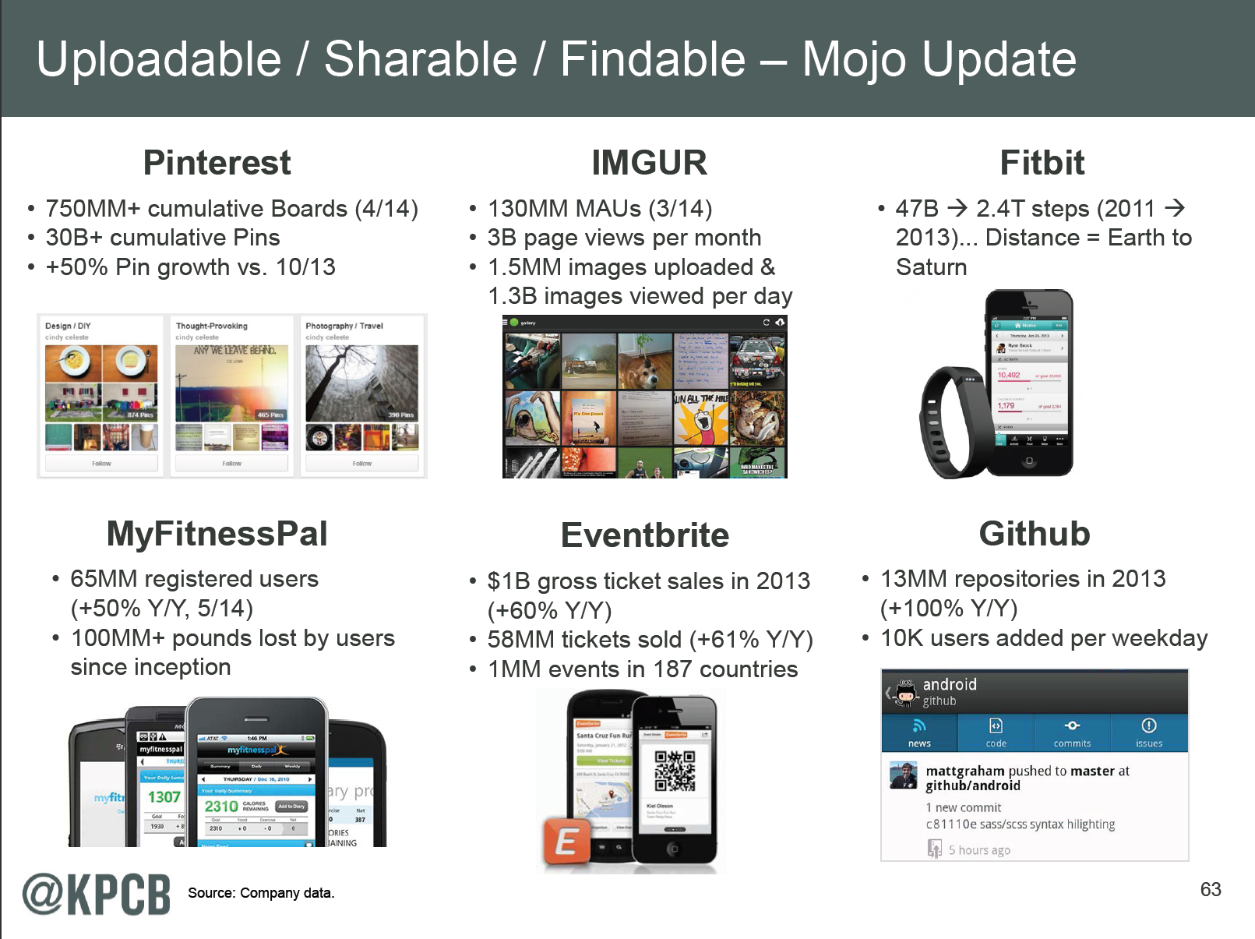

Slide 4
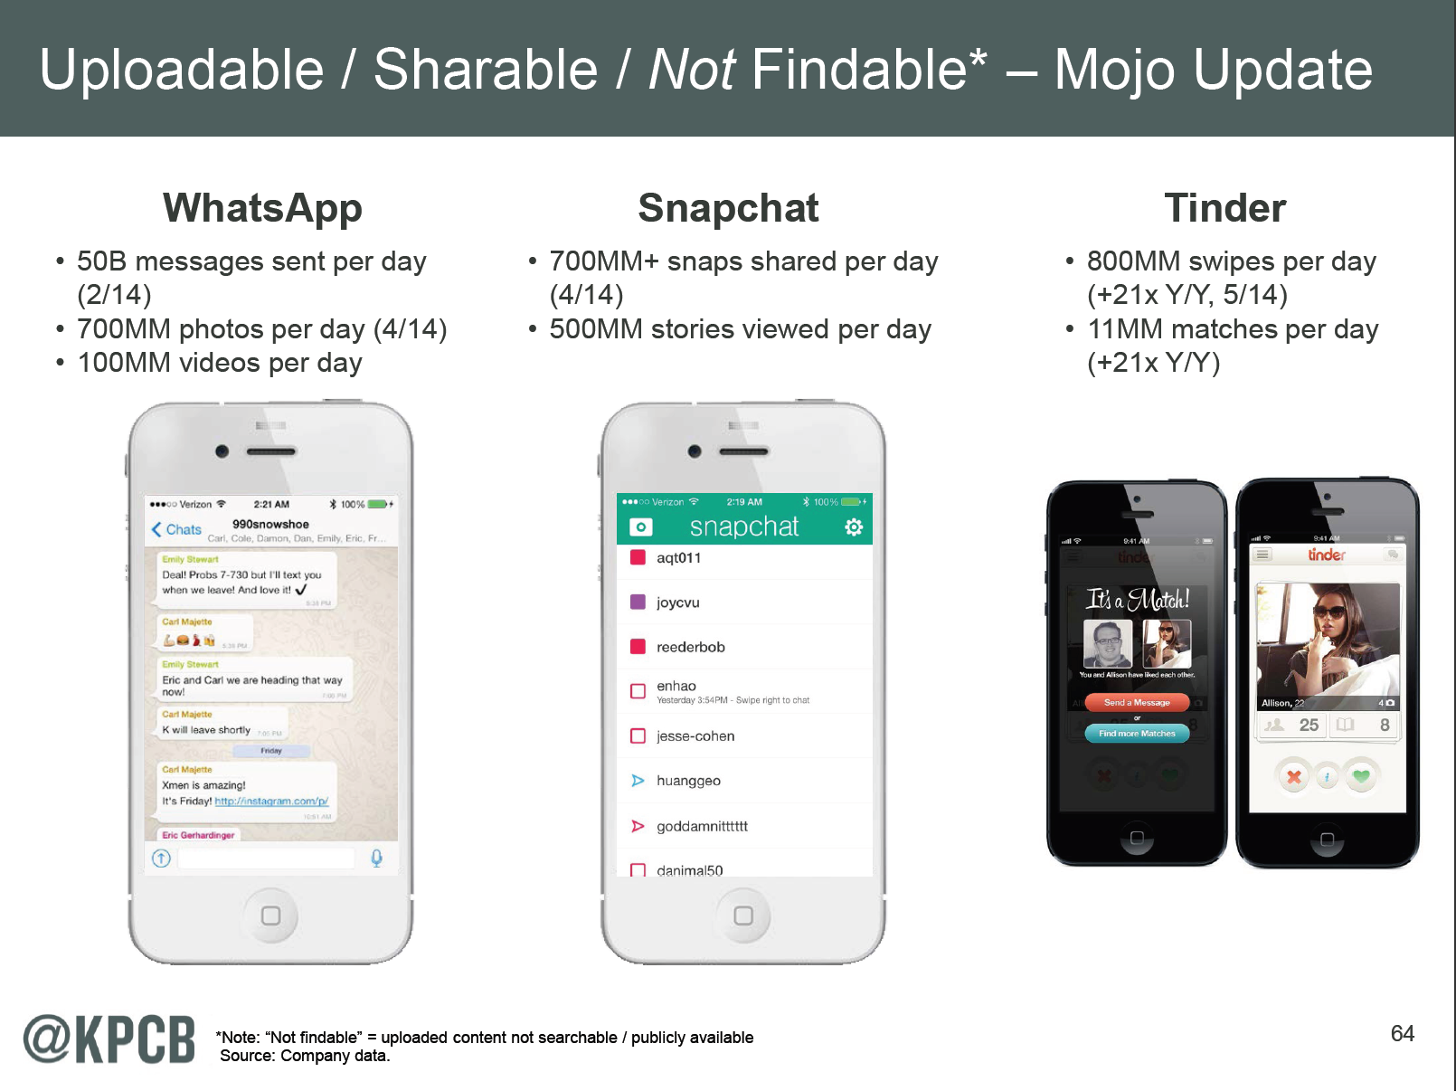

Slide 5
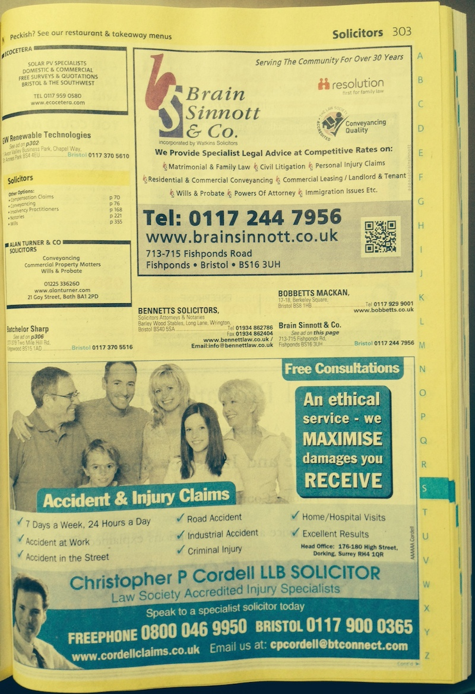
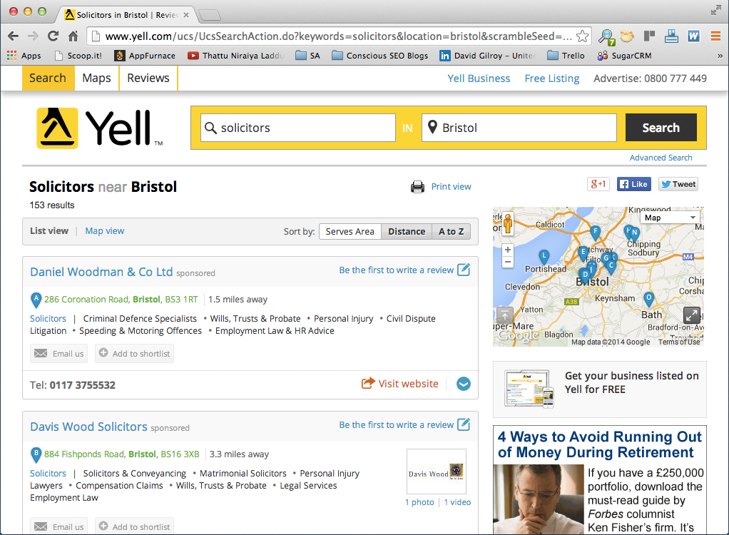
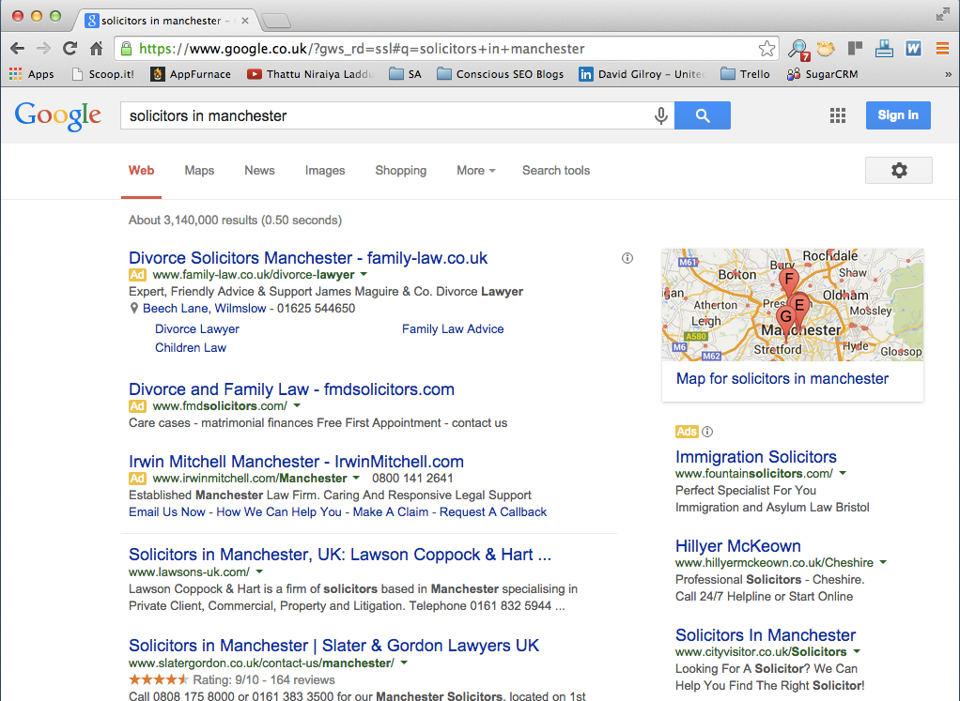


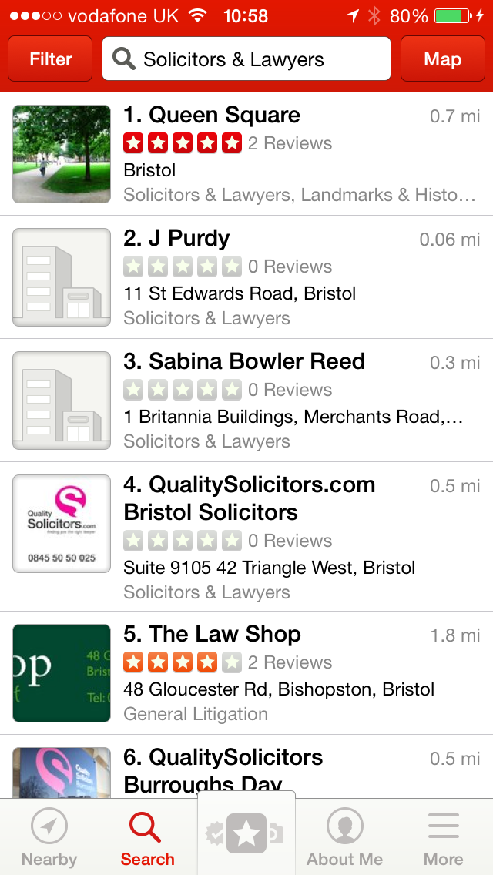
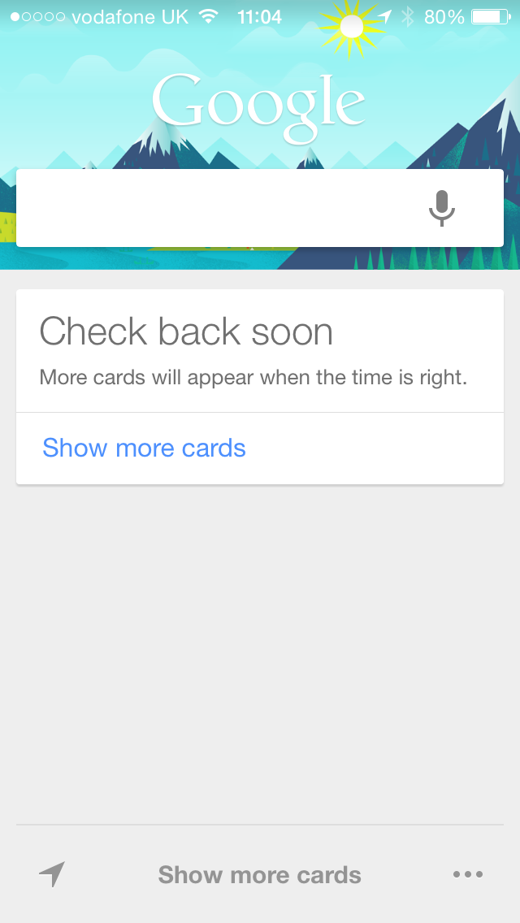
Then -> Now

Slide 6

Exercise
Get our your phone
Search for “solicitor”
Scribble down the steps you took to do it

Slide 7
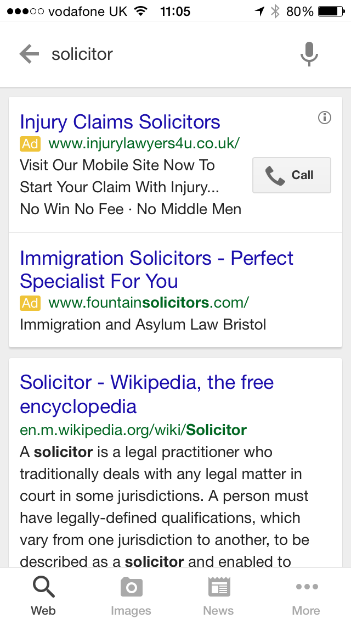
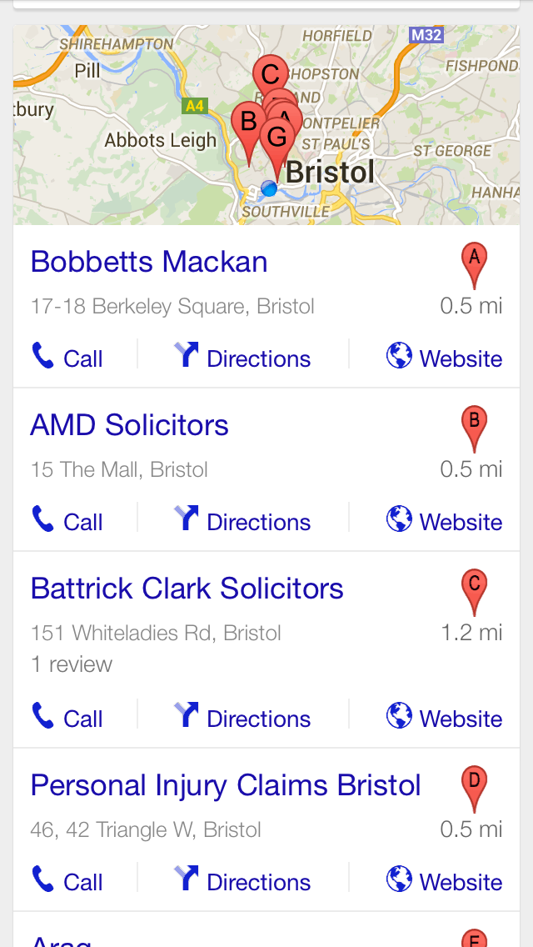
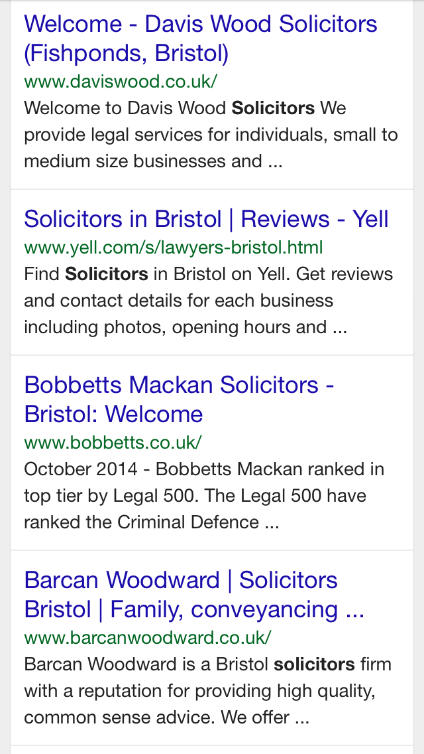
It gets worse

Slide 8

Why PPC?
PPC =

Slide 9
People Don’t Click On Ads
94% of searchers click on the organic results vs. 6% on the PPC ads
  e.g. “Bin collection day”, “Prince George”, “Weather in London” & “Directions to Excel”
65% of “high commercial intent” searches click on PPC ads vs. 35% for organic results
  e.g. “50L Brabantia bin bags”, “George commemorative mug”, “Ladies Burberry raincoat” & “Hotels near Excel”
(Source: GroupM & Econsultancy 2012 & Wordstream 2012)

Slide 10
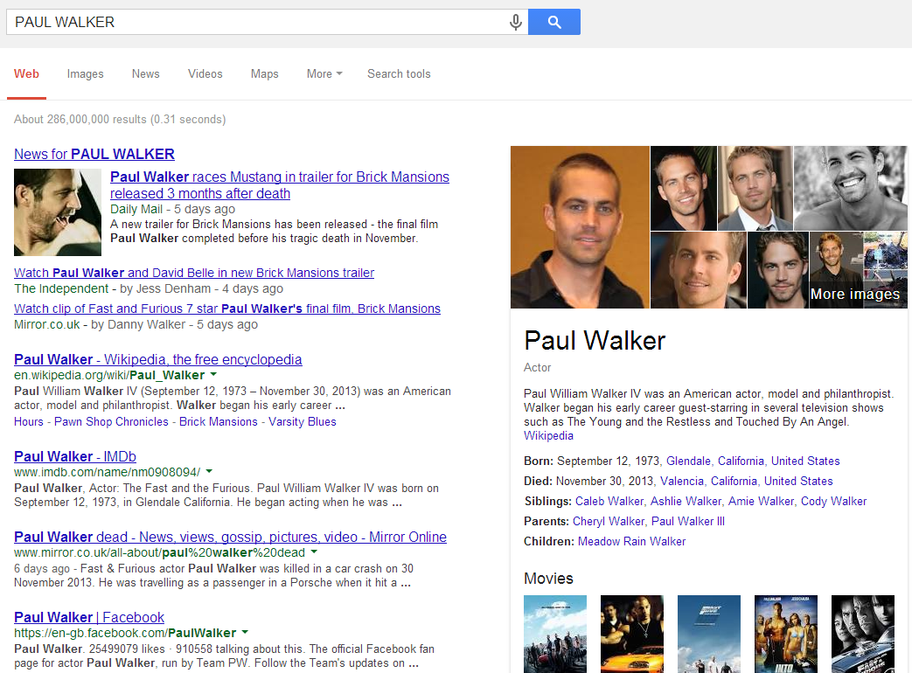
Q. Top Search Phrase of 2013?

Slide 11
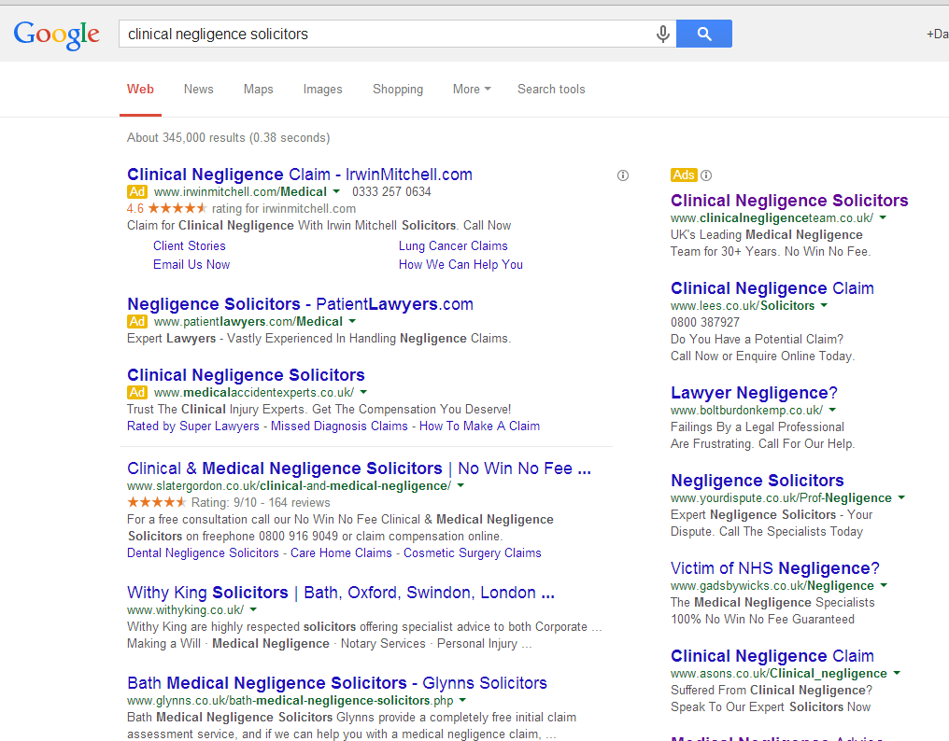
64.6% of Commercial Search goes PPC

Slide 12
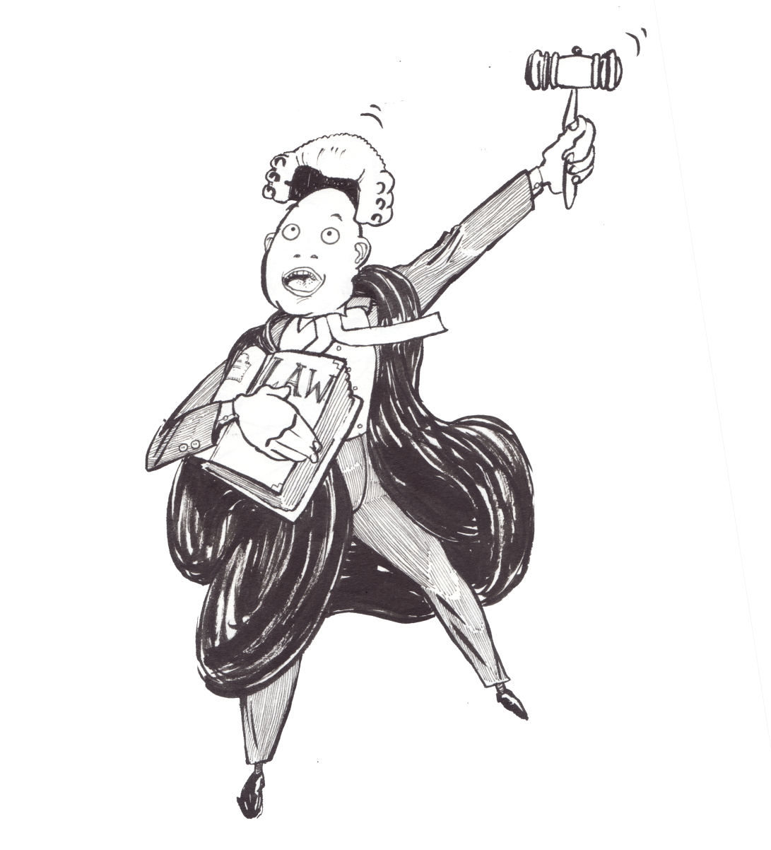
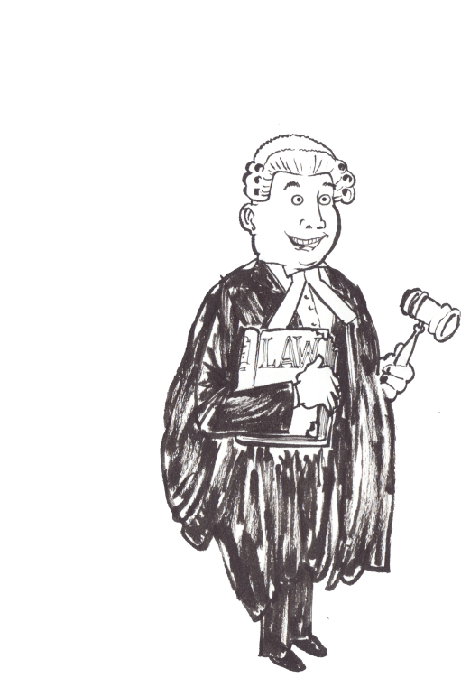
13 Top Tips for
Legal ROI

Slide 13
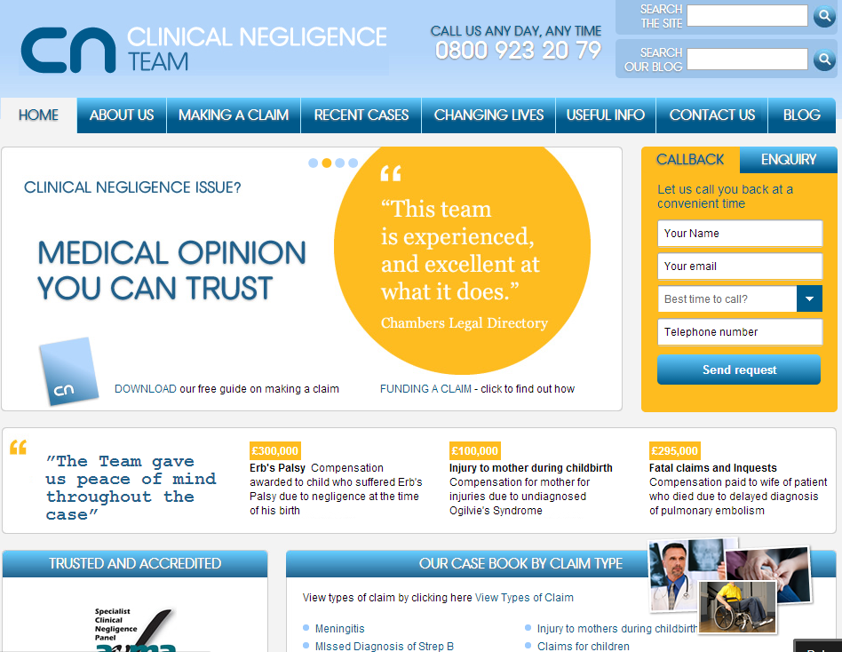
1. Get a great website

Slide 14
2. Be Fussy - Play to Your Firm’s Strengths
Regional
“Clifton Solicitors”
“Divorce Solicitors in Greenwich”
Generic
Specialist
“UK Solicitors”
“Intellectual Property Solicitors”
National

Slide 15
2. Be Fussy – Target Action Orientated Search
Solicitor X spent £29,277 on 51 leads - March 2013 to April 2014
Lead Generation Phrases
Top 10 Cost Phrases
claim against the nhs
cauda equina solicitors bristol
solicitors dealing in misdiagnosis bradford
medical negligence solictors
solicitors for medical neglagence fareham
medical negligence against the nhs
medical negligence solicitors in burnley
cheap solicitor for medical neglichance
medical negligence claims
solicitor to sue hospital
cauda equina syndrome
third degree tear
misdiagnosis of cancer
necrotising fasciitis
3rd degree tear
cancer misdiagnosis
4th degree tear
birth injury signs
mrsa infection
claiming from nhs

Slide 16
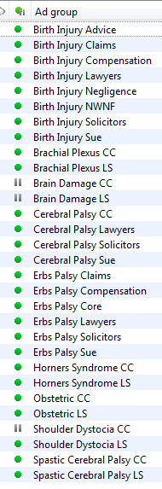
3. Get Granular: Campaigns, Ad groups & Keywords
Client X has campaigns to cover:
Generic search phrases
Regional targeting
Specialist service areas
Campaigns
Each campaign contains 30+ ad groups
All relevant search areas covered
Ad groups
Tight keyword clusters in ad groups
Exact match wherever possible
Use Broad Match Modified if necessary but with monitor for negative keywords
Test 2+ relevant ads per ad group

Slide 17
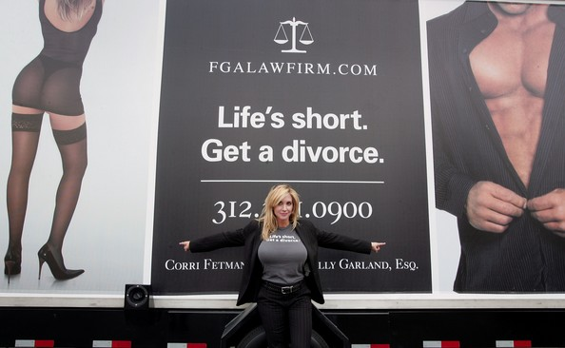
4. What are you going to advertise?

Slide 18

4. Brainstorm Advertising Topics

Slide 19
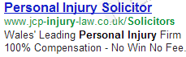
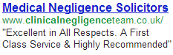
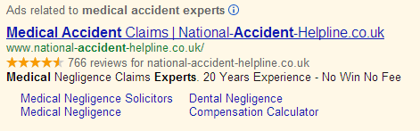
4. Three options + examples
Locations
Client Quotes
Sitelinks & Reviews

Slide 20
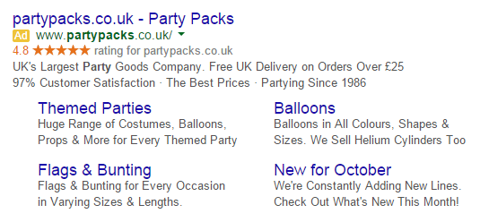
4. Use Ad Extensions
Seller Ratings
30 unique reviews within a 12 month period, average rating of 3.5/5 or more
Call Out Extensions
Highlight additional aspects of your business and add another line of text to your ad
Enhanced Sitelinks
Add two additional lines of text to each sitelink, shows when ad is in #1, gives ads greater presence on search results page

Slide 21
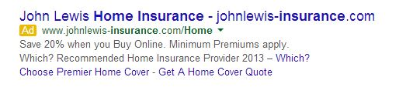
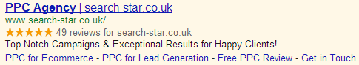
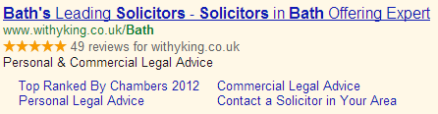
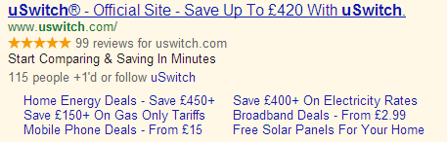
5. Google is going Social

Slide 22
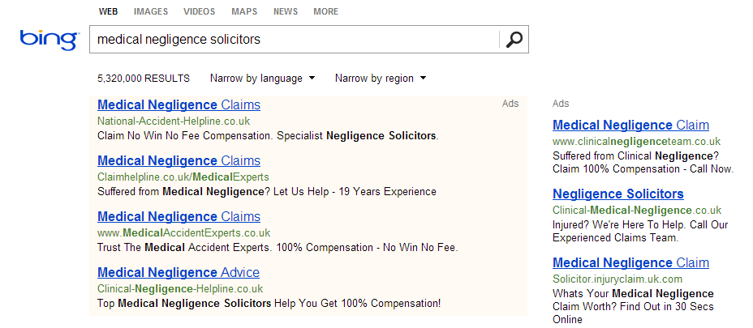
6. Don’t forget Yahoo & Bing
Source: Legal Client X,Y & Z Jan-Sep 2013

Slide 23
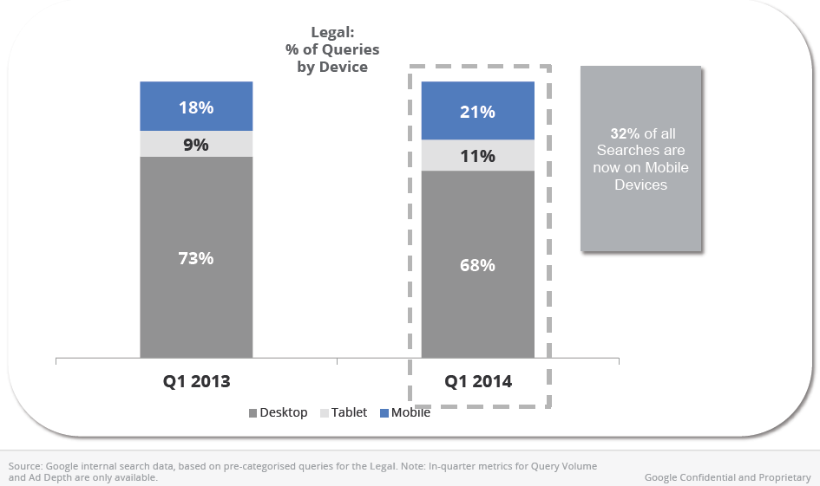

7. Think mobile

Slide 24
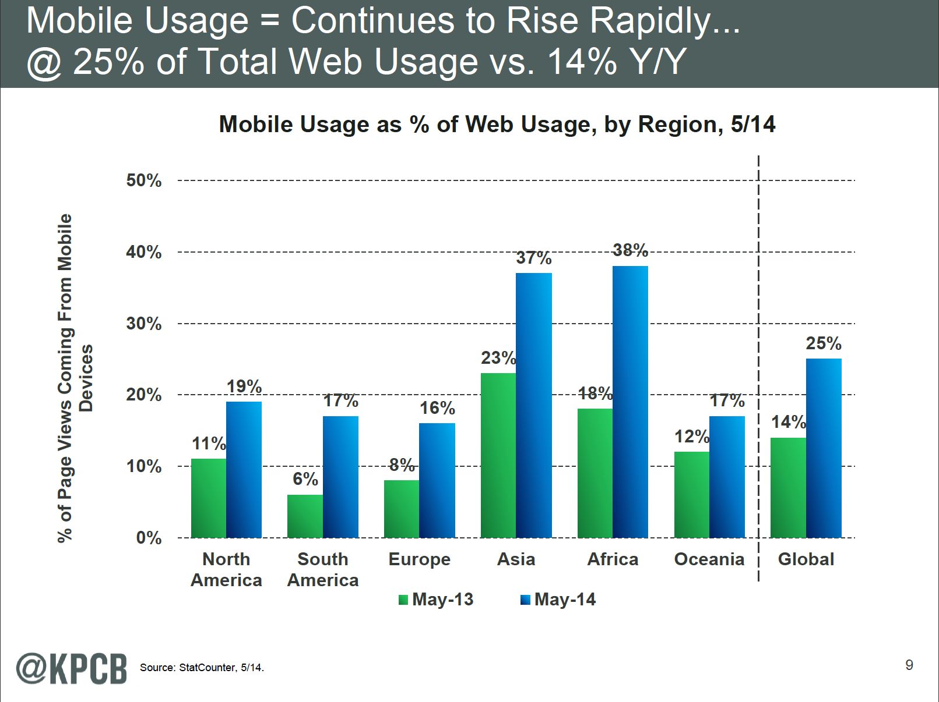
7. Global mobile usage

Slide 25
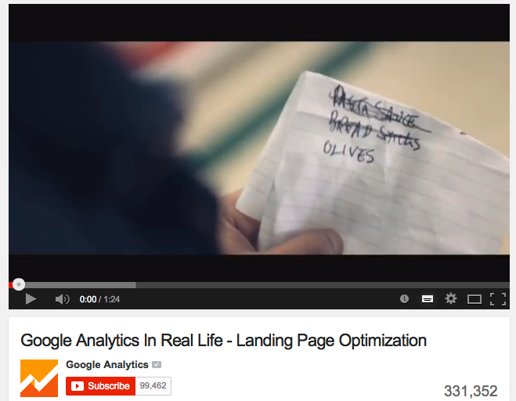
8. Google Adwords Remarketing

Slide 26
8. Do Remarketing
User navigates to your site
User becomes a customer
User lands on site
User added to remarketing audience
Remarketing ad shown to user
User clicks on remarketing ad
User browses other sites

Slide 27
8. Remarketing Audiences
Target people that have left the site without making contact
Segment audiences & ad messages by contact looked at
90 day cookie split into multiple audiences of varying cookie length

Slide 28
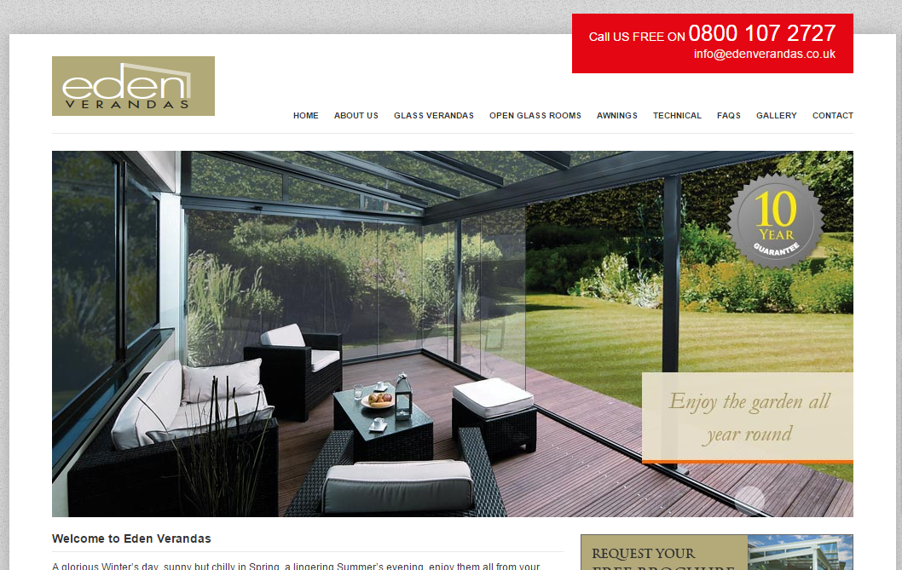

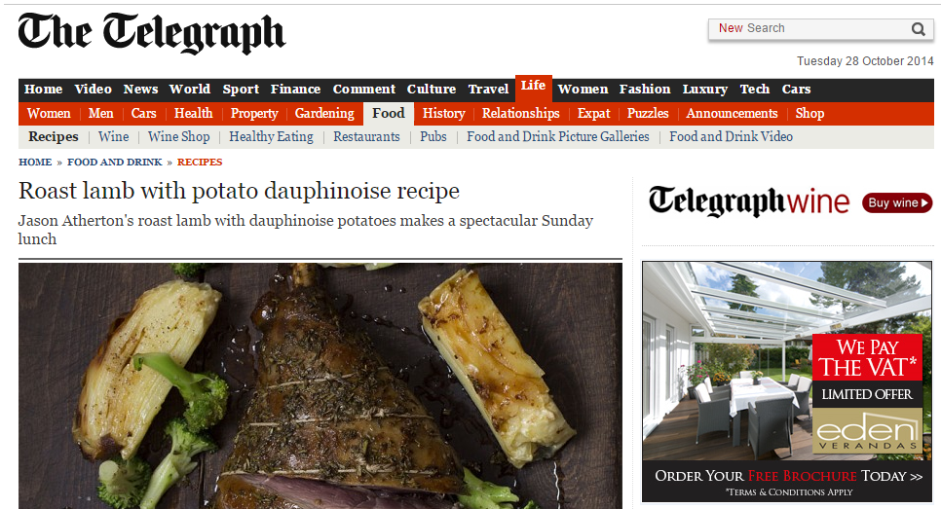
8. Remarketing Image Ads
Image Ad
Website
Reflect the branding of your site
Include a call to action

Slide 29


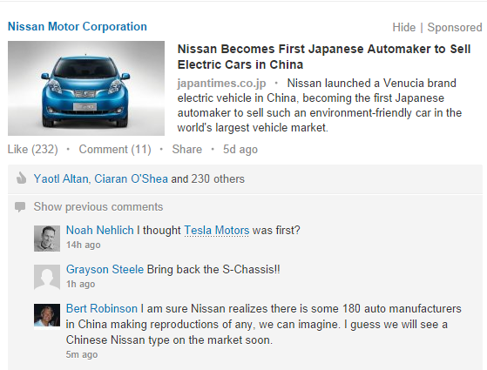


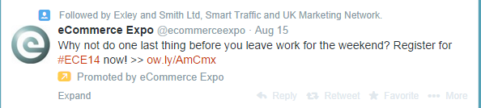
9. Social Advertising

Slide 30
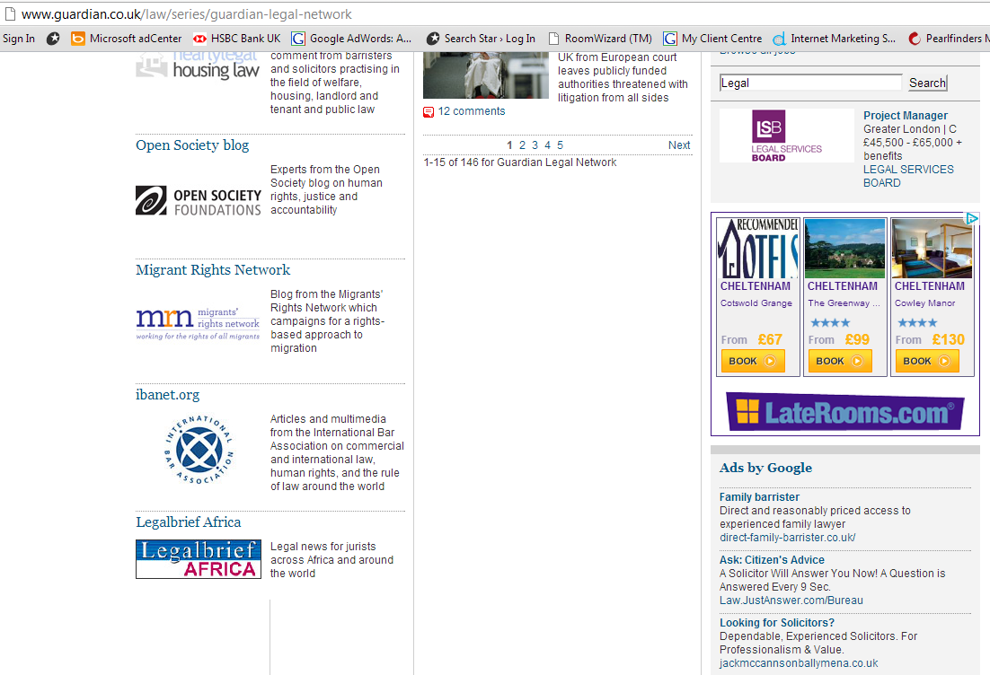
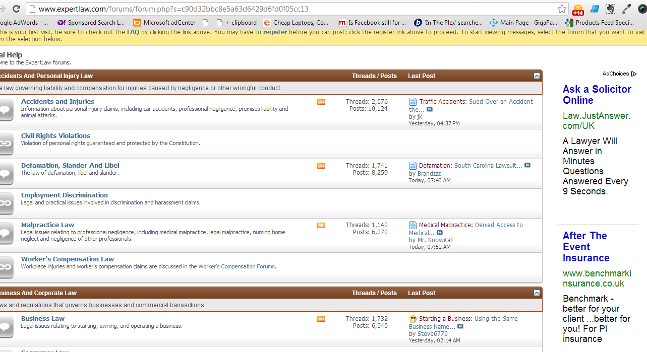
10. Content & Display - Beware

Slide 31
11. Track Everything
Set up goals & campaign tracking
Use Google Analytics
Understand the full value of Mobile
  Cross device tracking
  Phone numbers, forms, walk-ins etc.

Slide 32
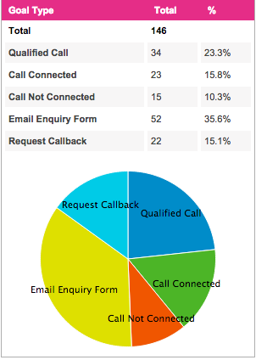
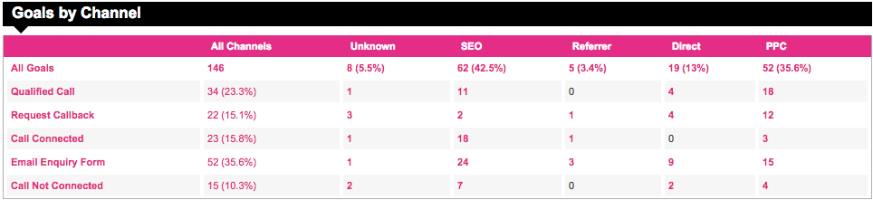
12. Trackability

Slide 33
13. Achievable Cost Per Lead?
Personal
“Solicitor in xxx”: £25-£100 per lead
“Divorce Solicitors in xxx”: £50-£200 per lead
“Will dispute solicitor”: £70-£230 per lead
Negligence
Medical: £60-£200 per lead
Birth Injury: £150-£600 per lead
Professional: £80-£300 per lead
Commercial
£60-£200 per lead
Source: Search Star clients 2014

Slide 34
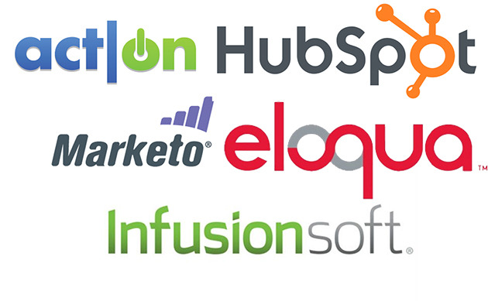

Marketing Automation

Slide 35
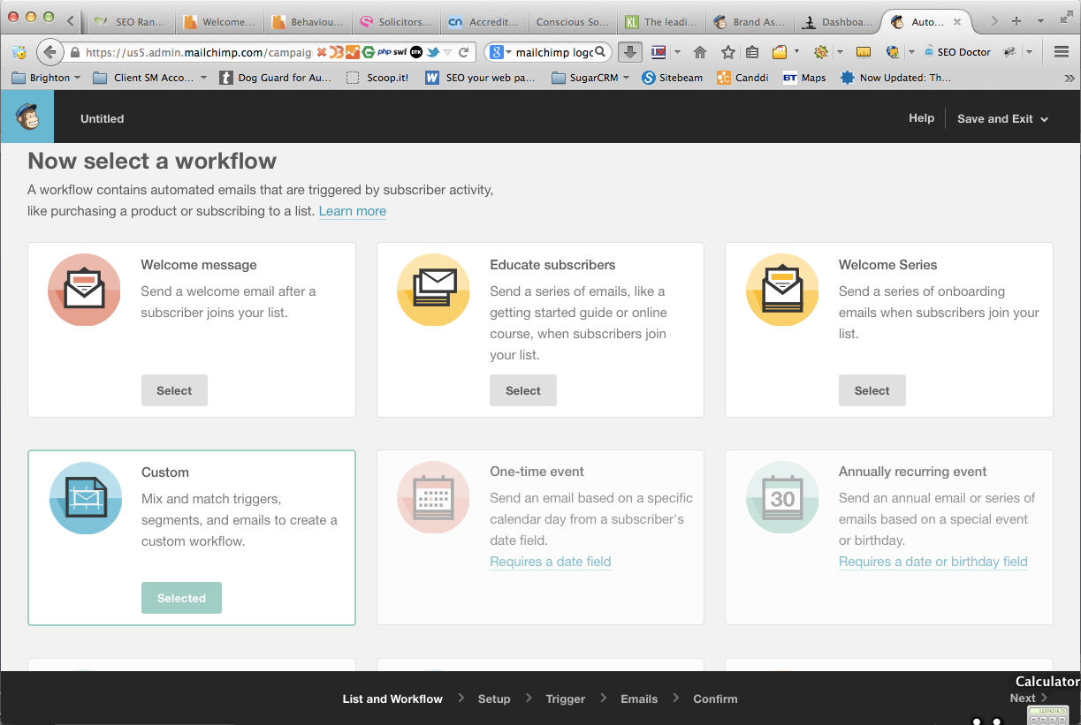

Slide 36
Brainstorm Email Workflows

Slide 37
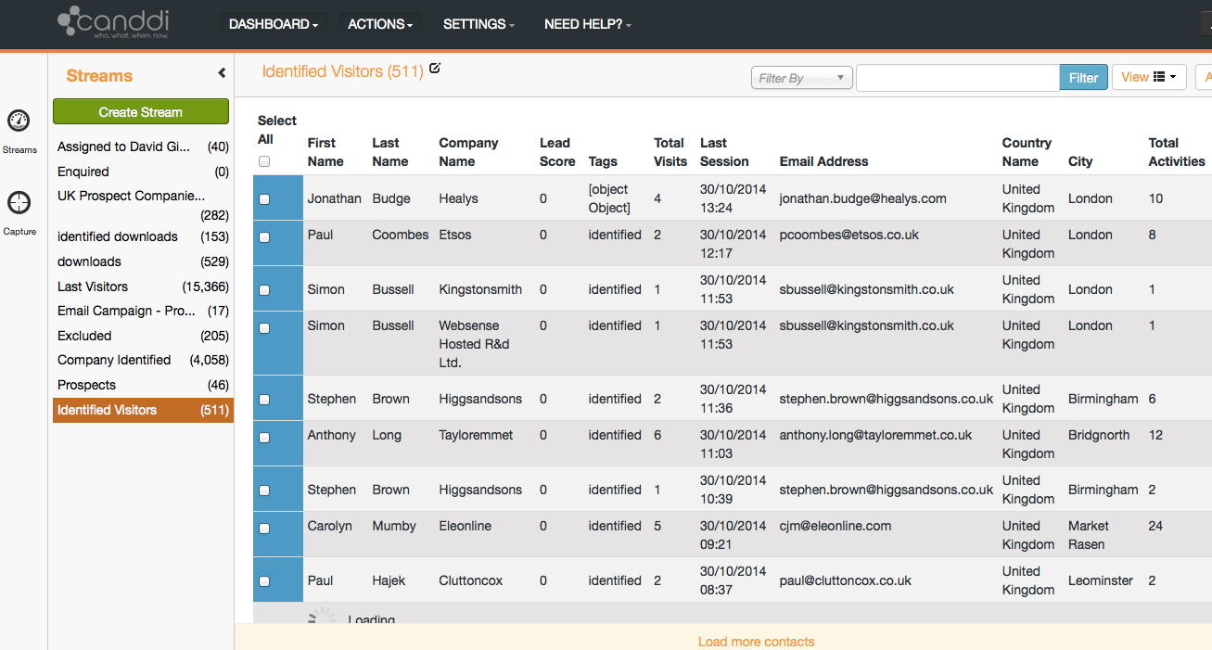
Canddi Tracking & Process

Slide 38
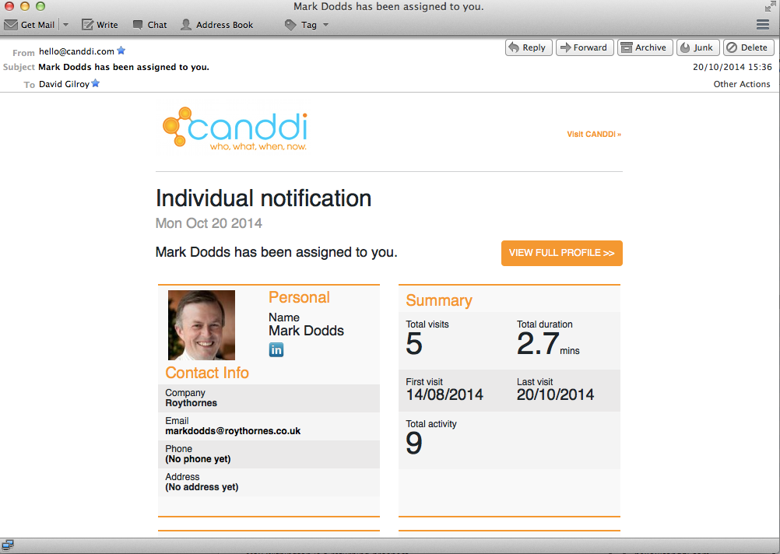
Alerting on assignment

Slide 39
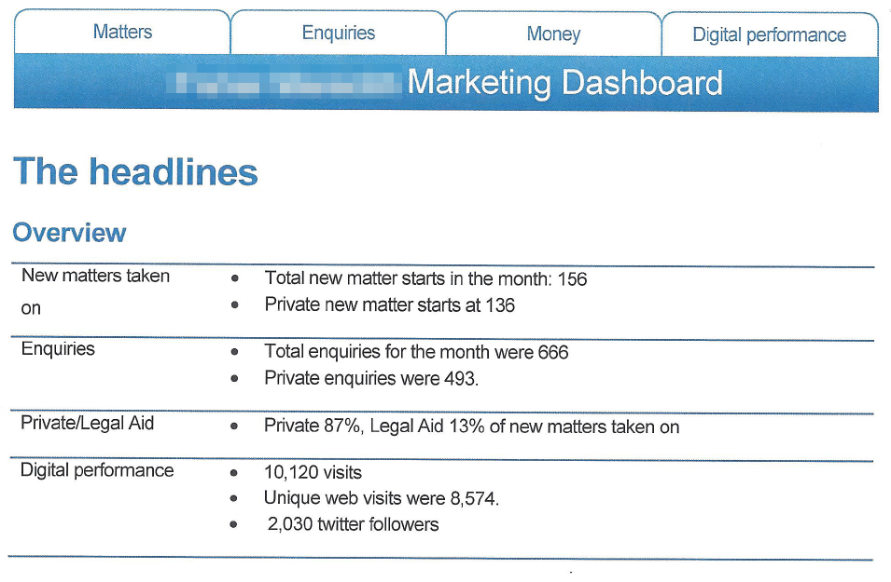
Marketing Dashboard

Slide 40
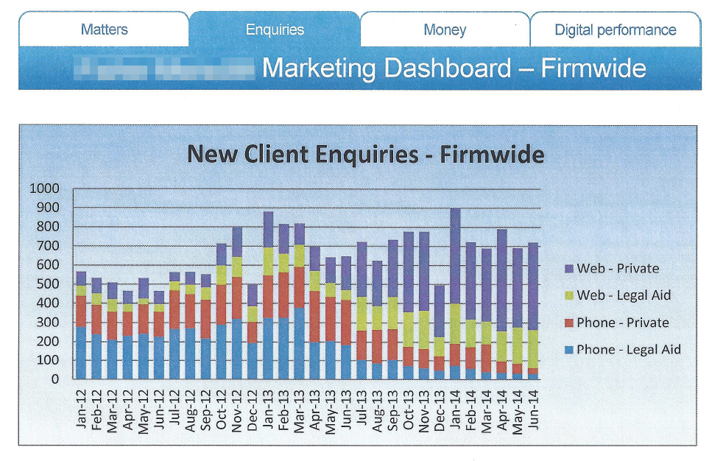
Marketing Dashboard

Slide 41


