Slide 1
Marketing + Efficiency + Money = Profit

Slide 2
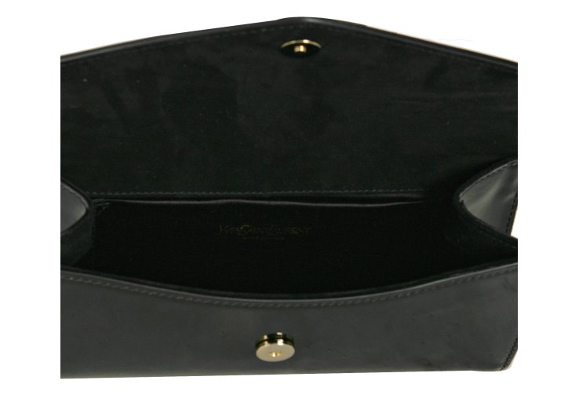
MONEY
Marketing

Slide 3
The two sides of marketing
Invisible
Visible

Slide 4
LMS Benchmarking

Slide 5
Visible – 2 – 5 partners
Notes:
Both turning over £1m.
LEFT
Bulk is membership of QS (shh)
Entered QS in middle of recession
RIGHT
Only spend £4k
PEP is about the same as the one on the left

Slide 6
Visible – 2 – 5 partners cont.
Notes:
Both in similar geographies
Turnover c. £1m
LEFT
4 locations
RIGHT
1 location

Slide 7
Visible – 5 – 10 partners
Notes:
LEFT
£6m turnover
Very niche practice
45% GP
All about reputation
RIGHT
Mostly conveyancing
They do not include referral fees in their marketing cost
It’s “net’ off as revenue
Where are

Slide 8
Visible – 10+ partners
Notes:
LEFT
£6.5m turnover
Investment marketing budget are
Buying in conveyancing
Buying in PI work (marketing agreements)
RIGHT
£12.5m turnover
Regional firm
Spending on brand awareness

Slide 9
Typical marketing expenditure

Slide 10
The invisible cost

Slide 11
Measuring the invisible cost
X
Time spent on activity
X
Charge out rate
Recovery rate
Opportunity cost

Slide 12
Managing invisible costs
Department performance
Partner – productivity – 60%
Director / Senior Associate
Productivity – 75%
Associates
Productivity 95%
Trainees
Productivity 90%

Slide 13
Assessing return on investment
Capturing data correctly
Recording time
New work figures

Slide 14
Continuous marketing

Slide 15
Understanding the true link between Marketing and efficiency to create more profit
Process work
Passive investment by fee earner although client service key
Visible cost of marketing
Brand awareness
Passive investment by fee earner
Visible and some invisible cost of marketing
Added value work
Active involvement of fee earner
Significant invisible and some visible cost of marketing

