Slide 1
M+E+M=P Efficiency
Sarah Oliver
Product Manager, Advanced Legal
June 2015

Slide 2
Time
Resource
Project Management
Scope
Notes:
So you’re all able to lie back and relax in the sun – you’ve got plenty of time to implement all the marketing hints David’s just talked about?
In all work situations we are faced with the traditional project management triangle of time, resource and scope. Has anyone heard of this?
This shows the constraints of project management where each force is in opposition to each other. It is used to manage projects when deadlines slip and resources are lost. Traditionally a project manager would manage both resources and dates to complete a project, more recently they would also consider scope to ensure that the most valuable items are delivered. Projects can be constrained in one particular area – for example adhering to the latest change in compliance or claiming new legal aid rates gives a fixed date, an unwillingness for an organisation to hire new staff gives you fixed resource, certain elements of work are mandatory which gives a fixed scope…
The question you’re all asking is how do I claw back time to do all the things I need to do?
How can I increase the number of new clients I take on while still dealing with my current workload?
Where do I find the time to follow up on quotes I’ve sent out to customers?
How do I set aside time to create a marketing plan, never mind act on it?
Does my firm collect the right data for me to market effectively to contacts and clients?
I’m already overburdened in many areas of work…

Slide 3
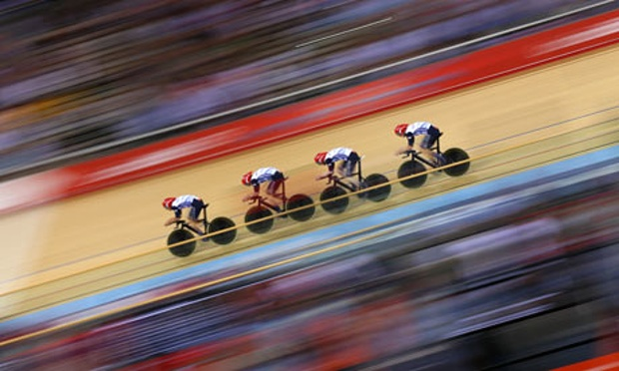
EFFICIENCY
Notes:
Have you got:
Overworked staff?
Demanding clients?
Greater competition?
Increasing compliance burden? (Bound by the shackles of compliance?)
The answer is to look for efficiencies – make more money and have time to spend marketing to make even more money.
If you refine your processes so that more letters can be automatically produced, your staff will save time from all the small repetitive tasks.
If you have a good process for following up on quotes and keeping your clients informed, they should become less demanding and on the phone less asking for updates.
If you set data collection mandatory during your on-boarding process, compliance is less of a headache.
If you keep clients happy with regular updates, then the competition will be less intense.
If you remove these key issues then you’ll have more time to grow your business, market to contacts, do business development activities, build better relationships. Happy clients will lead to more repeat business, so less need for big marketing efforts in new markets and less competition. So how can I become more efficient and claw back time?
One way is through the concept of marginal gains...cue Brailsford video
Believed in strategy of marginal gains – could win the Tour de France in 5 years time. They won it in 3 years when Wiggins won in 2012, then GB won 70% of the medals at the Olympics, then Froome won the Tour de France the following year.

Slide 4
Marginal Gains
Notes:
YOUTUBE CLIP (One of below):
Longer youtube link: https://www.youtube.com/watch?v=THNBIQenywc (06:30 to end)
BBC interview link: https://www.youtube.com/watch?v=gBY3q8TqoXY (All)
Brailsford believed in a concept that he referred to as the “aggregation of marginal gains.” He explained it as “the 1 percent margin for improvement in everything you do.” His belief was that if you improved every area related to cycling by just 1 percent, then those small gains would add up to remarkable improvement.
They started by optimizing the things you might expect: the nutrition of riders, their weekly training program, the ergonomics of the bike seat, and the weight of the tyres.
But Brailsford and his team didn’t stop there. They searched for 1 percent improvements in tiny areas that were overlooked by almost everyone else: discovering the pillow that offered the best sleep and taking it with them to hotels, testing for the most effective type of massage gel, and teaching riders the best way to wash their hands to avoid infection. They searched for 1 percent improvements everywhere.
This thinking harks back to the 1920s and the Gilbreths…

Slide 5
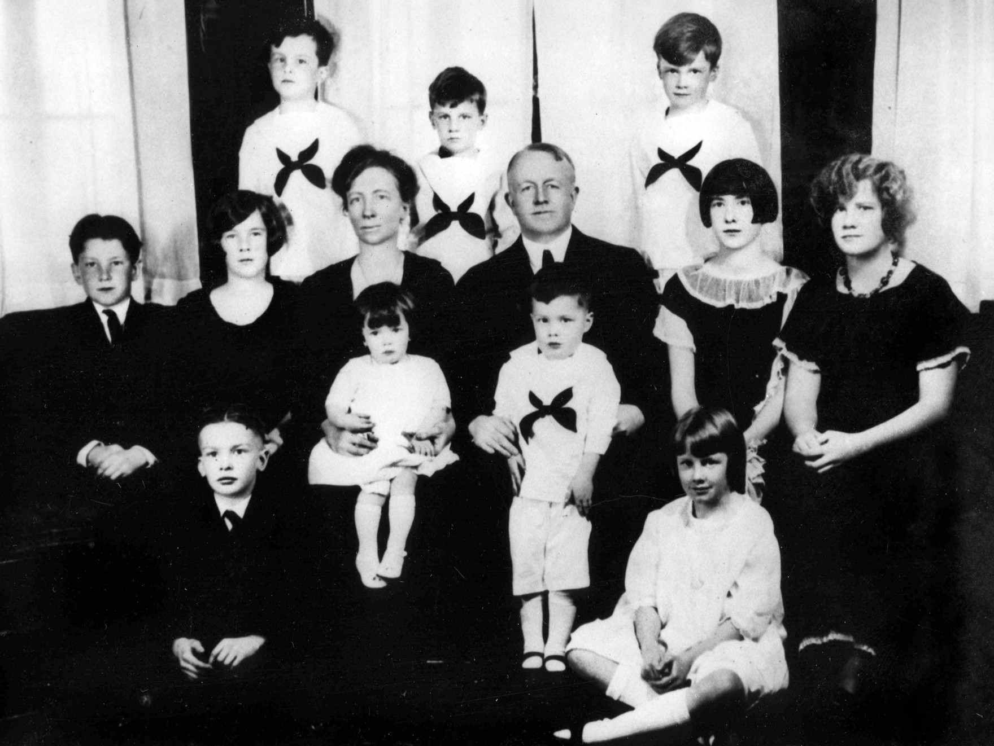
Notes:
One of the early pioneers of efficiency studies (motion studies) were the Gilbreths (photo taken in the early 20s). Frank and Lillian Gilbreth were pioneers of motion studies – the precursor to continuous process improvement. They focussed on improving the efficiencies in each motion/ activity, so tasks became more repeatable and therefore cheaper. They looked at body language and movement and timed or photographed each movement to see where the same tasks were happening over and over.
Starting in the war, Frank worked on disassembling small arms and after study, found there were 17 hand movements to learn to be the most efficient. Afterwards with his wife, Lillian, they educated engineering management to constantly question processes and adopt improvements. In more recent times, we understand the process of this to be continuous quality improvement or agile and the tool to achieve this to be workflow.
DVD Clip:
Clip from Cheaper by the dozen (1948) – how to take a bath in the principle’s office – around 19 mins in. Very short.
A more up-to-date example is

Slide 6
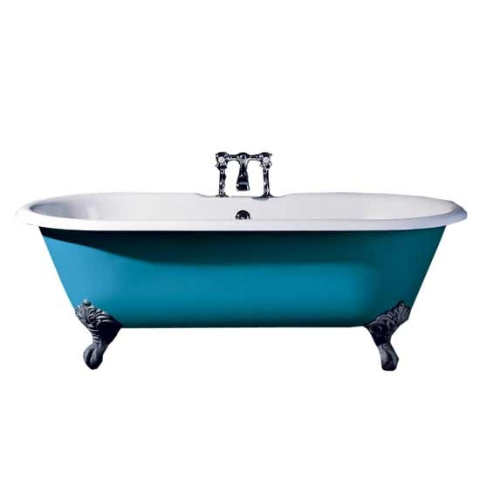
What processes could you change to become as efficient as Frank’s method of bathing in the time it takes to “play a record”?
Notes:
Workflow shouldn’t be scary. If seen as continuous process improvement, each step along the way will produce efficiencies.
It’s all about looking at your processes in a forensic manner, working out which tasks are repeatable and then automating them as much as possible.
Let’s look at your client on-boarding process.

Slide 7
Workflow
STEP FIVE
Review and repeat
STEP FOUR
Use of technology
STEP THREE
Focus in on problem areas
STEP TWO
Train staff in the process
STEP ONE
Map your process flow
Notes:
Map your process flow – INTERACTIVE SESSION - use post its – get participants to write down all the steps in a quoting process. Prospect calls for quote – Do details get recorded? – Send quote – Chase quote – Offer another service? Allow 10 minutes or so for this.
Train staff in process – Firstly look at the human side of the process – do all your staff know what to do and when? Do they have checklists? Does information get captured electronically? Do you end up with gaps in the information you hold about prospects and clients? Is there a focus on the client – do they get a quick response?
Focus in on problem areas – which activities in your quoting process are resource-intensive? Do you use document templates? Are these current? Do your support staff regularly make changes when typing up letters? I observed a secretary in a firm a few weeks ago, deleting then retying the firm name to format it in capitals and underline it. It only takes a few seconds but if this is a few seconds multiplied by however many letters a secretary produced in a day, taken over a month or a year – this adds up. Are there areas which are forgotten? Do you always follow-up on quotes? Do you set reminders to follow-up with prospects? Do you find out reasons why prospects don’t go with you?
Technology – So you’ve trained your staff and checked your processes – can you now streamline that process and make better use of technology? Collect information and input contact information at prospect stage – re-use that data in all communication with the client. Mandate the information to be collected at the prospect stage i.e. interests to know what events you run they may be interested in, email address for ease of communication, source of business so you can monitor your marketing. Set automatic reminders for tasks to follow up on quotes, obtain proof of ID etc. Integrate AML checks into your PCMS to ensure you have easy access to the checks. Escalate concerns, high risk matters, tasks requiring sign off to supervisors. Review and approve typed documents in the system to save time and costs of printing. Collaborate with clients, referrers, barristers via an online portal to easily mark up changes and remove the headache of emailing documents around.
Review – go back to step one and review. Make regular changes to your workflow to keep it up-to-date and continue to improve your processes.
So what technical tools can you use to achieve this?

Slide 8
Standalone or integrated?
Built for you or built by you?
Write code or user-friendly drag and drop?
Prescriptive or Flexible?
Case management or business processes?
Notes:
There are many different workflow technologies that you can use to improve your efficiencies. It depends on your firm – how much control you want and what skills you have.
Available options:
Integrated or standalone (single point) – Good example of where an integrated tool helps is to integrate your complaints management process into your case management or go directly from your client inception into case management. Including your wills information in your PCMS, means that you can query it and easily use it for marketing purposes.
Built for you or built by you – Time pressures may mean that it’s easiest to outsource your workflow creation to a software provider or a consultant but if you do it yourself then you will be able to tweak it quickly and easily implement changes to constantly improve your process. We have a firm doing just this with a conveyancing workflow – they make changes on a weekly basis directly related to feedback from users.
Code or user-friendly drag and drop – developer-centric coding or technical languages to build workflow? Tools can be very different.
Prescriptive or flexible – Do you want to lock down processes – when bringing in temporary staff – a firm we work with wants a very prescribed process to bring in students to cover the holiday period with little training. Some firms take a more flexible attitude especially in more specialised areas where experienced fee earners are doing the majority of the work.
Case management or business processes – where are your greatest inefficiencies? Workflow is often seen as a tool for conveyancing, for PI…what about your complaints process, credit control, or marketing?

Slide 9
“I’ve seen things you wouldn’t believe…”
Notes:
Batty: I've seen things you people wouldn't believe. Attack ships on fire off the shoulder of Orion. I watched C-beams glitter in the dark near the Tannhauser gate. All those moments will be lost in time... like tears in rain... Time to die.
A popular quote from Bladerunner – set in 2019 – where will workflow technologies be in another 5 years time? 100 years on from the Gilbreths. It seems fitting that as we consider how law firm technology will look in another 5 years, that the Olympics in 2020 will be held in Tokyo – where the modern day understanding of lean and continuous process improvement has developed and a country always seen to be at the forefront of new technologies.
The legal world will be more mobile – less office based (we are already seeing virtualised legal practices)– greater expectation of access from both solicitors, clients and referrers – run workflows on the move
Paperless – obsolete physical copies of files and forms
Greater digitalisation – social media (see how airlines have started communicating with consumers) – emails – less post – government portals (digital by default strategy)
More collaboration on cloud-based sharing platforms – google drive – collaboration portals – will you be able to open your processes up to online platforms?

